Slide 1
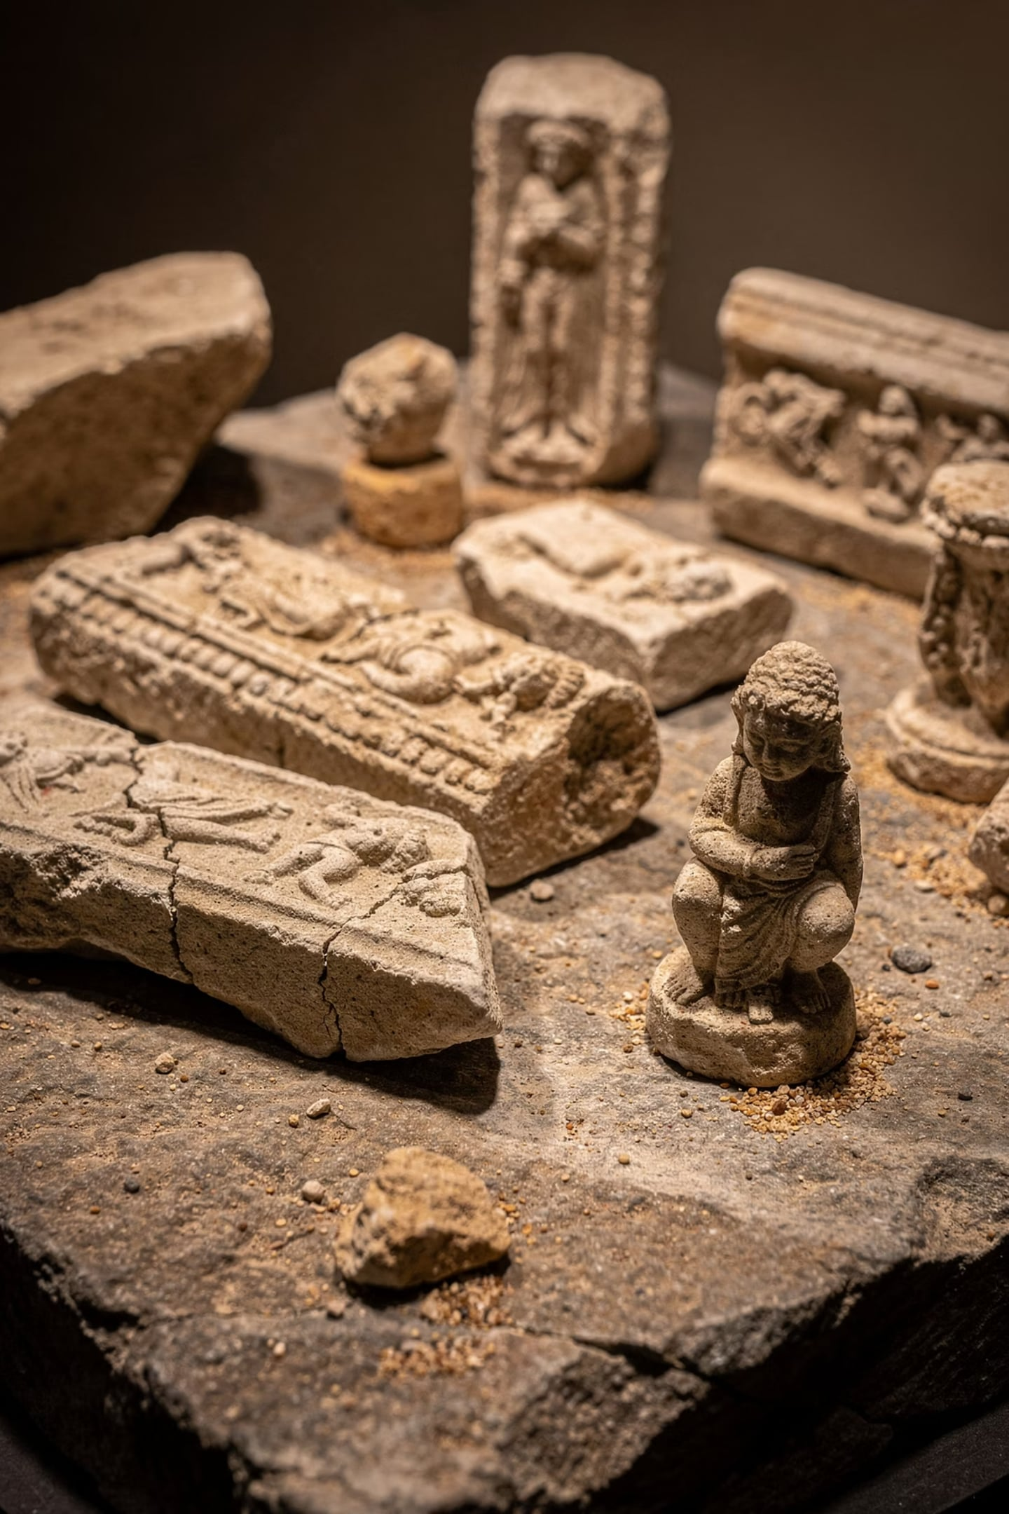
Nano-Filler Reinforced Polymeric Adhesives for Archaeological Stone Restoration
Development of epoxy and PVAc adhesives reinforced with nano-SiO₂ and nano-ZnO, combined with Paraloid B-72 as a reversible isolation coating, for restoring fractured limestone and marble antiquities.
SCIENTIFIC RESEARCH COMMISSION, BAGHDAD, IRAQ

Slide 2
Research Team
Israa Abdulsatar Ismael
Faris Muayed Ahmed
Scientific Research Commission, Baghdad, Iraq
Scientific Research Commission, Baghdad, Iraq
Omer A. Alwash*
Luma J. Hamoody & Nadia Fakhry Ibraheem
Corresponding Author — omar.a.abdulameer@src.edu.iq
Scientific Research Commission, Baghdad, Iraq

Slide 3
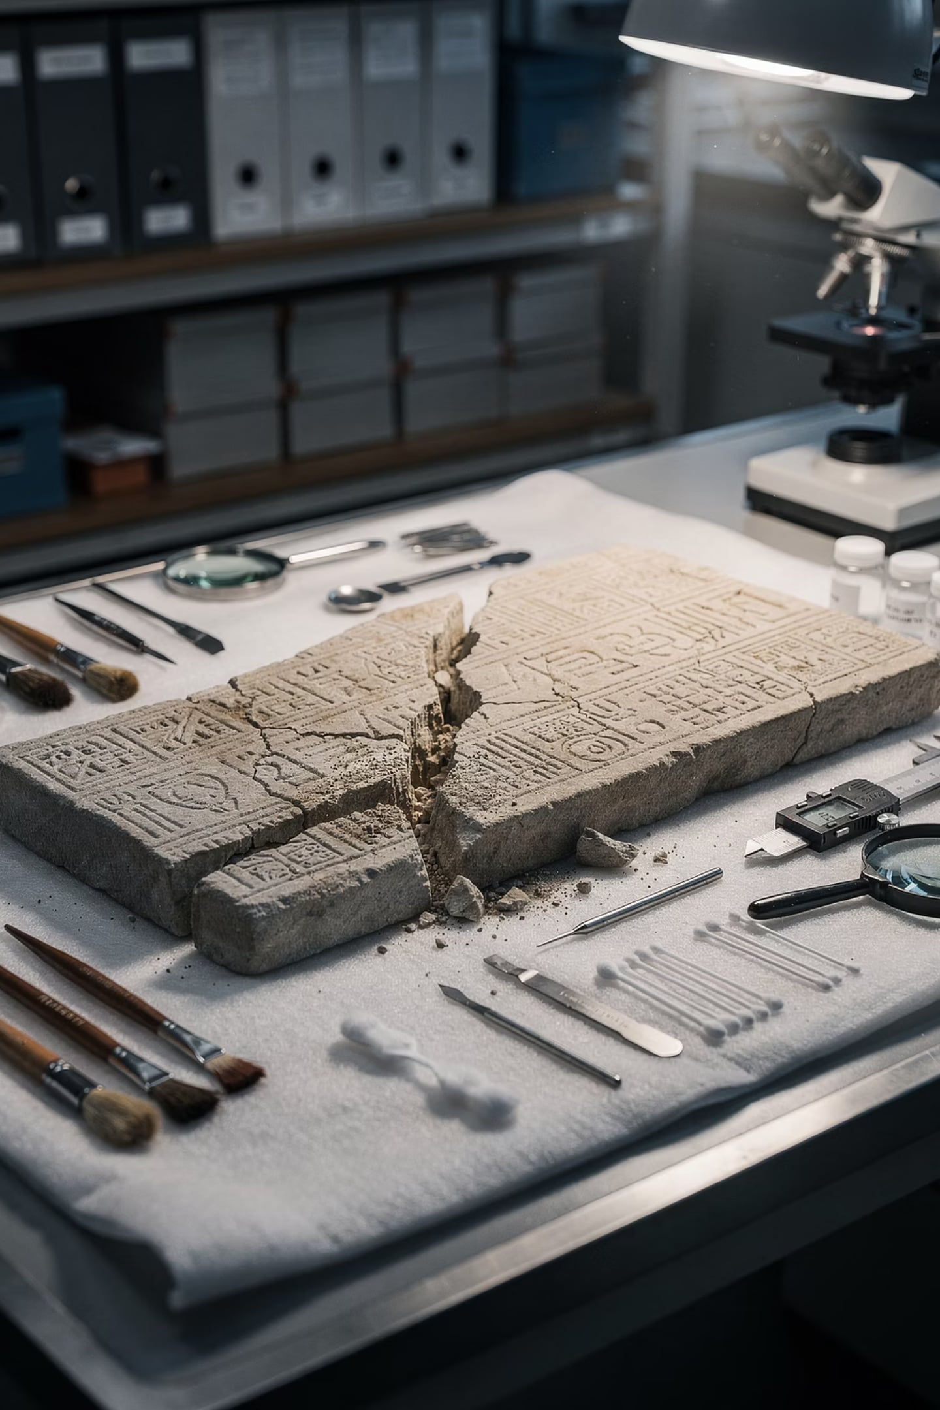
Why This Research Matters
Iraq holds one of the world's richest archaeological heritages. Stone artifacts suffer from environmental deterioration, transport damage, and armed conflict. Reliable polymeric adhesives are essential to ensure structural stability while preserving historical authenticity.
Challenge
Epoxy is strong but irreversible; PVAc is reversible but weaker. No study had combined SiO₂ + ZnO nanoparticles in both systems under identical conditions.
Gap
Paraloid B-72 as a reversible isolation layer before adhesive bonding had not been comprehensively evaluated alongside nano-reinforced adhesives.

Slide 4
Study Objectives
01
02
Develop Nano-Adhesive Systems
Apply Reversible Barrier
Formulate epoxy and PVAc reinforced with SiO₂ and ZnO nanoparticles at 2 wt% and 5 wt%.
Use Paraloid B-72 as an isolation coating to protect original stone surfaces and enable future removal.
03
04
Mechanical Evaluation
Characterize with FTIR & XRF
Assess bond strength, shear, tensile, compressive strength, and slip resistance on limestone and marble.
Identify chemical interactions and elemental composition of stones and adhesive systems.

Slide 5

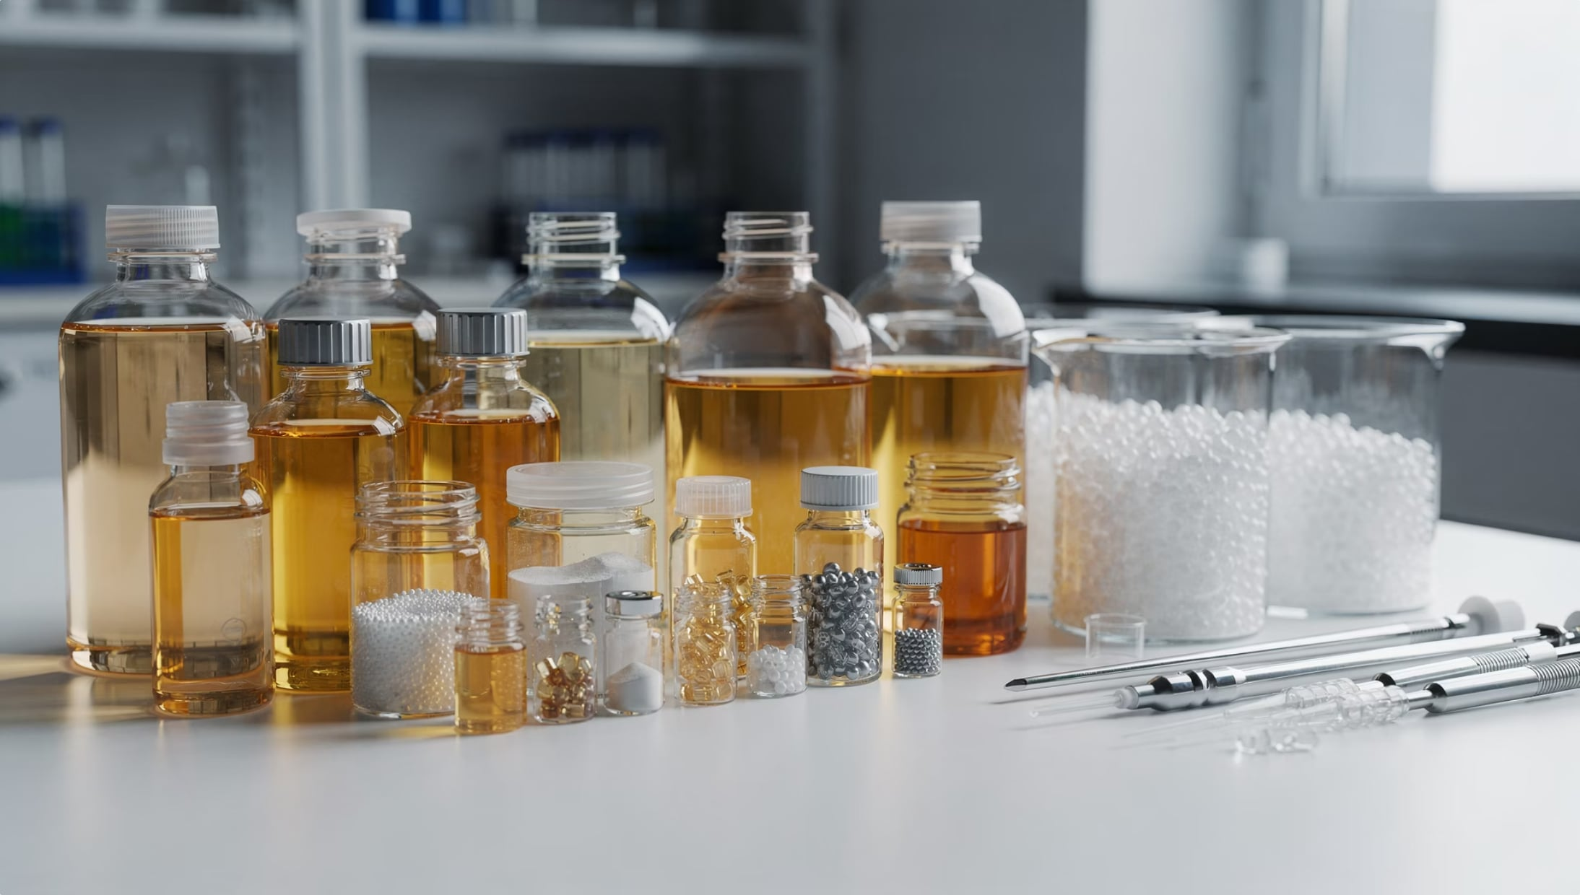

Materials Used
Epoxy Resin (Conbextra EP10)
DGEBA type, mix ratio 3:1 with ethylene diamine hardener. Viscosity 150–200 cps at 25°C.
PVAc (Abnilshimi Co., Iran)
Viscosity 29,000–30,000 cp, density 1.3–1.35 g/cm³, solid content 59%, pH 9.
Paraloid B-72
EMA/MA copolymer (70%/30%), density 1.15 g/cm³. Dissolved in acetone at 50% for stone priming.
Nano-Fillers: SiO₂ & ZnO
Both ~50 nm grain size, added at 2 wt% and 5 wt%. Purity 99.7%.

Slide 6
Sample Formulations
Seven adhesive systems were prepared and tested on limestone samples from Sulaymaniyah Governorate, northern Iraq.
No.
Sample
Composition
1
Epoxy + hardener
Pure epoxy, 3:1 ratio
2
Epoxy + 2% nano (SiO₂ & ZnO)
Nanoparticles dispersed at 500 rpm for 2 h
3
Epoxy + 5% nano (SiO₂ & ZnO)
Highest nano-loading in epoxy
4
PVAc (pure)
Commercial emulsion adhesive
5
PVAc + 2% nano (SiO₂ & ZnO)
Nano-reinforced PVAc
6
PVAc + 5% nano (SiO₂ & ZnO)
Highest nano-loading in PVAc
7
Paraloid B-72 (50% in acetone)
Reversible isolation primer layer

Slide 7
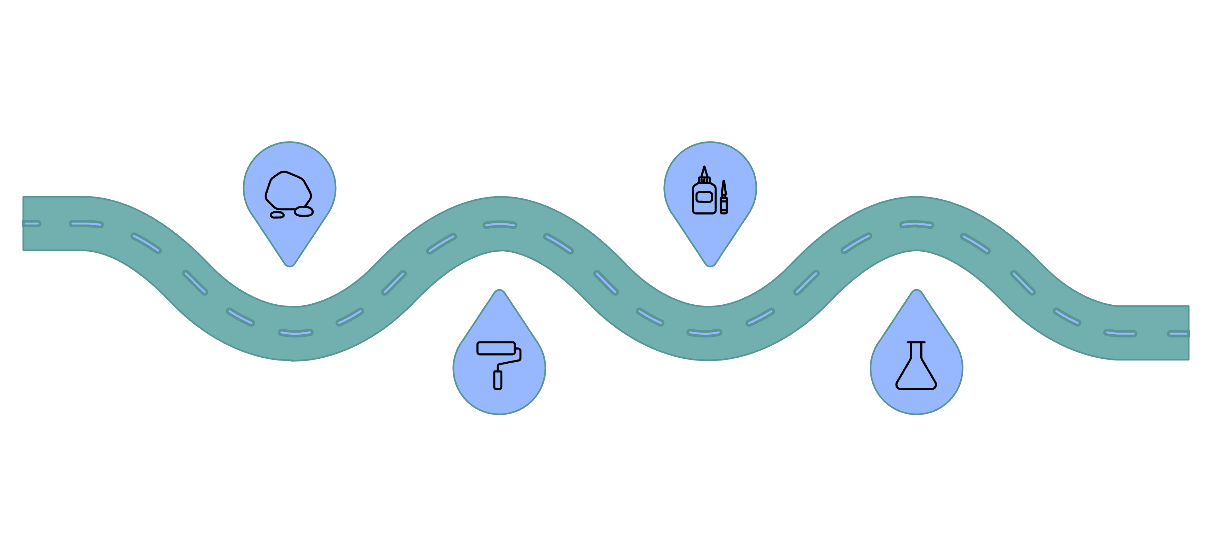
Experimental Methodology
Stone prep
Nano-adhesive
Clean, wash, oven-dry at 100°C
Spread 2–3 mm on 75×75 mm joint
Paraloid primer
Cure & test
Epoxy 7 days, PVAc 3 days, test
2–3 mm layer, dry 3–5 min
Limestone blocks were cut to standard dimensions for each test type: 75×75 mm² for bond/shear, 10×2×2 cm for tensile/elongation, and 12×12 cm for slip resistance. Weathering tests included salt crystallization (Na₂SO₄) and 20-cycle water immersion.

Slide 8
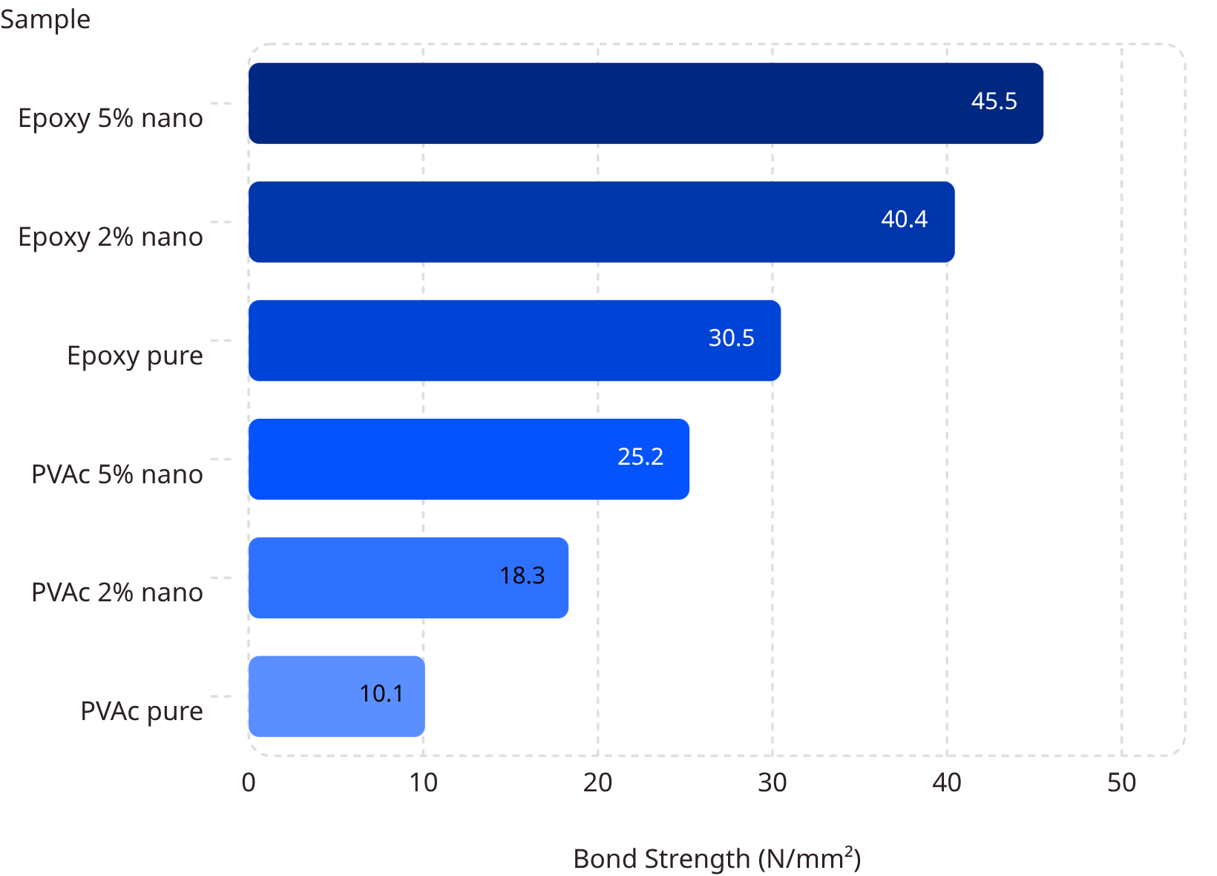
Bond Strength Results
Key Findings
Adding 5% (SiO₂ + ZnO) to epoxy raised bond strength from 30.481 → 45.519 N/mm². The synergistic nano-network distributes compressive loads over a larger area.
SiO₂ provides structural rigidity; ZnO adds chemical adhesion and environmental protection. PVAc values (10–25 N/mm²) are suitable for small stone fragments.

Slide 9
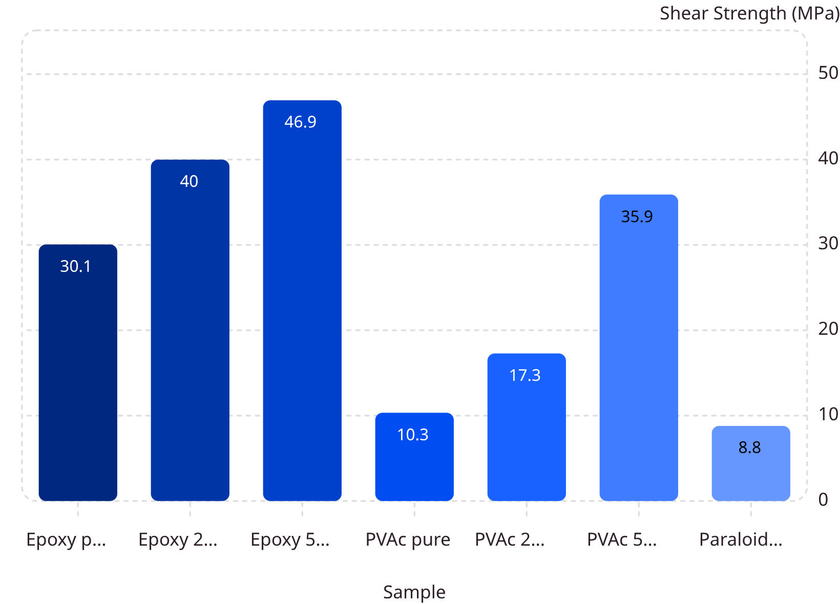
Shear Strength Results
Interpretation
Epoxy + 5% nano achieved the highest shear strength: 46.94 MPa. The nano-network inhibits polymer chain slippage, enhances chemical adhesion at the epoxy–stone interface, and fills voids.
PVAc + 5% nano reached 35.90 MPa — a dramatic improvement over pure PVAc (10.34 MPa), though interaction remains primarily physical.

Slide 10
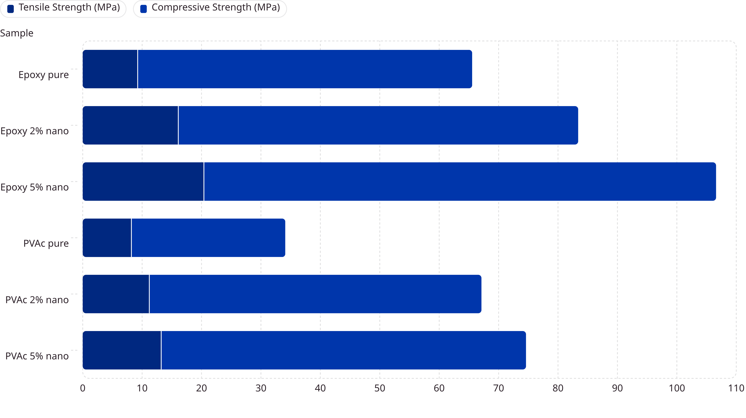
Tensile & Compressive Strength
Epoxy + 5% nano achieved tensile strength of 20.4 MPa and compressive strength of 86.20 MPa. ZnO increases rigidity; SiO₂ increases flexibility. Combined, they form a nano-network that blocks crack propagation. PVAc showed moderate improvement, suitable for small, low-load fragments.

Slide 11
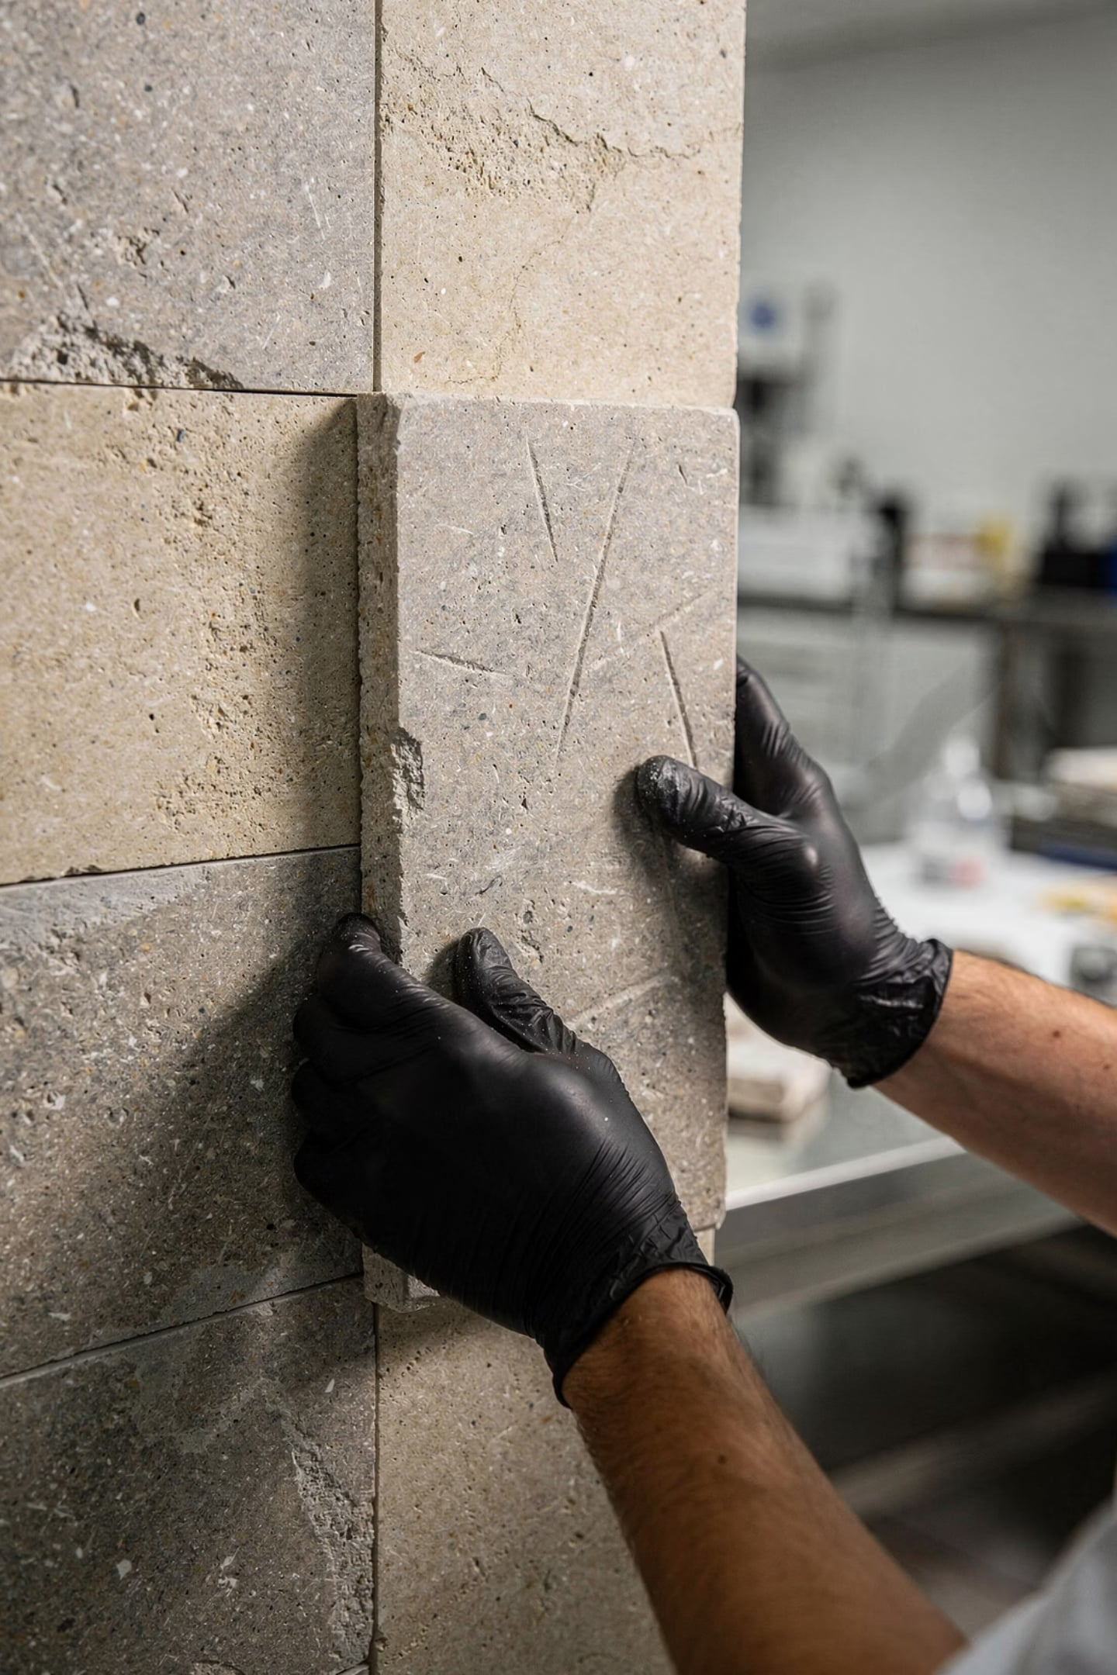
Slip Resistance & Physical Properties
PVAc Nano-Adhesives
Epoxy Adhesives
Lower slip resistance — fixing time up to 15 minutes. Higher viscosity needed for vertical applications.
Best slip resistance: stone fixed in 2–3 minutes without support. Suitable for vertical wall installation.
Paraloid B-72
Fixed in approximately 5 minutes. Functions as primer/barrier, not structural adhesive.

Slide 12

Curing Time Comparison
Water Immersion Resistance
Adhesive
Initial Cure
Final Cure
Viscosity (P)
All adhesives withstood 20 cycles of immersion (6 h in distilled water) and drying (4 h at 70°C) without dissolution or failure. This enables museum-standard washing of stone pieces when salt efflorescence appears.
Epoxy (all)
2–3 h
7 days
1.22–4.50
PVAc (all)
5–6 h
4 days
4.9–5.2
All formulations passed water immersion and salt crystallization weathering tests.
Paraloid B-72
1–2 h
24 h
4.0

Slide 13
XRF Analysis of Stone Substrates
Elemental Composition
Significance
XRF confirmed that the experimental limestone and marble are chemically similar to Iraqi museum artifacts. The dominant calcium content, combined with silica and iron oxides, forms strong chemical bonds with epoxy, PVAc, and nano-additives (SiO₂ and ZnO), validating the adhesive systems for authentic artifact restoration.
Stone
Ca%
Si%
Fe%
Na%
Mg%
Limestone
37.68
0.1045
0.1309
0.21
0.031
Marble
34.06
0.0653
0.0279
0.22
0.034

Slide 14
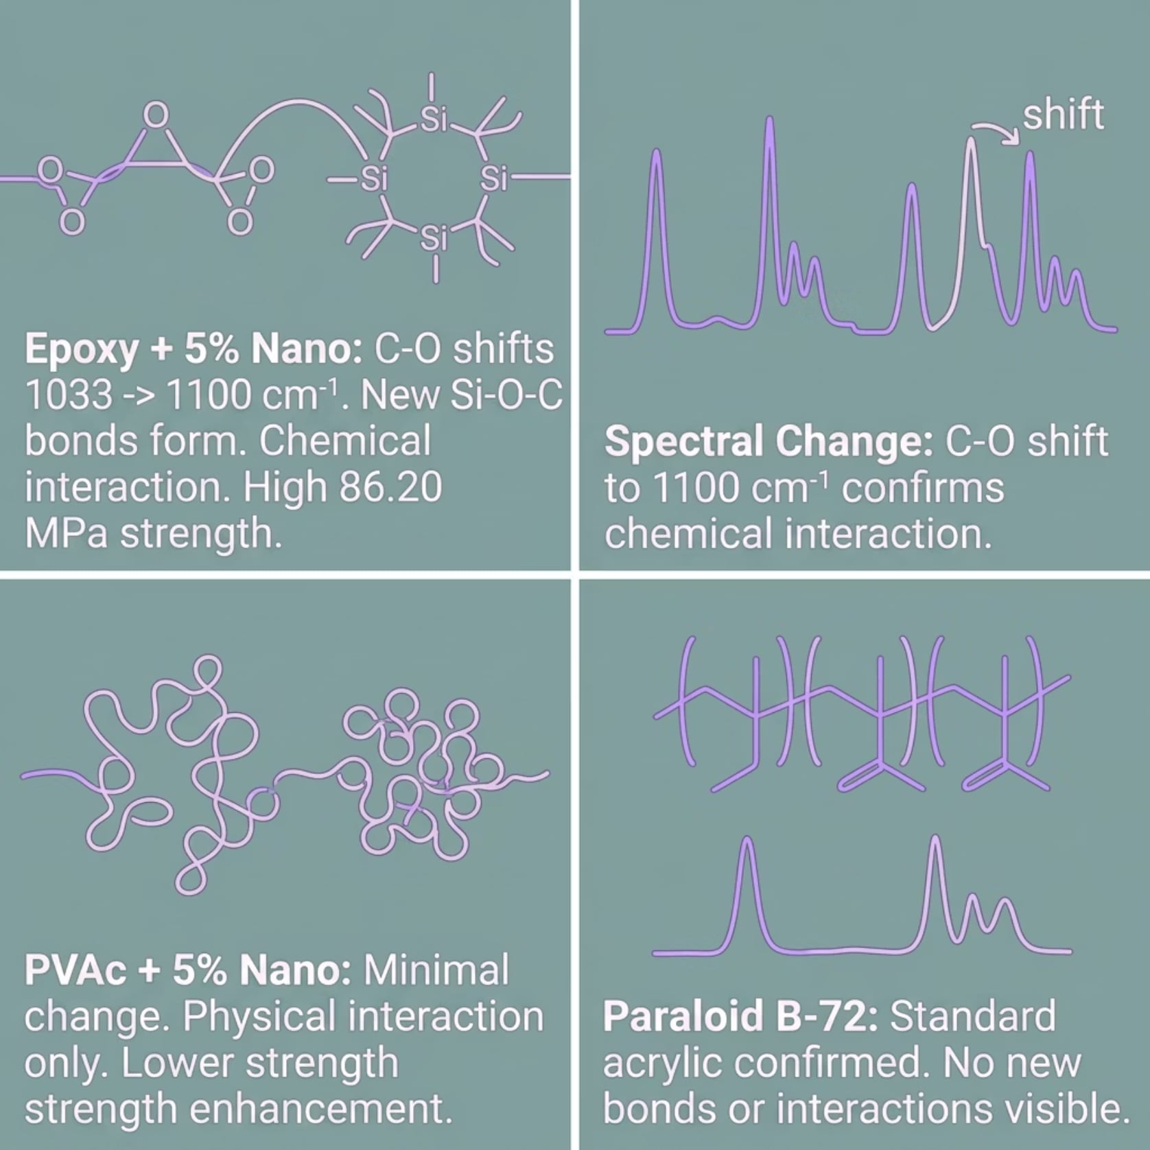
FTIR Spectral Analysis
Key Findings
Adding 5% (SiO₂ + ZnO) to epoxy caused a significant shift in C-O stretching bands from 1033 → 1100 cm⁻¹, indicating new Si-O-C chemical bonds between SiO₂ and the epoxy matrix — explaining the dramatic mechanical improvement.
PVAc showed only minor spectral changes, confirming nanoparticle interactions are physical rather than chemical. Paraloid B-72 confirmed its typical acrylic structure with no new interactions.

Slide 15
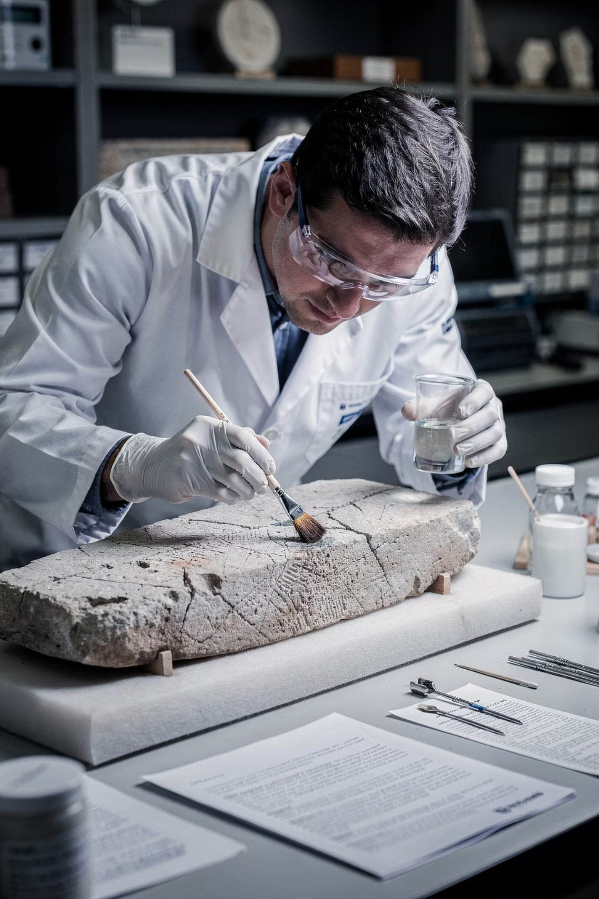
Paraloid B-72: The Reversible Barrier
How It Works
Reversibility
Applied at 50% in acetone, spread 2–3 mm, dried 3–5 min. Creates a barrier preventing direct adhesive contact with the artifact surface.
Removable with acetone or methyl ethyl ketone. Enables future detachment of adhesives without physical or chemical damage to the stone.
Additional Benefits
Increases water resistance of artifact surfaces. Does not cause discoloration. Widely accepted in cultural heritage conservation.

Slide 16
Mechanical Performance Summary
46.94
86.20
MPa Shear
MPa Compression
Epoxy + 5% nano (SiO₂ & ZnO) — highest shear strength achieved
Epoxy + 5% nano — peak compressive strength
45.52
35.90
N/mm² Bond
MPa PVAc Shear
Epoxy + 5% nano — highest bond strength recorded
PVAc + 5% nano — best PVAc shear performance

Slide 17
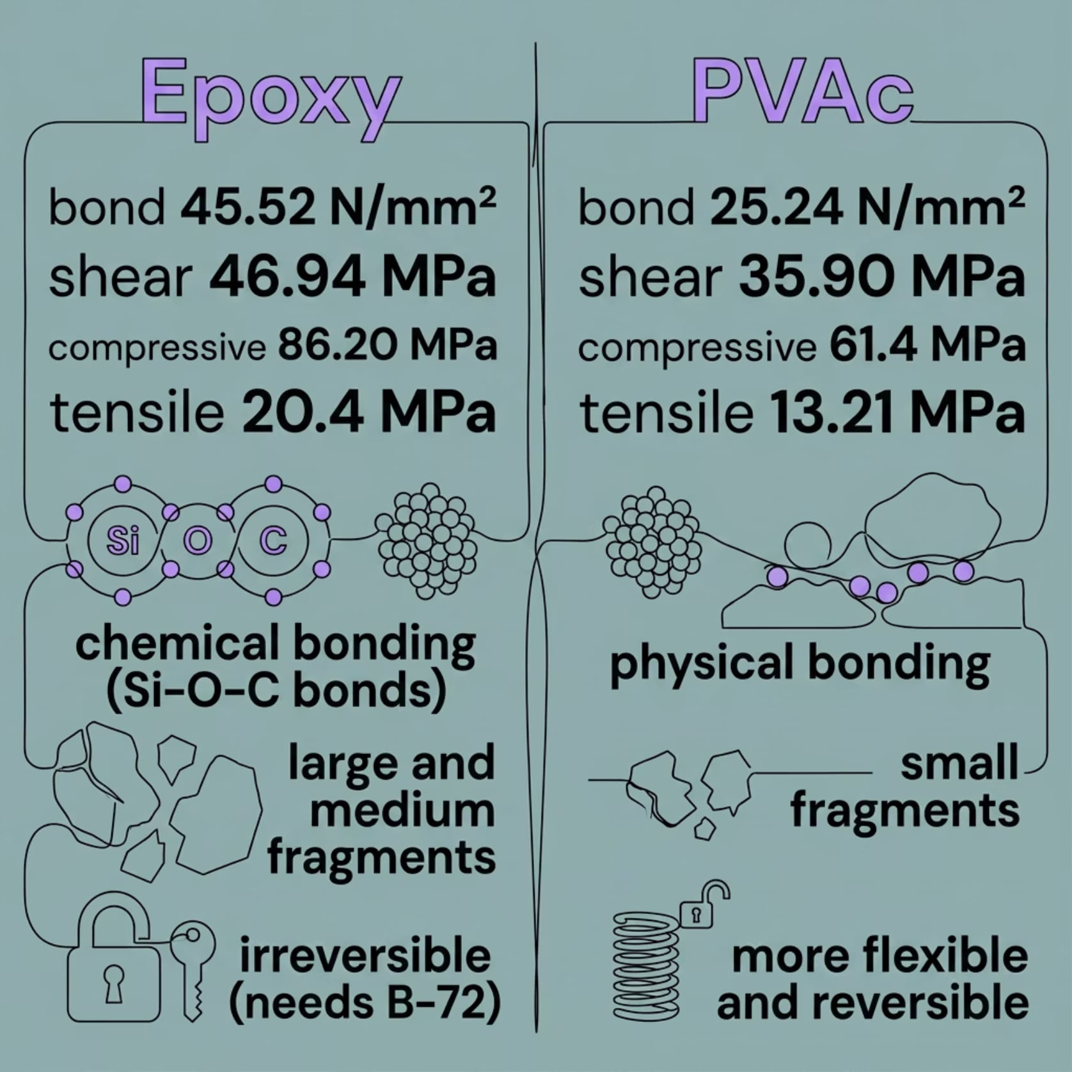

Epoxy vs. PVAc: A Comparison
Which to Choose?
Epoxy + 5% nano is recommended for large and medium stone fragments requiring high structural strength. Nano-interaction is chemical (Si-O-C bonds), yielding superior mechanical performance.
PVAc + 5% nano is preferred for small, low-load fragments. Nano-interaction is physical, offering moderate improvement with greater flexibility and easier handling.
Both systems require Paraloid B-72 as a reversible primer before application.

Slide 18
Conclusions
Nano-reinforcement significantly improves all mechanical properties
PVAc improves with nanoparticles but remains secondary to epoxy
5% (SiO₂ + ZnO) in epoxy forms a nano-network that inhibits crack propagation, distributes stresses, and fills voids — yielding the highest performance across all tests.
Nanoparticle interaction with PVAc is physical, not chemical, limiting mechanical enhancement. Still suitable for small stone fragments.
Paraloid B-72 is essential for reversible, ethical conservation
All adhesives passed water immersion and weathering tests
Acts as a solvent-removable barrier, protecting original substrates and enabling future adhesive removal without damage.
Confirming suitability for museum environments where periodic washing of salt-affected artifacts is required.

Slide 19
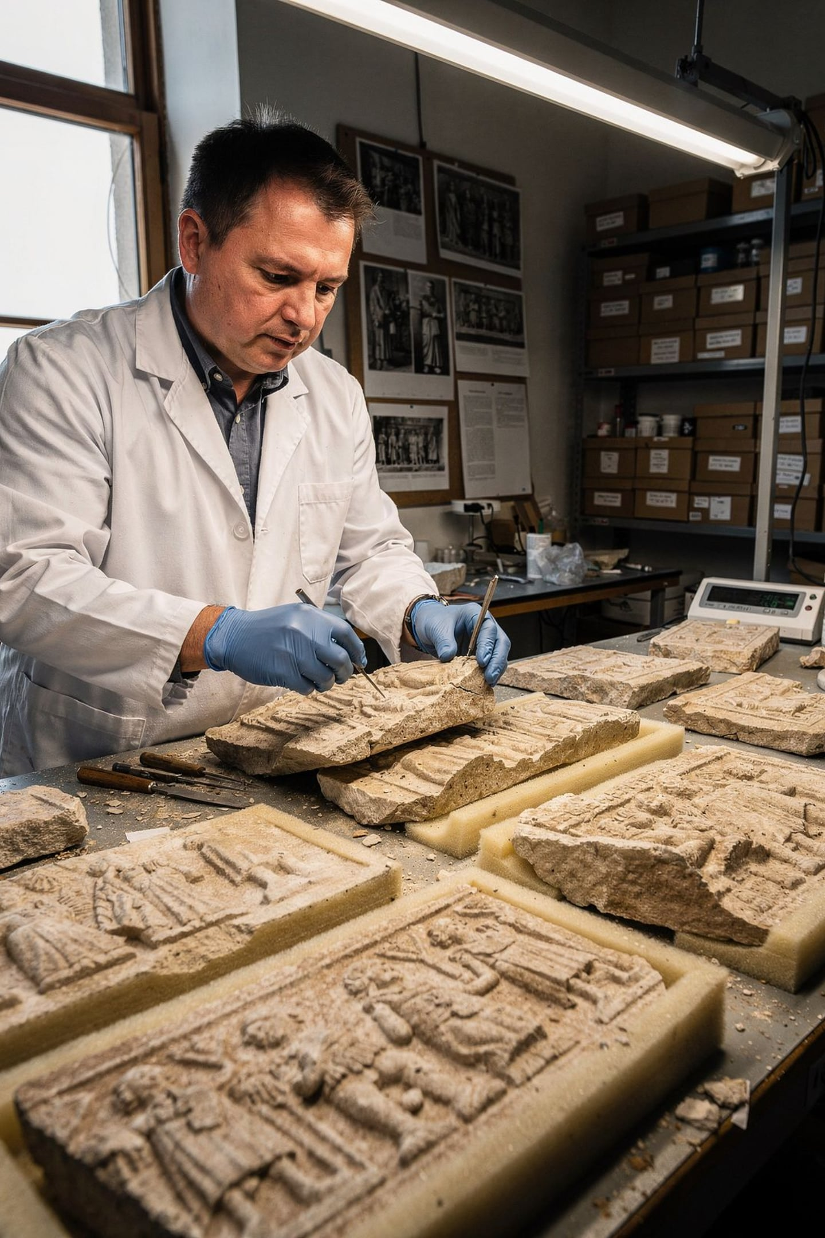




Recommendations
Large & Medium Fragments
Use Epoxy + 5% (SiO₂ & ZnO) for high bonding and structural strength.
Small Fragments
Use PVAc + 5% (SiO₂ & ZnO) for low-load, flexible bonding.
Surface Protection
Always apply Paraloid B-72 as a reversible primer — never as a structural adhesive.
Future Research
Investigate higher loadings (7–10%) to determine maximum improvement limits and cost-effectiveness.

Slide 20
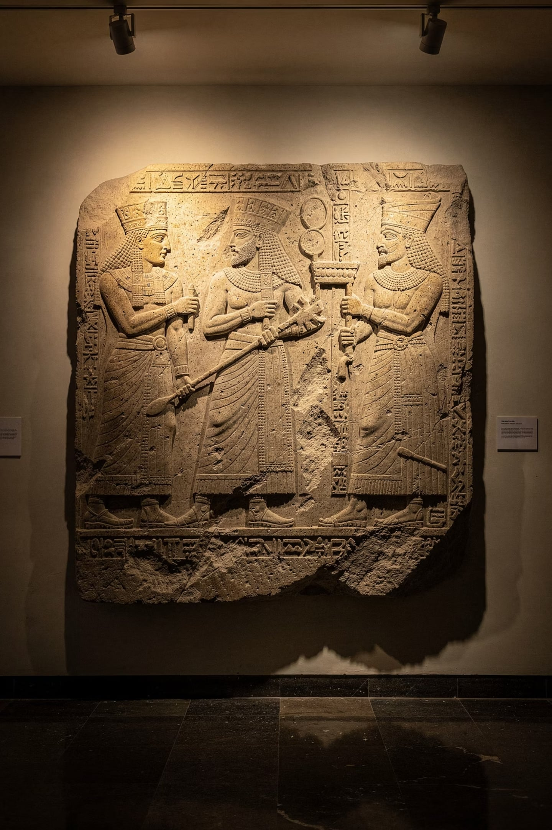
Preserving Iraq's Heritage
Nano-filler reinforced polymeric adhesives offer a high-performance, reversible, and scientifically validated solution for the restoration of limestone and marble archaeological artifacts — bridging materials science and cultural heritage conservation.
KEYWORDS: ARCHAEOLOGICAL RESTORATION · POLYMERIC ADHESIVES · NANOPARTICLES · ACRYLIC COPOLYMER · PARALOID B-72

