Slide 1

Microwave-Assisted Synthesis of Carbon Quantum Dots (CQDs) from Biomass-derived Oil Palm Trunks Biochar for Lead Ion (Pb²⁺) Detection
Presented by:
Nurul Assikin Binti Ariffin
Doctor of Philosophy in Applied Physics
Supervisor:
Associate Prof. Dr. Nurul Huda Osman

Slide 2
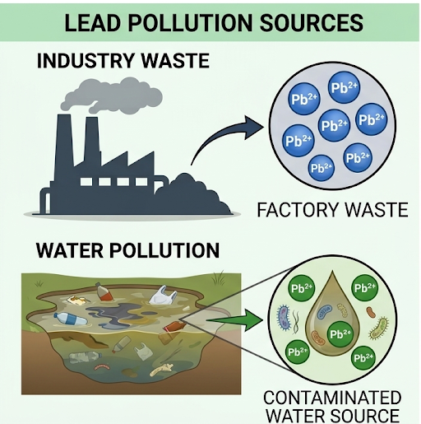
Lead (Pb²⁺) is highly toxic heavy metal often found in industrial wastewater, posing severe health risks even at low concentrations.
Conventional methods are costly, time-consuming, and require bulky laboratory equipment.
Therefore, a fast, simple, and affordable Pb²⁺ detection method is needed.

Slide 3

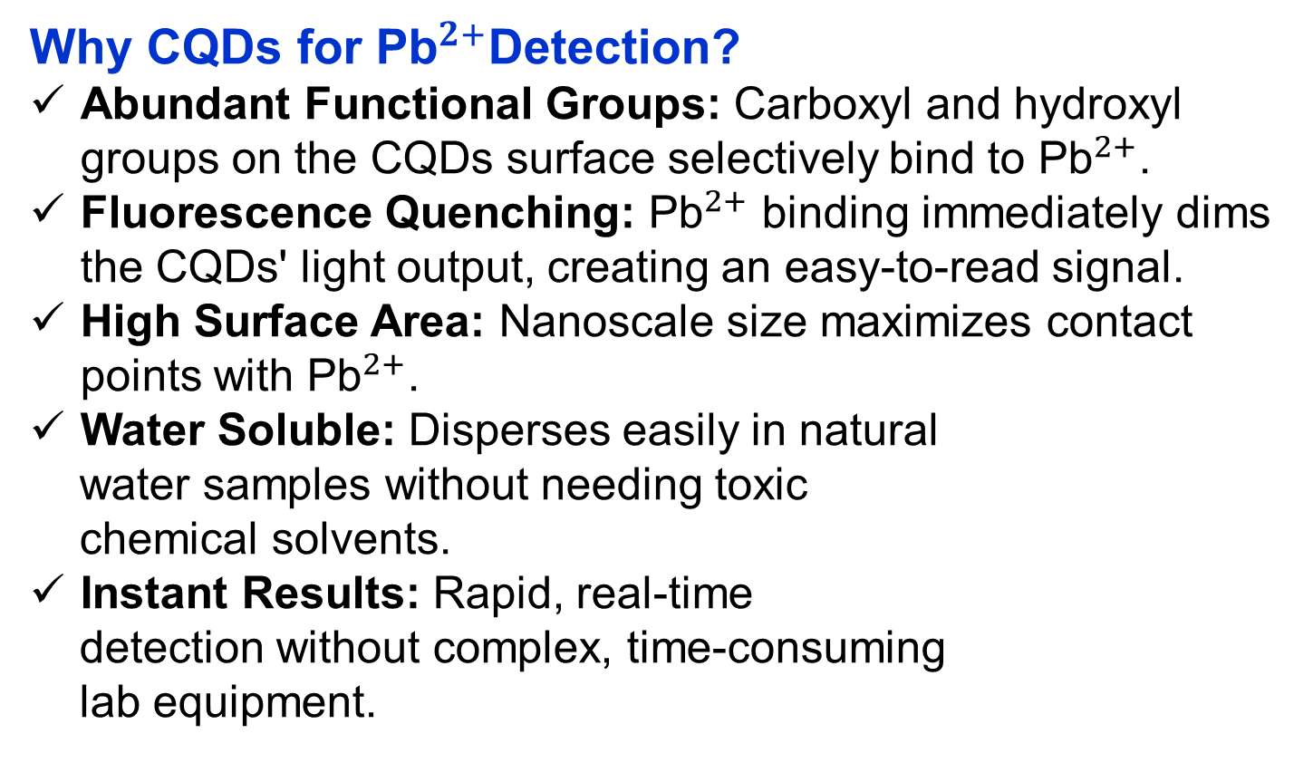
Why CQDs for ${\text{Pb}}^{2+}$Detection?
Abundant Functional Groups: Carboxyl and hydroxyl groups on the CQDs surface selectively bind to ${\text{Pb}}^{2+}$.
Fluorescence Quenching: ${\text{Pb}}^{2+}$ binding immediately dims the CQDs' light output, creating an easy-to-read signal.
High Surface Area: Nanoscale size maximizes contact points with ${\text{Pb}}^{2+}$.
Water Soluble: Disperses easily in natural
water samples without needing toxic
chemical solvents.
Instant Results: Rapid, real-time
detection without complex, time-consuming
lab equipment.
Lead (Pb²⁺) is highly toxic heavy metal often found in industrial wastewater, posing severe health risks even at low concentrations.
Conventional methods are costly, time-consuming, and require bulky laboratory equipment.
Therefore, a fast, simple, and affordable Pb²⁺ detection method is needed.

Slide 4
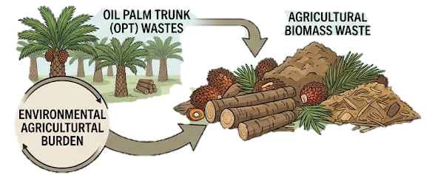
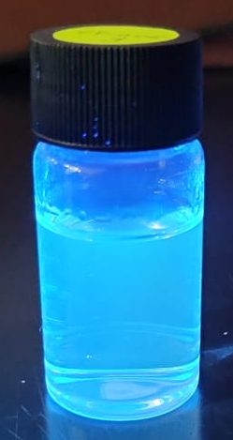

Why CQDs for ${\text{Pb}}^{2+}$Detection?
Abundant Functional Groups: Carboxyl and hydroxyl groups on the CQDs surface selectively bind to ${\text{Pb}}^{2+}$.
Fluorescence Quenching: ${\text{Pb}}^{2+}$ binding immediately dims the CQDs' light output, creating an easy-to-read signal.
High Surface Area: Nanoscale size maximizes contact points with ${\text{Pb}}^{2+}$.
Water Soluble: Disperses easily in natural
water samples without needing toxic
chemical solvents.
Instant Results: Rapid, real-time
detection without complex, time-consuming
lab equipment.
Where can sources of CQDs be obtained?
Origin: Derived sustainably from agricultural biomass waste, specifically Oil Palm Trunk (OPT).
Abundance: Highly available from major agricultural waste.
High Carbon Content: Naturally rich in carbon matrix, serving as an ideal precursor for CQDs synthesis.
Waste-to-Value: Converts environmental agricultural burden into high-value functional nanomaterials.

Slide 5
OPT pyrolysis
Temperature: 700˚C.
Precursor preparation
Mass: 0.03g mixed with 5 mL distilled water.
Sample characteristics and Pb²⁺ testing
CQDs were tested for UV-Vis, DLS, FTIR, and PL analysis.
Heating rate: 5 °C/min (under a constant N₂ purge)
Soaking time: 2 hours.
Activator: NaOH (0.07g) mixed with Urea (2.4g)
After being microwaved, the samples were transferred to the freezer and allowed to remain there overnight.
Using 50 ppm of Pb²⁺ and testing using PL analysis to check the photoluminance and quenching effect to the CQDs.
How can CQDs be synthesised?
Microwave-assisted method was selected because it is rapid, energy-efficient, simple, and suitable for producing CQDs from biomass with good control over their properties.
In microwave-assisted methods the precursors are heated due to absorption of the direct microwave radiation.
This process is more energy efficient because energy is absorbed directly by the molecules instead of the reaction vessel.
Where can sources of CQDs be obtained?
Origin: Derived sustainably from agricultural biomass waste, specifically Oil Palm Trunk (OPT).
Abundance: Highly available from major agricultural waste.
High Carbon Content: Naturally rich in carbon matrix, serving as an ideal precursor for CQDs synthesis.
Waste-to-Value: Converts environmental agricultural burden into high-value functional nanomaterials.

Slide 6
Methodology: Microwave-assisted method
OPT pyrolysis
Temperature: 700˚C.
Precursor preparation
Mass: 0.03g mixed with 5 mL distilled water.
Sample characteristics and Pb²⁺ testing
CQDs were tested for UV-Vis, FTIR, and PL analysis.
Heating rate: 5 °C/min (under a constant N₂ purge)
Soaking time: 2 hours.
Activator: NaOH (0.07g) mixed with Urea (2.4g)
After being microwaved, the samples were transferred to the freezer and allowed to remain there overnight.
Using 50 ppm of Pb²⁺ and testing using PL analysis to check the photoluminance and quenching effect to the CQDs.
How can CQDs be synthesised?
Microwave-assisted method was selected because it is rapid, energy-efficient, simple, and suitable for producing CQDs from biomass with good control over their properties.
In microwave-assisted methods the precursors are heated due to absorption of the direct microwave radiation.
This process is more energy efficient because energy is absorbed directly by the molecules instead of the reaction vessel.

Slide 7
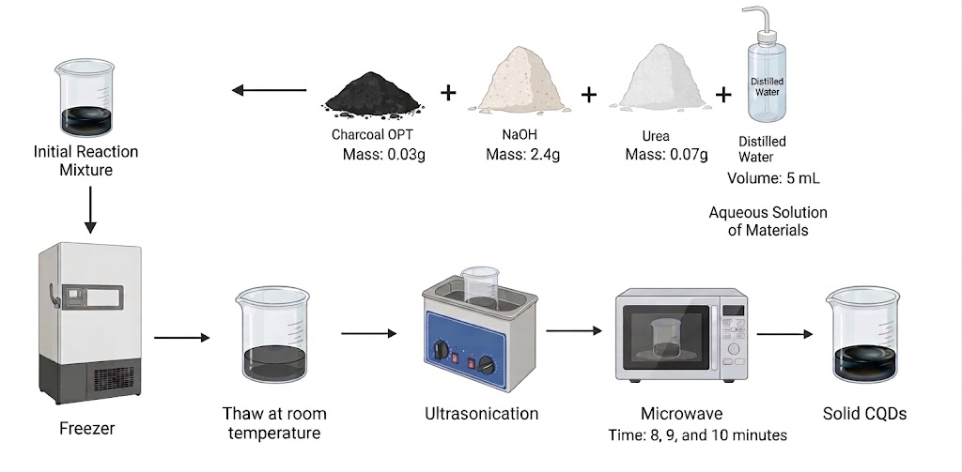
Methodology: Microwave-assisted method
OPT pyrolysis
Temperature: 700˚C.
Precursor preparation
Mass: 0.03g mixed with 5 mL distilled water.
Sample characteristics and Pb²⁺ testing
CQDs were tested for UV-Vis, DLS, FTIR, and PL analysis.
Heating rate: 5 °C/min (under a constant N₂ purge)
Soaking time: 2 hours.
Activator: NaOH (0.07g) mixed with Urea (2.4g)
After being microwaved, the samples were transferred to the freezer and allowed to remain there overnight.
Using 50 ppm of Pb²⁺ and testing using PL analysis to check the photoluminance and quenching effect to the CQDs.
Precursor preparation:
Sample characteristics: UV-Vis, FTIR and PL analysis
Detection of Pb²⁺ using PL analysis – to evaluate the detection capability for Pb²⁺ (quenching effect)

Slide 8
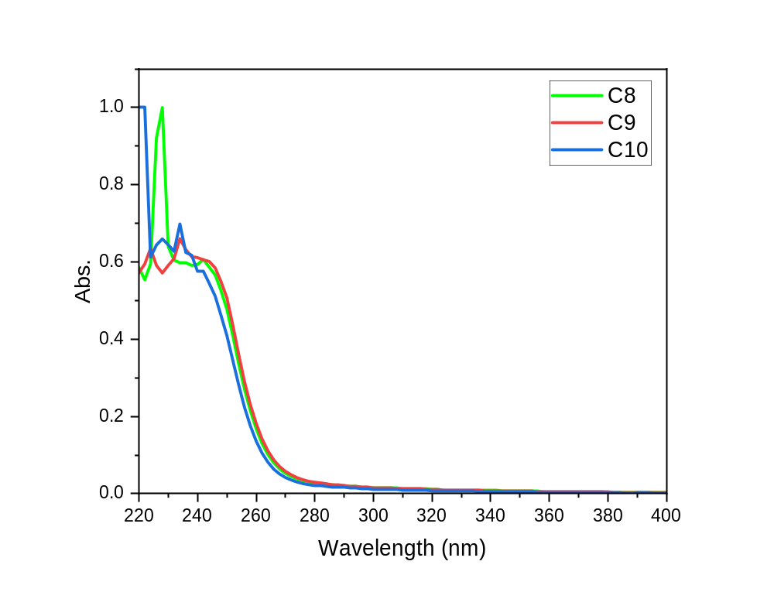
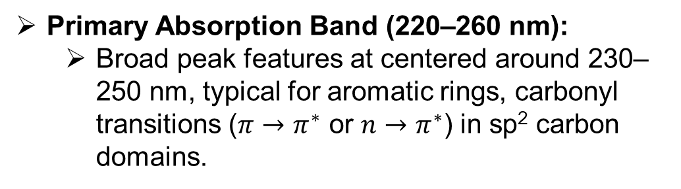
Results & Discussion:
UV-Vis Analysis:
Primary Absorption Band (220–260 nm):
  Broad peak features at centered around 230–250 nm, typical for aromatic rings, carbonyl transitions ($π→π^{∗}$ or $n→π^{∗}$) in sp² carbon domains.
Peak Differences Below 240 nm:
  C8 (Green): Exhibits high-intensity sharp peak at approximately 230 nm, due to π – π* transition of aromatic C=C bonds in sp² hybridisation of aromatic domains.
  C9 (Red): Displays a minor peak near ~234 nm indicates π–π* transition with possible contribution from surface states.
  C10 (Blue): Shows a sharp spike at 220 nm and a moderate local peak at ~234 nm, also refer to π–π* transition

Slide 9
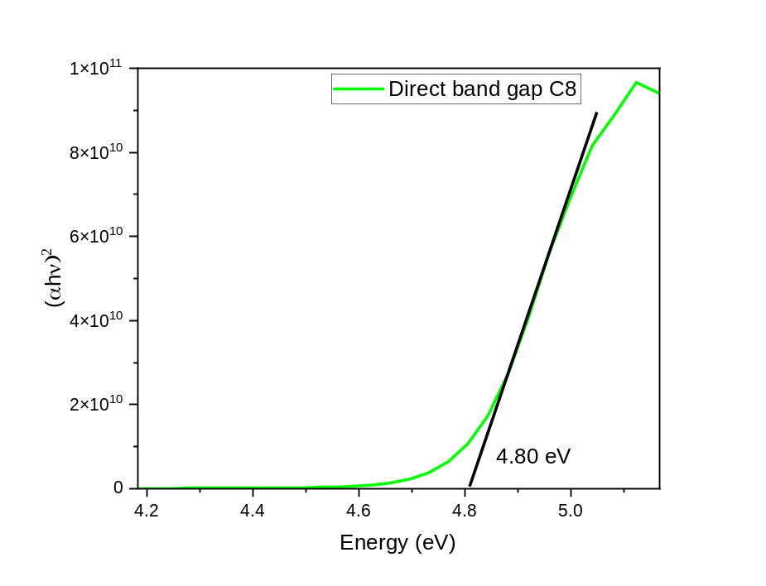
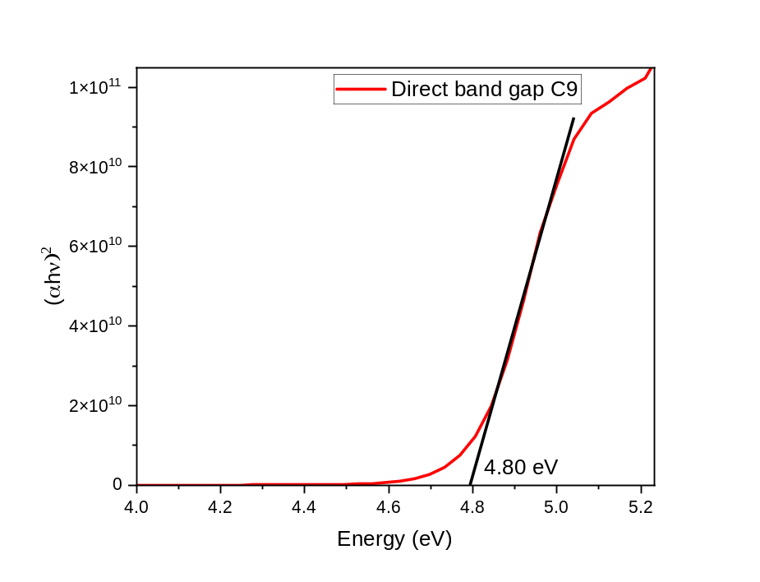
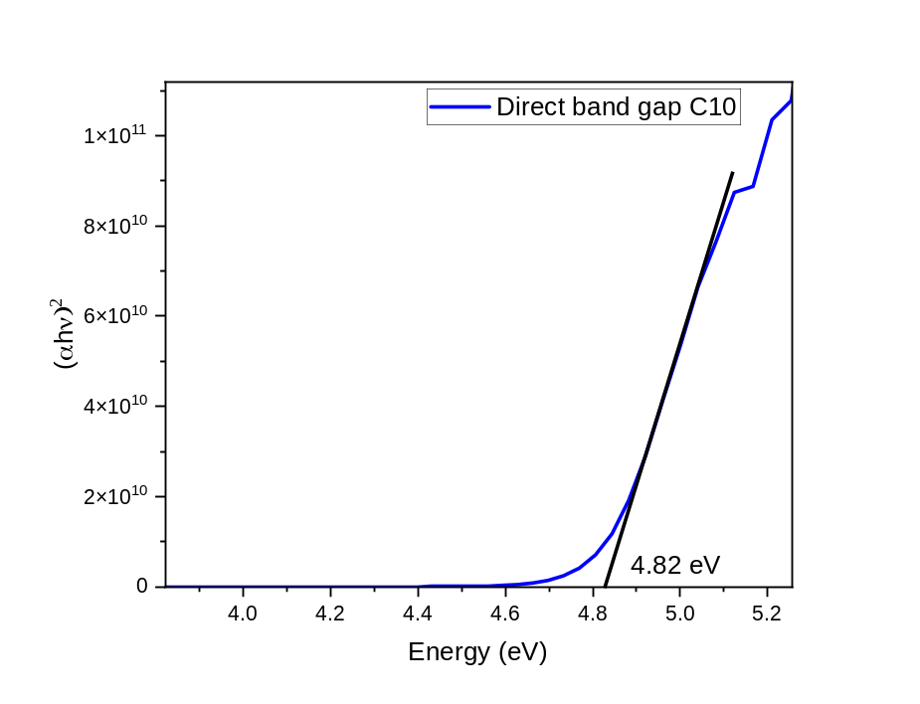
Results & Discussion:
UV-Vis Analysis:
The band gap energy was calculated using the Tauc plot.
The smaller the carbon domains, the stronger the quantum confinement in biochar OPT to happen.

Slide 10
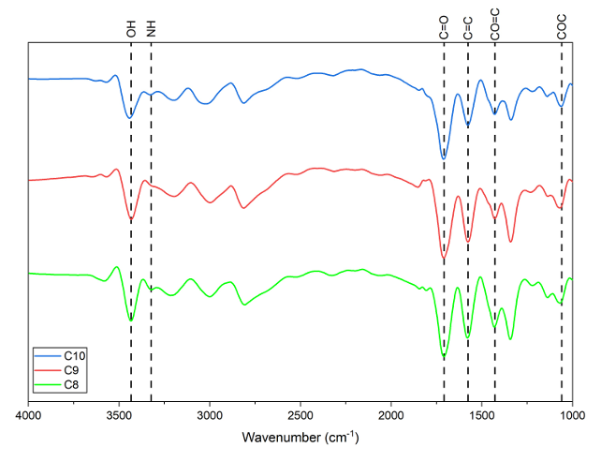
Results & Discussion:
FTIR Analysis:
High-frequency region (3200–3400 cm⁻¹):
  Broad peak at ~3400 cm⁻¹ corresponds to O–H stretching (hydroxyl groups).
  Shoulder at ~3200 cm⁻¹ corresponds to N–H stretching (amine groups).
  These groups transform charcoal from hydrophobic to hydrophilic, enabling stable aqueous dispersions.
  Essential for aqueous metal ion sensing applications.

Slide 11
Results & Discussion:
FTIR Analysis:
Fingerprint region (1600–1800 cm⁻¹):
  Sharp peak at ~1720 cm⁻¹ indicates C=O stretching (carbonyl/carboxyl/amide groups).
  Peak at ~1640 cm⁻¹ corresponds to C=C stretching of the graphitic core.
  The well-defined C=C peak suggests a highly ordered sp² carbon structure, inherited from the charcoal precursor.
Lower-frequency region (1000–1450 cm⁻¹):
  Peaks near 1450 cm⁻¹ indicate C–N stretching, confirming nitrogen doping from urea.
  Peak at ~1050 cm⁻¹ corresponds to C–O–C or C–O stretching.
  These oxygen- and nitrogen-containing groups enhance fluorescence and provide active sites for Pb²⁺ binding.

Slide 12
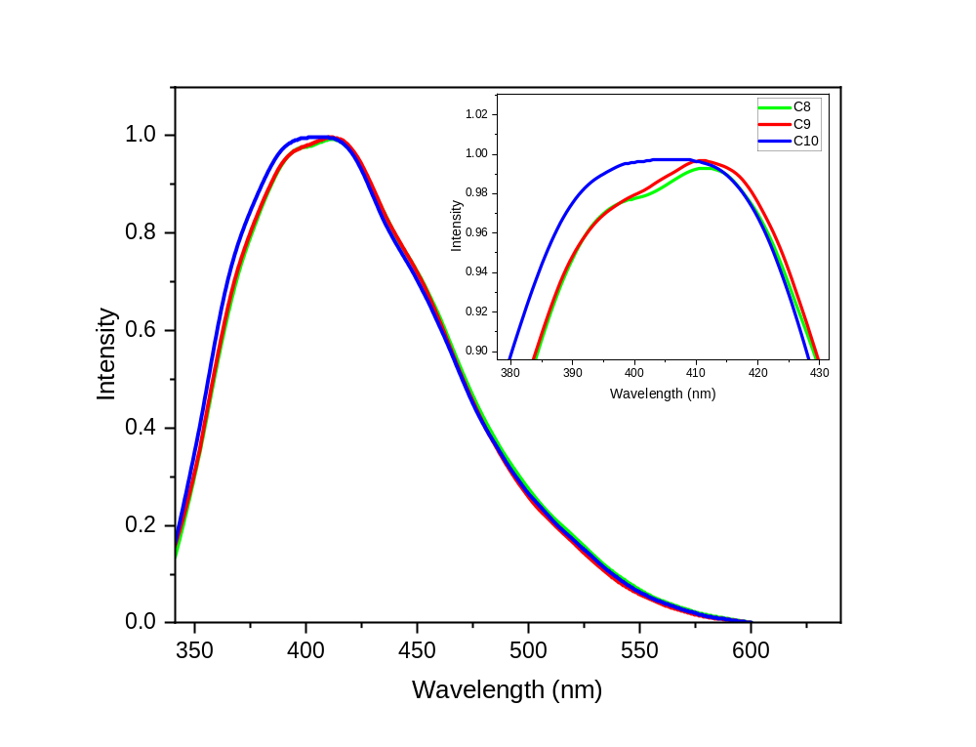
Results & Discussion:
PL Analysis:
Biochar CQDs show emission peak changes with time.
Emission peaks for C8 and C9 at 411–411.5 nm, respectively.
Emission peak for C10 shows blue-shifts to 405.5 nm.
The size reduction is attributed to prolonged microwave irradiation, which causes surface etching or fragmentation of graphitic domains.
The size estimation was calculate using effective mass approximation (EMA) model.
Sample | Emission peak (nm) | Calculated CQDs radius, r (nm) | Calculated CQDs diameter, d (nm)
C8 | 411 | 1.781 | 3.562
C9 | 411.5 | 1.783 | 3.566
C10 | 405.5 | 1.759 | 3.519

Slide 13
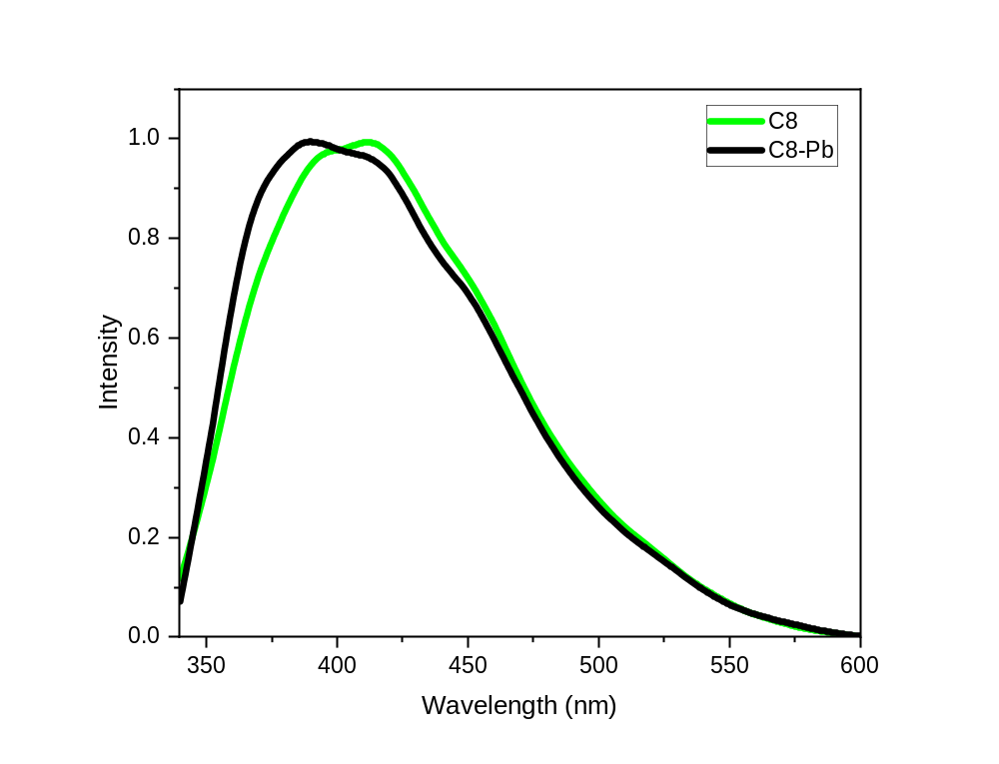
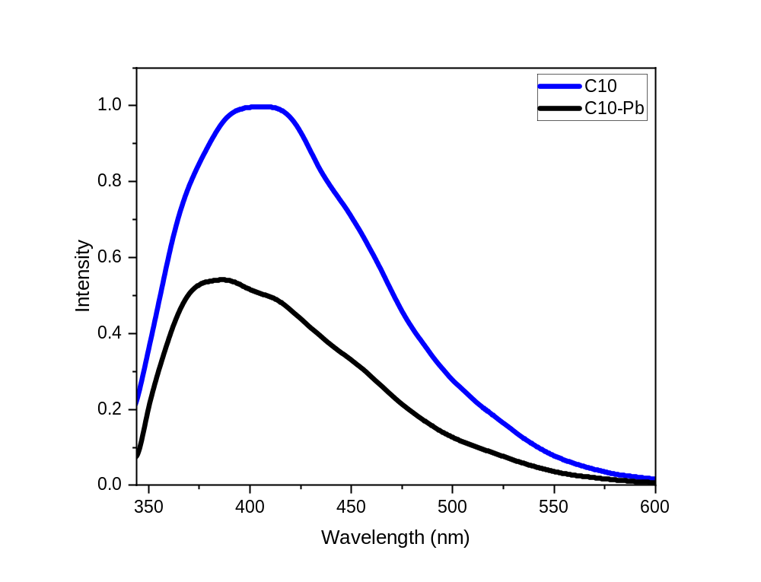
Results & Discussion:
PL Analysis:
A blue-shift trend was observed for the Biochar OPT samples.
Emission peak for C8 is shifted from 411 nm to 391.5 nm.
Emission peak for C10 is shifted from 405.5 nm to 383.5 nm.
Fluorescence intensity dropped significantly.
Samples | Emission peak (nm) | Calculated CQDs radius, r (nm) | CQDs diameter, d (nm)
C8-Pb | 391.5 | 1.706 | 3.413
C10-Pb | 383.5 | 1.676 | 3.352

Slide 14
Results & Discussion:
PL Analysis:
Results show a measurable reduction in effective particle size for all samples after Pb²⁺ exposure.
  C8: ~3.562 nm → ~3.413 nm (≈0.149 nm reduction)
  C10: ~3.519 nm → ~3.352 nm (≈0.167 nm reduction)
Effect of synthesis duration:
  Samples synthesized for 10 minutes show the higher diameter reduction.
  Longer synthesis time produces:
    Higher density of active surface functional groups
    Stronger Pb²⁺ binding
    Greater modification of the CQDs electronic structure.
Samples | Emission peak (nm) | CQDs diameter, d (nm)
C8 | 411 | 3.562
C8-Pb | 391.5 | 3.413
C10 | 405.5 | 3.519
C10-Pb | 383.5 | 3.352

Slide 15
Conclusion:
Sustainable & Low-Cost Precursor: CQDs were successfully synthesized from agricultural biomass waste (OPT Biomass) and converting an environmental burden into high-value nanomaterials.
Rapid & Energy-Efficient Synthesis: The microwave-assisted method was effective because energy is absorbed directly by the precursor molecules, providing a rapid, energy-efficient reaction with good control over the CQD properties.
Clear Sensing Signal via Photoluminescence Quenching: Exposure to 50 ppm Pb²⁺ produced significant fluorescence quenching, blue-shifting of photoluminescence emission peaks, and a measurable reduction in calculated effective particle diameter.
Acknowledgment:
This research was funded by the Ministry of Higher Education under Fundamental Research Grant Scheme (FRGS/1/2023/STG05/UPM/02/10).

Slide 16
References:
Prasongthum N, Suemanotham A, Sisuthog W, Thanmongkhon Y, Chaiya C, Attanatho L. Hydrothermal carbonization of oil palm trunk: Hydrochar properties and combustion behaviors. Energy Reports 2023;9:380–6. https://doi.org/10.1016/j.egyr.2023.09.033.
Qureshi SS, Premchand, Javed M, Saeed S, Abro R, Mazari SA, et al. Hydrothermal carbonization of oil palm trunk via taguchi method. Korean Journal of Chemical Engineering 2021;38:797–806. https://doi.org/10.1007/s11814-021-0753-0.
Mahat NA, Shamsudin SA. Transformation of oil palm biomass to optical carbon quantum dots by carbonisation-activation and low temperature hydrothermal processes. Diam Relat Mater 2020;102. https://doi.org/10.1016/j.diamond.2019.107660.
Dong Z, Qi J, Yue L, Zhou H, Chen L, Gu J, et al. Biomass-based carbon quantum dots and their agricultural applications. Plant Stress 2024;11. https://doi.org/10.1016/j.stress.2024.100411.
Mahat NA, Shamsudin SA. Blue luminescence carbon quantum dots derived from oil palm empty fruit bunch biomass. IOP Conf. Ser. Mater. Sci. Eng., vol. 736, Institute of Physics Publishing; 2020. https://doi.org/10.1088/1757-899X/736/5/052001.
Nguyen KG, Baragau IA, Gromicova R, Nicolaev A, Thomson SAJ, Rennie A, et al. Investigating the effect of N-doping on carbon quantum dots structure, optical properties and metal ion screening. Sci Rep 2022;12. https://doi.org/10.1038/s41598-022-16893-x.
Chunduri LAA, Kurdekar A, Patnaik S, Dev BV, Rattan TM, Kamisetti V. Carbon Quantum Dots from Coconut Husk: Evaluation for Antioxidant and Cytotoxic Activity. Materials Focus 2016;5:55–61. https://doi.org/10.1166/mat.2016.1289.
Saleem H, Saud A, Zaidi SJ. Sustainable Preparation of Graphene Quantum Dots from Leaves of Date Palm Tree. ACS Omega 2023;8:28098–108. https://doi.org/10.1021/acsomega.3c00694.
Gozali Balkanloo P, Mohammad Sharifi K, Poursattar Marjani A. Graphene quantum dots: synthesis, characterization, and application in wastewater treatment: a review. Mater Adv 2023;4:4272–93. https://doi.org/10.1039/d3ma00372h.
Takahama S, Kitamura M, Ide Y, Umemura K. Variation in the responses of carbon quantum dots (CQDs) synthesized from native coconut husk and coconut husk-derived charcoal. Opt Mater (Amst) 2022;131. https://doi.org/10.1016/j.optmat.2022.112739.

Slide 17
TERIMA KASIH / THANK YOU
Any Questions?

