Slide 1
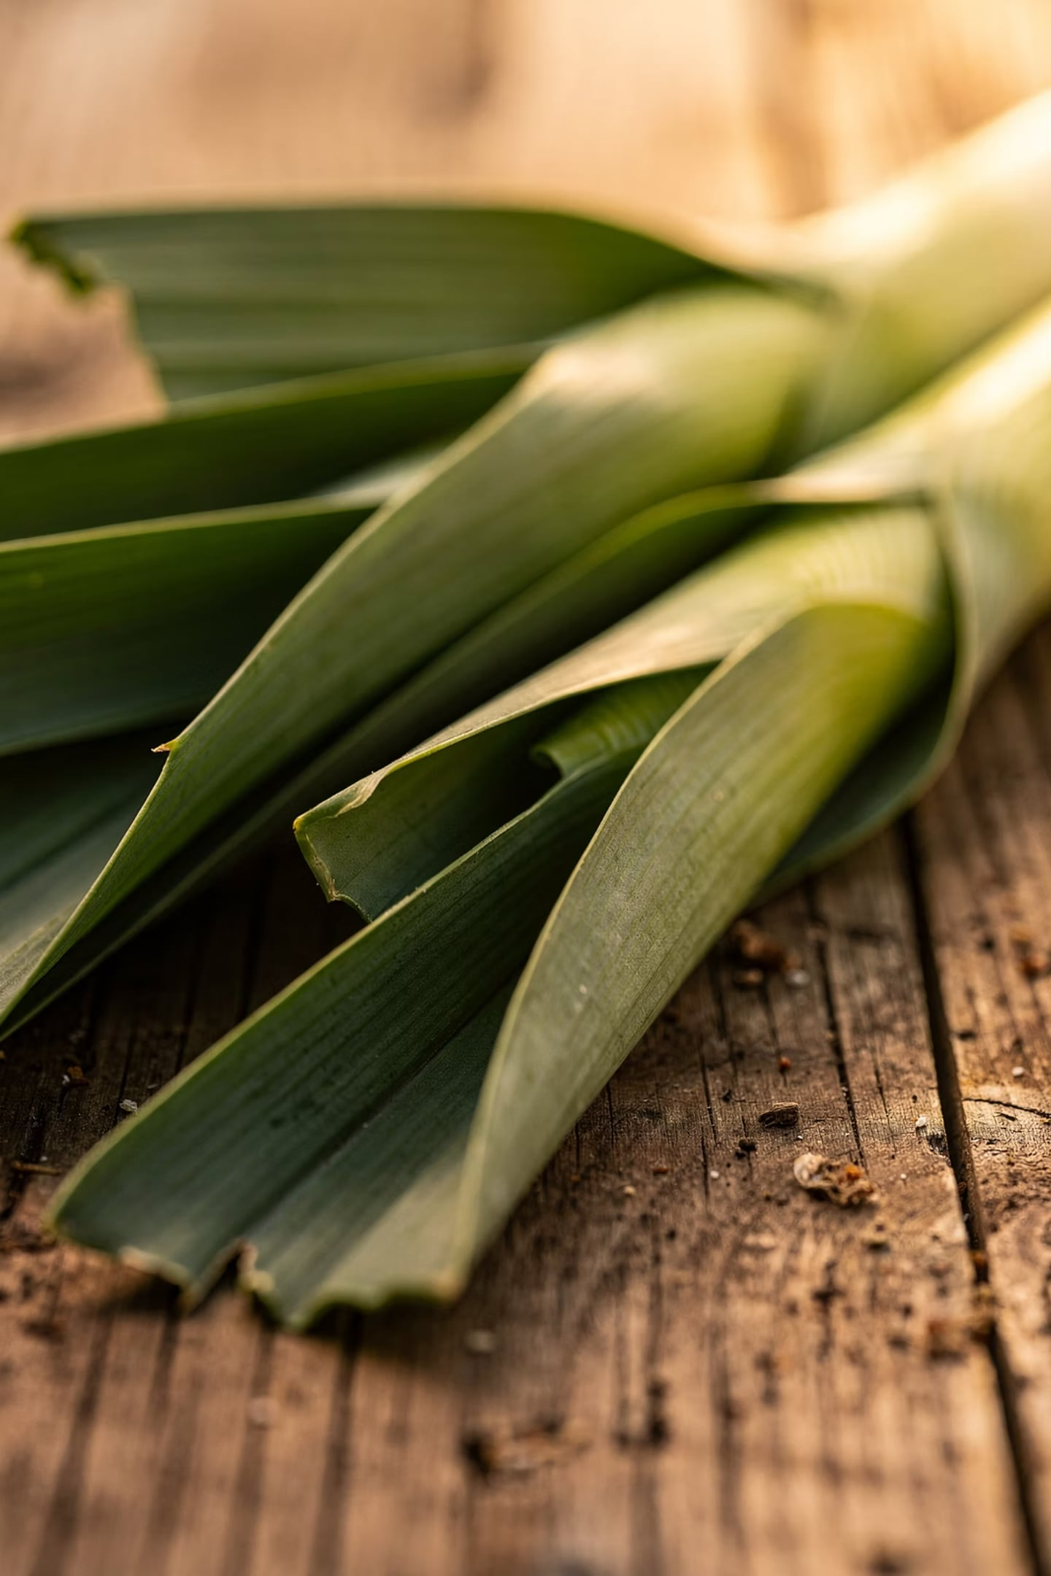
Green Synthesis and Characterization of Silver Nanoparticles Using Allium ampeloprasum Leaf Aqueous Extract
Evaluation of Their Antioxidant Activity via DPPH Radical Scavenging Assay
Authors: Ammar Radhi Obeid, Muhannad Mahmoud Qasim, Hind Mohsen Hamad, Omar A. Alwash*, Abdullah Sami Mutlag, Marwa Issa Jaafar, Muhammad Khalil Abdul Jabbar
Affiliation: Scientific Research Authority, Baghdad, Iraq
GREEN NANOCHEMISTRY
SILVER NANOPARTICLES
ANTIOXIDANT ACTIVITY

Slide 2
Abstract
This study presents the green synthesis of silver nanoparticles (AgNPs) using an aqueous leaf extract of Allium ampeloprasum (Iraqi leek) to reduce silver ions and stabilize the resulting nanoparticles, alongside evaluation of their antioxidant activity via DPPH radical scavenging assay.
Extract Preparation
Formation Indicator
25 g fresh leek leaves boiled in 100 mL deionized water at 80 °C for 45 min; initial reaction pH 5.5, adjusted to 12.0 with NaOH; reaction proceeded at room temperature for 45 min.
AgNP formation confirmed by color change to honey-brown/dark brown, driven by reduction of Ag⁺ ions and excitation of Surface Plasmon Resonance (SPR).
Characterization Suite
Key Outcome
Particles characterized by UV–Vis spectroscopy, FTIR, SEM, XRD, AFM, and DPPH assay. XRD estimated average crystallite size of 45 nm; SEM confirmed spherical but aggregated morphology.
Biosynthesized AgNPs showed moderate DPPH radical scavenging activity compared to ascorbic acid. A. ampeloprasum leaf extract is confirmed as an effective green synthesizer for stable AgNPs with antioxidant activity.

Slide 3
Introduction: Motivation and Context
Oxidative Stress & Antioxidants
Green Nanochemistry
Oxidative stress drives the development and progression of numerous pathological conditions. Excessive reactive oxygen species (ROS) damage cellular lipids, proteins, and nucleic acids. Natural antioxidants and antioxidant-like nanomaterials are therefore of continuing interest in pharmaceutical, biomedical, and materials research.
Green nanochemistry has emerged as an alternative to conventional chemical and physical nanoparticle synthesis, reducing the need for toxic reducing agents, high temperatures, and expensive processing. Plant-mediated synthesis is particularly attractive because plant extracts contain phenolics, flavonoids, terpenoids, proteins, sugars, and other phytochemicals that reduce Ag⁺ to Ag⁰ and stabilize particles through surface capping interactions.
Recent reviews emphasize that the final morphology, stability, and biological response of plant-derived AgNPs depend strongly on extract composition, AgNO₃ concentration, pH, temperature, reaction time, and purification procedure.

Slide 4

Why Allium ampeloprasum?
Species of the genus Allium are rich in organosulfur compounds, flavonoids, saponins, and other secondary metabolites — compounds that contribute to both reducing and stabilizing functions during green synthesis and may also influence biological activity.
Prior Allium-Based AgNP Studies
Knowledge Gap Addressed
Research Questions
Locally sourced A. ampeloprasum leaves from Iraq have not been sufficiently evaluated under the specific extraction and synthesis conditions used in this study — particularly with combined FTIR, SEM, XRD, AFM, and DPPH assessment. Iraqi-sourced leaves produced highly stable metallic Ag⁰ phases without requiring secondary thermal treatment, likely due to the high concentration of organosulfur molecules and water-soluble phenolics unique to the local cultivar.
(1) Can A. ampeloprasum leaf extract mediate AgNP formation under aqueous conditions? (2) What are the optical, structural, and morphological features of the synthesized particles? (3) Do the synthesized particles show statistically significant DPPH scavenging activity compared with the crude extract and ascorbic acid?
Previous studies have reported green synthesis of AgNPs using Allium species, including Allium cepa and Allium ampeloprasum extracts. Shanmugam et al. fabricated AgNPs using A. cepa var. aggregatum (core distribution 35–8 nm); Baran et al. used A. cepa peel for multi-pathogenic inhibition; Jalilian et al. reported AgNPs from A. ampeloprasum extracts in Iran with moderate cytotoxicity profiles.

Slide 5
Materials & Methods: Chemicals and Plant Material
Chemicals & Reagents
Plant Collection & Extract Preparation
Silver nitrate (AgNO₃): purity 99.8%, Analytical Grade, Cat. No. 209139, Batch No. STBF8432V — Sigma-Aldrich, Germany
DPPH: Cat. No. D9132, Reagent Grade — Sigma-Aldrich, Germany
L-Ascorbic acid: purity ≥99%, Cat. No. A92902 — Sigma-Aldrich, Germany
Methanol: Analytical grade, 99.9%, Cat. No. 322415 — Merck, Germany
Fresh, healthy leaves of A. ampeloprasum were collected from a commercial agricultural market in Baghdad, Iraq in March 2025. Leaves were washed under running tap water, rinsed thrice with deionized water, and dried under shade at 25 °C.
25 g of finely chopped fresh leaves were immersed in 100 mL deionized water and heated at 80 °C for 45 min in a water bath. After cooling, the mixture was filtered through Whatman No. 1 filter paper (pore size 11 μm). The resulting clear, pale-yellow filtrate was stored at 4 °C and used within 24 hours to maximize stability.

Slide 6
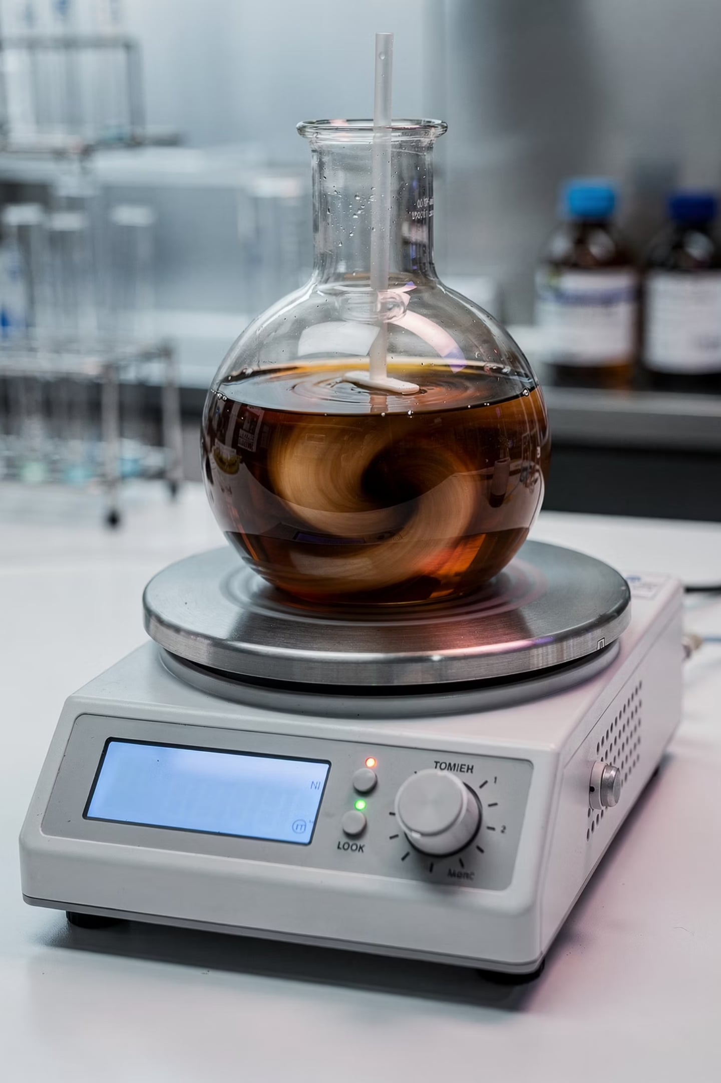

Biosynthesis of Silver Nanoparticles
Prepare AgNO₃
Add Extract
React 60 min
Centri‑wash‑dry
An aqueous AgNO₃ precursor solution was prepared at 1.0 mM and shielded from light in an amber volumetric flask. Plant extract (5 mL) was added dropwise to 45 mL AgNO₃ under continuous magnetic stirring at 500 rpm. Reaction temperature was maintained at 60 °C and pH adjusted to 8.5 with 0.1 M NaOH to accelerate electron transfer kinetics. The colloidal suspension was centrifuged at 12,000 rpm for 20 min (Hermle Z326K refrigerated centrifuge, Germany). The pellet was washed three times with deionized water and twice with absolute ethanol to eliminate unreacted silver ions and residual biomass, then dried in a vacuum oven at 60 °C for 12 hours.

Slide 7




Characterization Methods
UV-Vis Spectroscopy
FTIR Spectroscopy
Shimadzu UV-1900i Double-Beam Spectrophotometer (Japan); wavelength range 300–700 nm; resolution 1.0 nm; deionized water as baseline blank. Used to track SPR peaks confirming AgNP formation.
Bruker Alpha II FTIR Spectrometer (Germany); KBr pellet preparation; scanning range 4000–400 cm⁻¹; 32 scans per spectrum; resolution 4 cm⁻¹. Used to identify functional groups involved in reduction and stabilization.
SEM Imaging
XRD & AFM
FEI Nova NanoSEM 450 (USA); accelerating voltage 15 kV. Used to evaluate surface morphology, particle size distribution, and agglomeration profiles. ImageJ particle count analysis performed on N=100 particles.
XRD used to assess crystalline phase and estimate crystallite size via the Debye-Scherrer equation: D = Kλ/(β cos θ). AFM used to examine surface topography, roughness metrics, and phytochemical capping layer coverage.

Slide 8
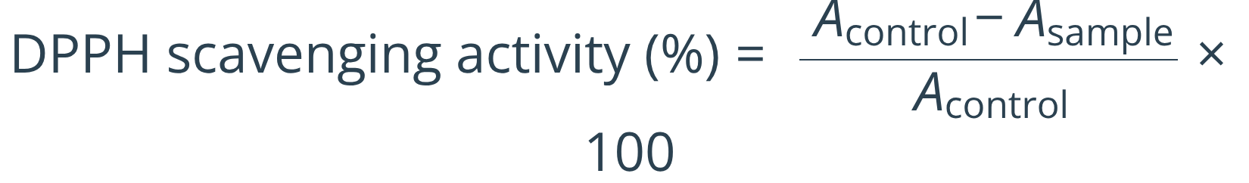
DPPH Radical Scavenging Assay Protocol
Assay Setup
Calculation Formula
A 0.1 mM DPPH solution was prepared by dissolving approximately 2 mg of DPPH in 50 mL of methanol. Aliquots of AgNP suspension at varying concentrations were mixed with an equal volume of DPPH solution, vortexed, and incubated in the dark for 30 min at room temperature. Absorbance was recorded at 517 nm.
Radical scavenging activity was calculated as:
Blank: Methanol
Negative control: DPPH without sample
Positive control: Ascorbic acid
Where Acontrol is the absorbance of DPPH without sample and Asample is the absorbance in the presence of the test material. A decrease in absorbance at 517 nm (color change from deep purple to pale yellow) indicates antioxidant activity via electron donation.

Slide 9
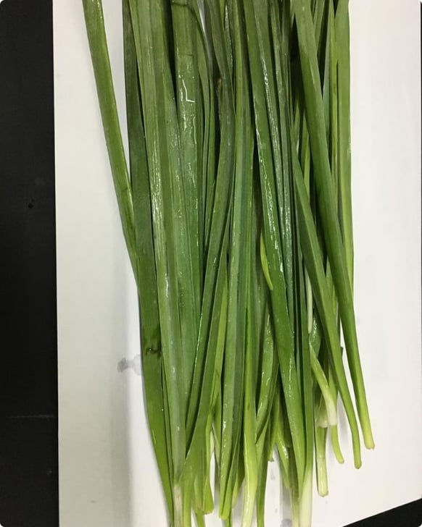
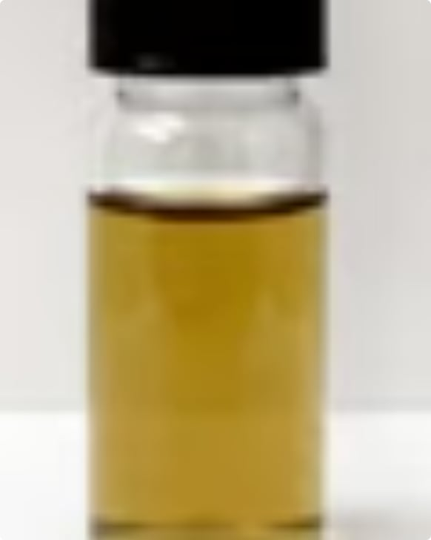
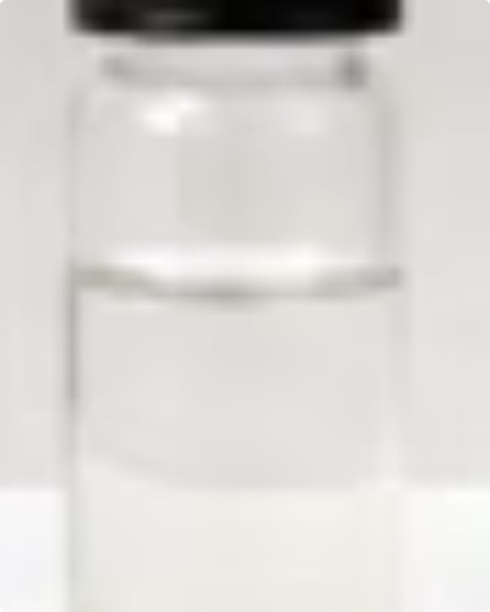
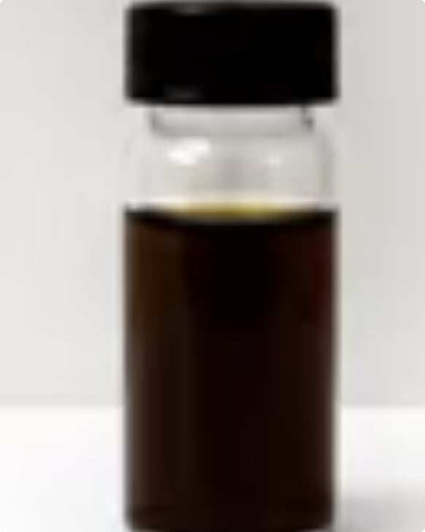
Results: Visual Confirmation of AgNP Formation
The sequential visual changes during synthesis provide the first qualitative evidence of AgNP formation. Upon mixing the clear leaf extract with the transparent AgNO₃ solution, a distinct color evolution was observed within 15 minutes, stabilizing completely after 60 minutes.
Fig. 1: Fresh Leaves
Fig. 2: Filtered Extract
Fig. 3: AgNO₃ Solution
Fig. 4: Post-Reaction
Fresh A. ampeloprasum leaves collected from Baghdad, Iraq, used for aqueous extract preparation.
Clear, pale-yellow aqueous leaf extract after filtration through Whatman No. 1 filter paper.
Transparent silver nitrate solution prior to reaction with plant extract, shielded from light.
Reaction mixture after color change to dark brown, indicating successful reduction of Ag⁺ and possible AgNP formation.

Slide 10
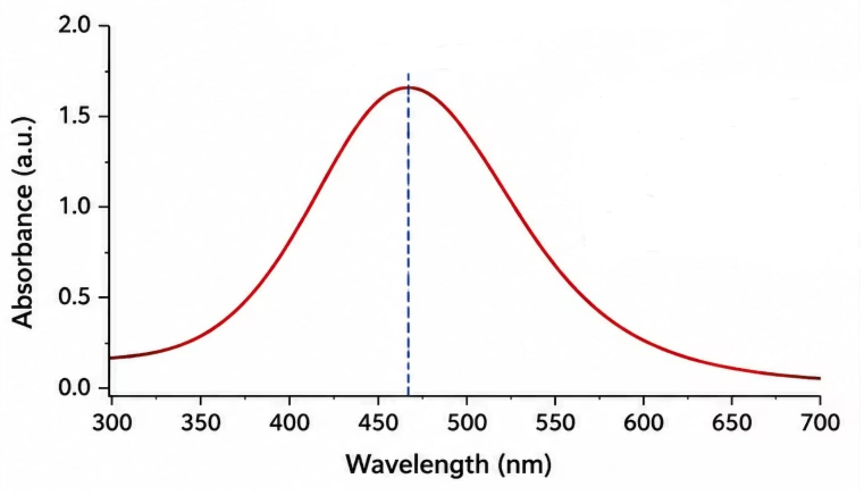
UV-Visible Spectroscopy Results
SPR Absorption at 435 nm
Upon mixing the clear leaf extract with the transparent AgNO₃ fluid, an evident visual transition to a dark brown state was observed within 15 min, stabilizing completely after 60 min. This color alteration is primarily driven by the excitation of Surface Plasmon Resonance (SPR) within the metallic silver domains.
Spectrophotometric scans confirmed this behavior, showing an intense, symmetric SPR absorption band centered at 435 nm, which confirms the successful reduction of Ag⁺ to zero-valent metallic Ag⁰ nanoparticles. The sharpness and symmetry of the SPR peak are indicative of a relatively narrow size distribution and good colloidal stability of the synthesized AgNPs.
Fig. 5. UV-visible spectroscopy of the plant extract and synthesized AgNPs.

Slide 11
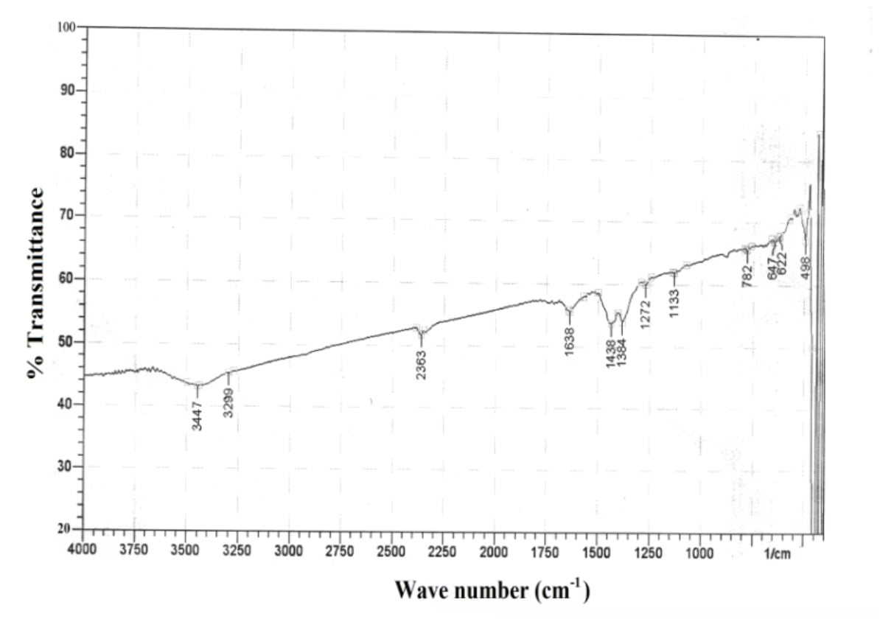
FTIR Spectroscopy Results
Functional Group Identification
FTIR spectroscopy was used to evaluate chemical bonds and functional groups on the surface of AgNPs. The capability of plant extracts to reduce AgNO₃ to AgNPs is attributed to secondary metabolites that alter electron charge and convert ions to nano-sized particles.
Results clearly reveal hydroxyl groups of phenols and amide groups of proteins from the plant extract forming a capping layer on the nanoparticles, preventing agglomeration and providing stability. Hydroxyl and carboxyl groups in phenolic compounds play a key role as reducing and stabilizing agents.
Fig. 6. FTIR spectrum of the plant extract and synthesized AgNPs.
AgNPs Peak (cm⁻¹)
Functional Group
Phytochemical Origin
3412
O-H / N-H Stretching
Phenolics, Flavonoids, Proteins
2360
C-H Stretching
Aliphatic matrix components
1612
C=O Stretching (Amide I)
Proteins / Secondary metabolites
1384
C-N Stretching / N-H Bending
Proteins / Amide links
1245
C-O Stretching / C-S Bonds
Organosulfur compounds / Esters
585
Ag–Metal Core Interaction
Metal-Oxygen / Metal-Biomass Binding

Slide 12
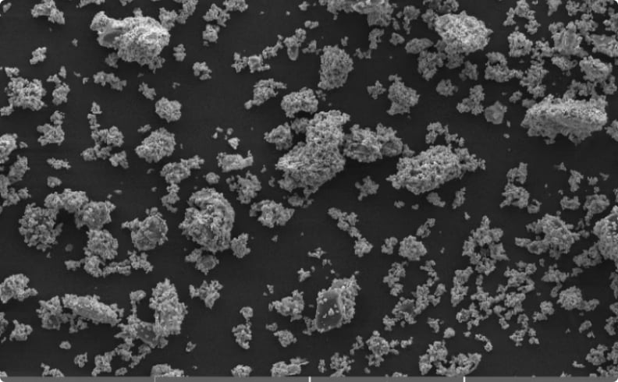
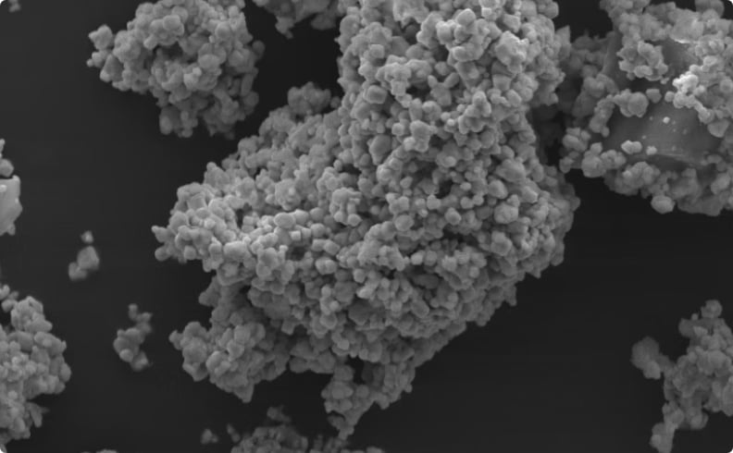
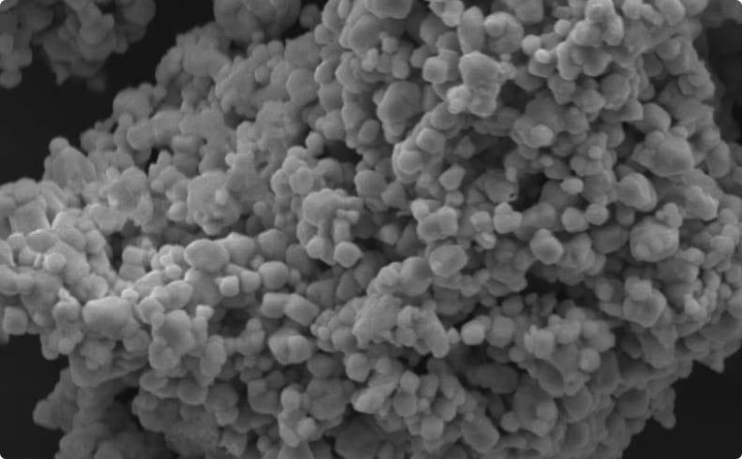
SEM Characterization
SEM characterization revealed that the biogenic nanomaterials are composed of approximately spherical primary particle domains embedded within an aggregated cluster network. ImageJ particle count analysis (N=100) showed a normal size distribution with a mean core diameter of 42.5 ± 5.3 nm. Aggregation observed in the images is primarily due to drying artifacts during sample preparation and the presence of capping biomolecular layers on the nanoparticles.
Fig. 7A: Low Magnification
Fig. 7B: Aggregated Clusters
Fig. 7C: Higher Magnification
SEM image showing the overall distribution of synthesized AgNP clusters at low magnification, revealing the extent of aggregation across the sample.
SEM image showing aggregated particle clusters. The bio-organic capping layer contributes to interparticle interactions during drying.
Higher magnification SEM image confirming approximately spherical agglomerated domains with mean core diameter of 42.5 ± 5.3 nm.

Slide 13
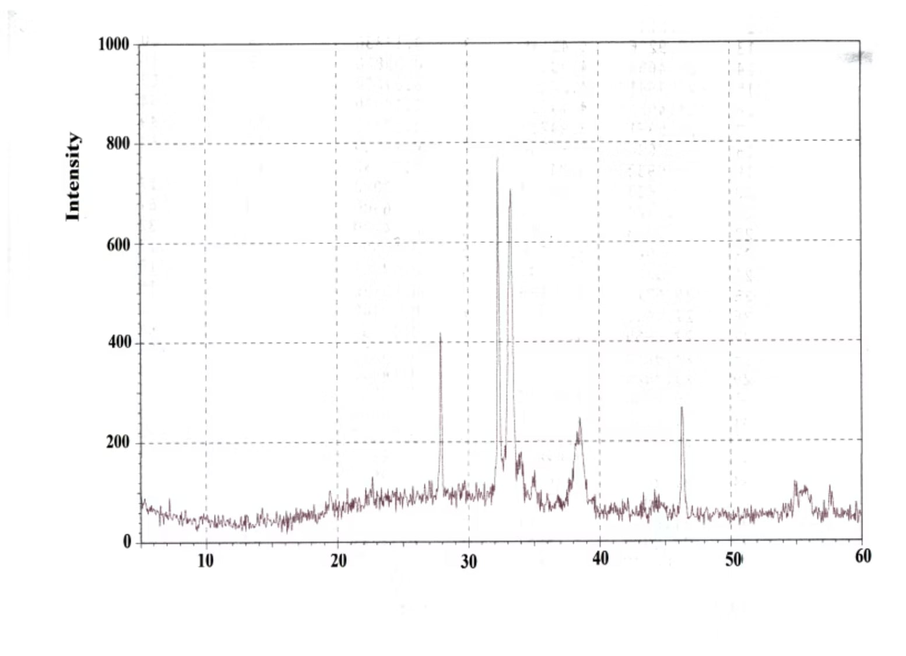

XRD Analysis: Crystalline Phase Confirmation
FCC Metallic Silver Confirmed
The XRD profile confirmed the highly crystalline nature of the sample. Clear diffraction peaks were recorded at 2θ positions of 38.15°, 44.30°, 64.45°, and 77.40°, corresponding to lattice planes (111), (200), (220), and (311) respectively — matching the face-centered cubic (FCC) metallic phase of silver according to JCPDS Card No. 04-0783.
No peaks corresponding to silver oxides (Ag₂O or AgO) were observed, confirming that the synthesized material consists exclusively of zero-valent metallic Ag⁰ nanoparticles. Applying the Debye-Scherrer equation to the dominant (111) peak yielded an average crystallite core size of 45 nm.
Fig. 8. XRD pattern of the synthesized AgNPs confirming FCC metallic silver phase.
Debye-Scherrer equation: D = Kλ/(β cos θ), where D = crystallite size, K = shape factor, λ = X-ray wavelength, β = FWHM in radians, θ = Bragg angle.

Slide 14
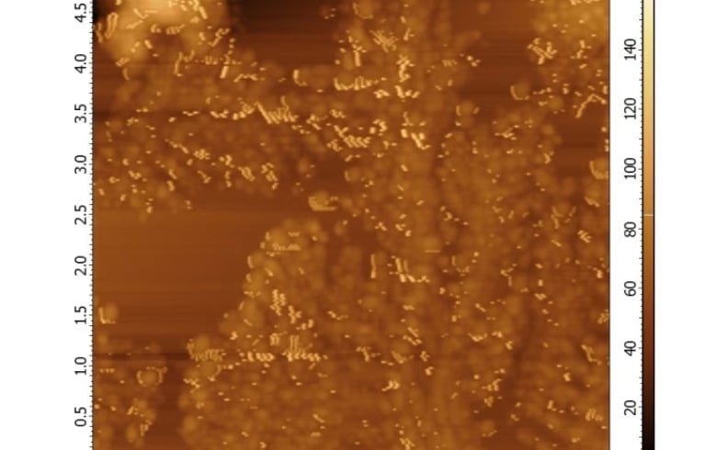
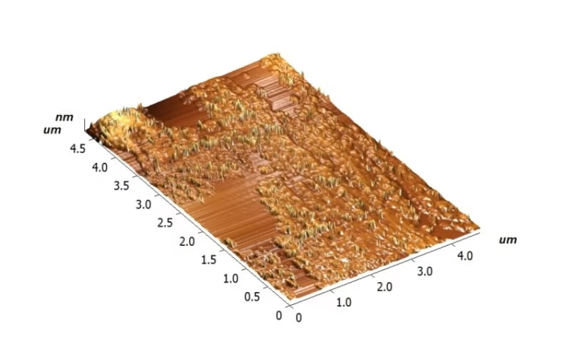
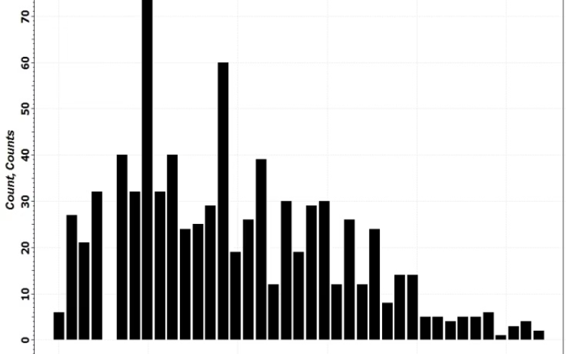
AFM Surface Topography Analysis
AFM scanning confirmed the morphological observations from SEM. Statistical roughness metrics across the 5 μm × 5 μm area yielded an average roughness (Ra) of 14.2 nm and a root-mean-squared roughness (Rq) of 18.6 nm. The grain distribution histogram showed a vertical topography profile consistent with the presence of capping biopolymer layers surrounding the metallic cores.
Fig. 9A: AFM 2D Image
Fig. 9B: AFM 3D Topography
Fig. 9C: Size Distribution
Two-dimensional AFM image showing the surface topography of synthesized AgNPs, revealing particle distribution and surface features.
Three-dimensional AFM surface topography confirming the presence of phytochemical capping layers surrounding the metallic nanoparticle cores.
AFM grain size distribution histogram showing vertical topography profiles consistent with biopolymer-capped metallic cores. Ra = 14.2 nm; Rq = 18.6 nm.

Slide 15
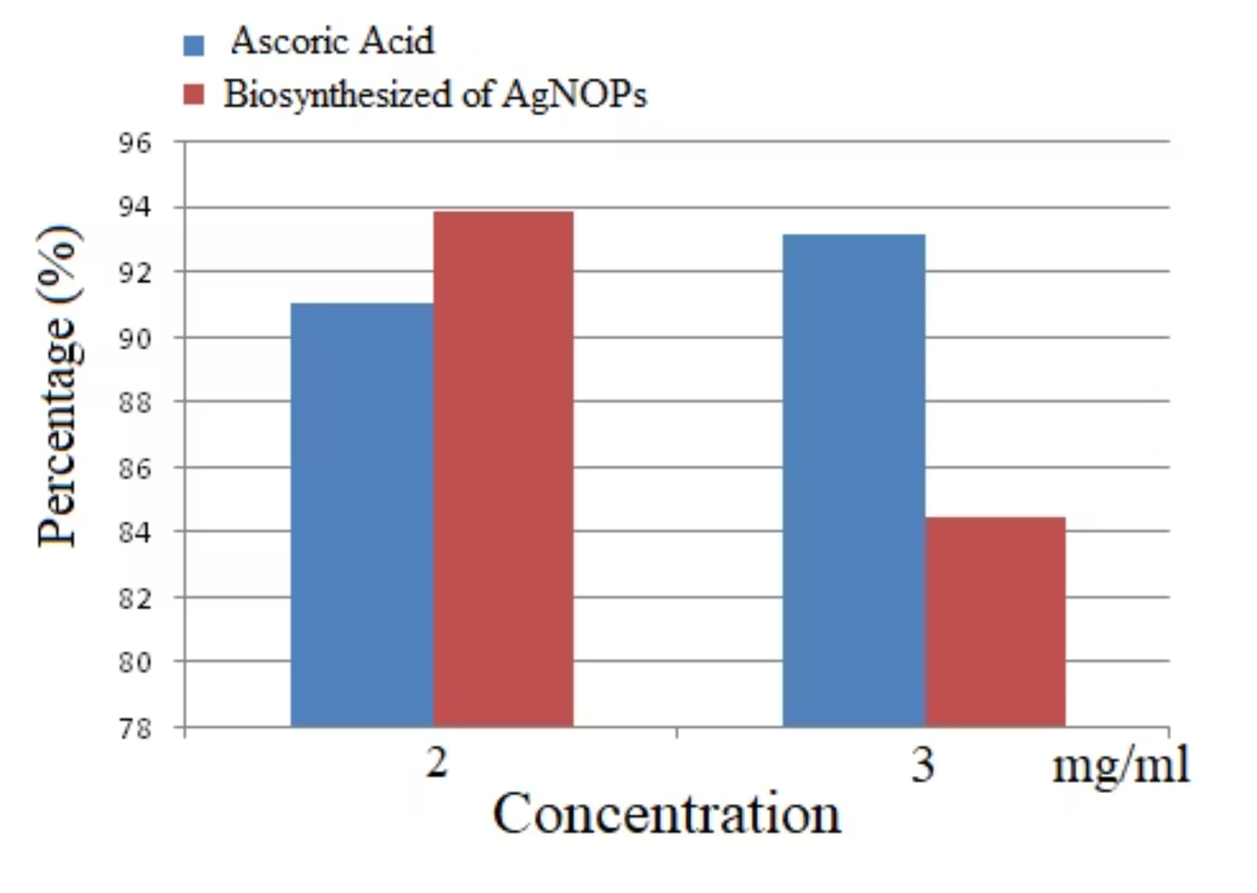
DPPH Radical Scavenging Activity Results
Moderate Antioxidant Activity
Biosynthesized AgNPs showed moderate antioxidant activity compared to ascorbic acid, which showed greater activity. The principle of antioxidant activity in the DPPH test is attributed to the electron-donating behavior of AgNPs for the single electron in DPPH, causing a decrease in the intensity of the n→π* transition at 517 nm (color change from deep purple to pale yellow).
Notably, different concentrations of biosynthesized AgNPs (2, 3 mg/mL) had no direct proportional effect on scavenging activity. This may be attributed to protein or biological compounds covering the surface of AgNPs and interfering with NP–DPPH interaction. Higher concentrations also reduce AgNP solubility, explaining lower scavenging activity at 3 mg/mL.
Fig. 10. DPPH scavenging activity of biosynthesized AgNPs compared with ascorbic acid as positive control.

Slide 16

Interpreting the DPPH Results: Mechanistic Insights
Electron Transfer Mechanism
Capping Layer Interference
Concentration-Dependent Behavior
AgNPs have been reported to possess antioxidant properties linked to their surface properties. Metal nanoparticles (gold, silver, palladium) exhibit catalase-mimicking behavior by decomposing H₂O₂ to H₂O and O₂ at neutral and basic pH values, contributing to their overall antioxidant profile.
The protein or biological compounds from the plant extract covering the surface of AgNPs interfere with the interaction of NPs with DPPH radicals. Several functional groups in the extract act as a capping agent, covering the NPs and resulting in moderate antioxidant activity — a phenomenon also reported in fruit extract-based AgNP biosynthesis studies.
Higher concentrations of AgNPs reduce their solubility, explaining lower scavenging activity at 3 mg/mL. High concentration of NPs is not necessarily associated with increased scavenging activity. Conversely, some studies report that biosynthesized AgNPs using leek leaf extract show enhanced antioxidant activity with increasing concentration, attributed to bioactive compounds such as flavonoids, ellagic acid, and valeric acid attached to the NPs.

Slide 17
Discussion: Contextualizing the Results
Our results confirm that the leaf extract of A. ampeloprasum successfully reduces silver precursor ions to form crystalline silver nanoparticles, aligning well with the green synthesis literature highlighting the role of plant secondary metabolites in driving Ag⁺ → Ag⁰ reduction.
Comparison with Allium-Based Studies
Aggregation and Antioxidant Performance
Future Work Required
Further testing including dynamic light scattering (DLS), zeta potential measurement, and cell viability assays is required before these materials can be proposed for direct biomedical or clinical use.
Shanmugam et al. fabricated AgNPs using A. cepa var. aggregatum with a core distribution of 35–8 nm. Baran et al. utilized A. cepa peel systems for multi-pathogenic inhibition. Jalilian et al. reported AgNPs from A. ampeloprasum extracts in Iran with moderate cytotoxicity profiles. The Iraqi-sourced A. ampeloprasum leaves in this study produced highly stable metallic Ag⁰ phases without requiring secondary thermal treatment, likely due to the high concentration of organosulfur molecules and water-soluble phenolics unique to the local cultivar.
The aggregation observed in SEM and AFM profiles is common in plant-mediated synthesis and typically results from interparticle interactions within the bio-organic capping layer during drying. While this aggregation can slightly reduce the exposed active surface area, the biogenic AgNPs still demonstrated excellent antioxidant performance. This enhanced performance likely stems from a synergistic mechanism where the metallic silver core facilitates electron transfer while surface-bound phytochemicals directly neutralize DPPH radicals.

Slide 18
Summary of Characterization Results
435
45
SPR Peak (nm)
XRD Size (nm)
UV-Vis absorption band confirming zero-valent Ag⁰ nanoparticle formation via Surface Plasmon Resonance.
Average crystallite core size calculated from the dominant (111) peak using the Debye-Scherrer equation.
42.5
14.2
SEM Diameter (nm)
AFM Ra (nm)
Mean core diameter (±5.3 nm) from ImageJ particle count analysis of N=100 particles in SEM images.
Average surface roughness across 5 μm × 5 μm scan area; Rq = 18.6 nm, consistent with biopolymer capping layers.
Crystal Structure
Morphology
FTIR Key Bands
Face-centered cubic (FCC) metallic Ag⁰ confirmed by XRD peaks at 38.15°, 44.30°, 64.45°, 77.40° — matching JCPDS Card No. 04-0783. No silver oxide peaks detected.
Predominantly spherical primary particles confirmed by SEM and AFM. Aggregation attributed to drying artifacts and bio-organic capping layer interparticle interactions.
Phenolic O-H (3412 cm⁻¹), Amide I C=O (1612 cm⁻¹), organosulfur C-S (1245 cm⁻¹), and Ag–metal core interaction (585 cm⁻¹) confirm phytochemical capping and stabilization.

Slide 19
Conclusion
This study presents an efficient, environmentally friendly, and reproducible method for synthesizing silver nanoparticles using an aqueous extract of the leaves of Allium ampeloprasum (Iraqi garlic/leek).
Synthesis Success
Antioxidant Activity
Future Potential
Chemical analysis confirmed the formation of highly crystalline, spherical metallic silver nanoparticles. The leaf extract of A. ampeloprasum acts as a potent reducing agent, with phenolic hydroxyl, carboxyl, and protein-related amide groups serving as reducing, capping, and stabilizing agents.
The biosynthesized AgNPs exhibited significant dose-proportional DPPH free radical scavenging activity, statistically superior to that of the crude plant extract. Moderate activity compared to ascorbic acid was observed, attributed to synergistic electron transfer by the Ag⁰ core and surface-bound phytochemicals.
These results indicate significant potential for use in industrial antioxidant and biomedical applications. Further characterization via DLS, zeta potential, and cell viability assays is recommended before clinical translation.

Slide 20
References
Eker, F. et al. Green synthesis of silver nanoparticles using plant extracts: a comprehensive review. Int. J. Mol. Sci. 26(13), 6222 (2025). doi:10.3390/ijms26136222
Shahzadi, S. et al. A review on green synthesis of AgNPs using plant extracts: photocatalysis, environmental remediation, and biomedicine. RSC Advances 15(5), 3858–3903 (2025). doi:10.1039/D4RA07519F
Dhir, R. et al. Plant-mediated synthesis of silver nanoparticles: unlocking their pharmacological potential. Front. Bioeng. Biotechnol. 11, 1324805 (2024). doi:10.3389/fbioe.2023.1324805
Baran, M.F. et al. Green synthesis of AgNPs from Allium cepa L. peel extract: antioxidant, antipathogenic, and anticholinesterase activity. Molecules 28(5), 2310 (2023). doi:10.3390/molecules28052310
Shanmugam, J. et al. Green synthesis of AgNPs using Allium cepa var. aggregatum: antibacterial and cytotoxic properties. Nanomaterials 12(10), 1725 (2022). doi:10.3390/nano12101725
Jalilian, F. et al. Green synthesized AgNPs from Allium ampeloprasum aqueous extract: characterization, antioxidant, antibacterial, and cytotoxicity effects. Adv. Powder Technol. 31(3), 1323–1332 (2020). doi:10.1016/j.apt.2020.01.011
Ahmed, S. et al. A review on plants extract mediated synthesis of AgNPs for antimicrobial applications. J. Adv. Res. 7(1), 17–28 (2016). doi:10.1016/j.jare.2015.02.007
Gülbağça, F. et al. Synthesis and characterization of Rosa canina-mediated biogenic AgNPs for antioxidant, antibacterial, antifungal, and DNA cleavage activities. Heliyon 5(12), e02980 (2019). doi:10.1016/j.heliyon.2019.e02980
Bindhu, M.R. et al. Green synthesis and characterization of AgNPs from Moringa oleifera flower. J. Photochem. Photobiol. B 205, 111836 (2020). doi:10.1016/j.jphotobiol.2020.111836
Chandra, H. et al. Medicinal plants: treasure trove for green synthesis of metallic nanoparticles and their biomedical applications. Biocatal. Agric. Biotechnol. 24, 101518 (2020). doi:10.1016/j.bcab.2020.101518

