Slide 1
Exploratory Nano-Fertilizer
Response Signatures
in Q21 Quinoa under Salinity
Simple scientific presentation
Jurf Al-Naddaf, Baghdad • 2025–2026
Raghad S. Mouhamad
Scientific Research Commission, Baghdad, Iraq
Notes:
This presentation summarizes an exploratory field screening of Q21 quinoa under saline conditions. The focus is on which formulation improved which trait.

Slide 2
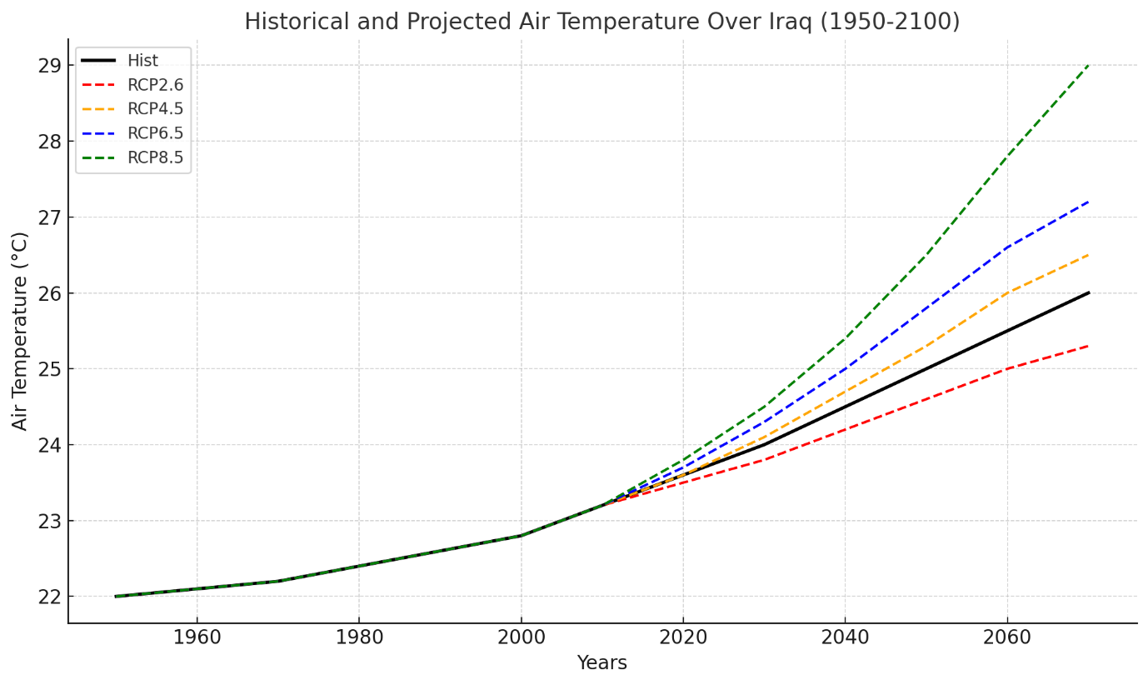
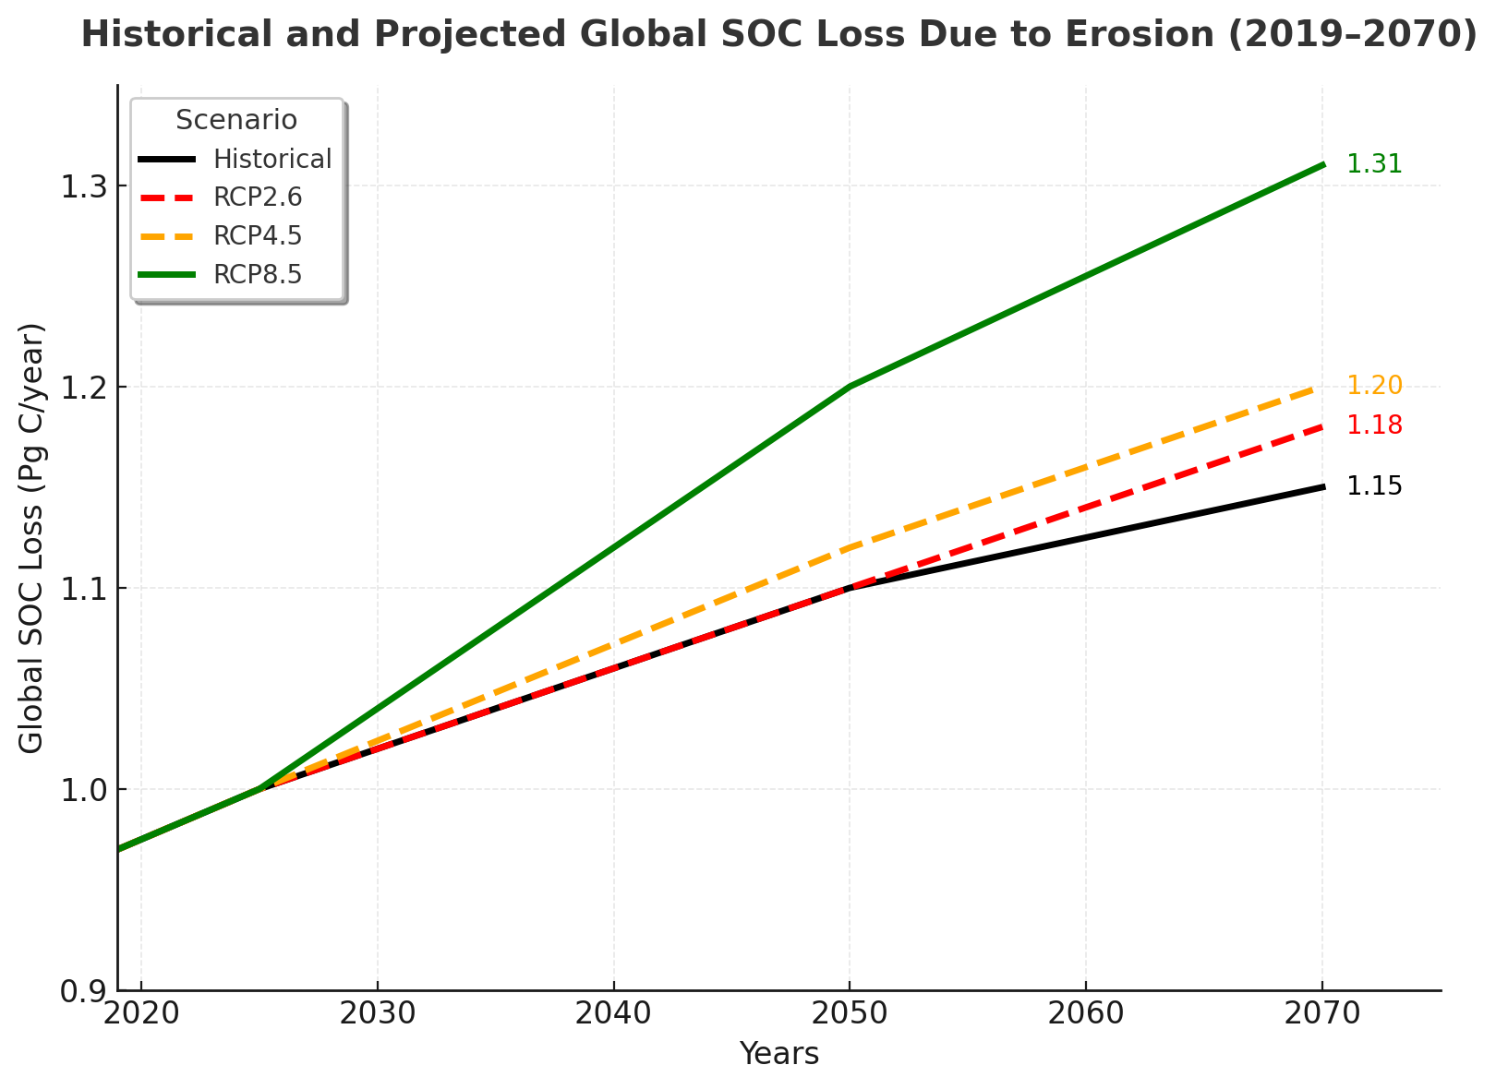
FigurHistorical and Projected Temperature Changes in Iraq (1950-2100) Based on RCP Emission Scenaros

Slide 3
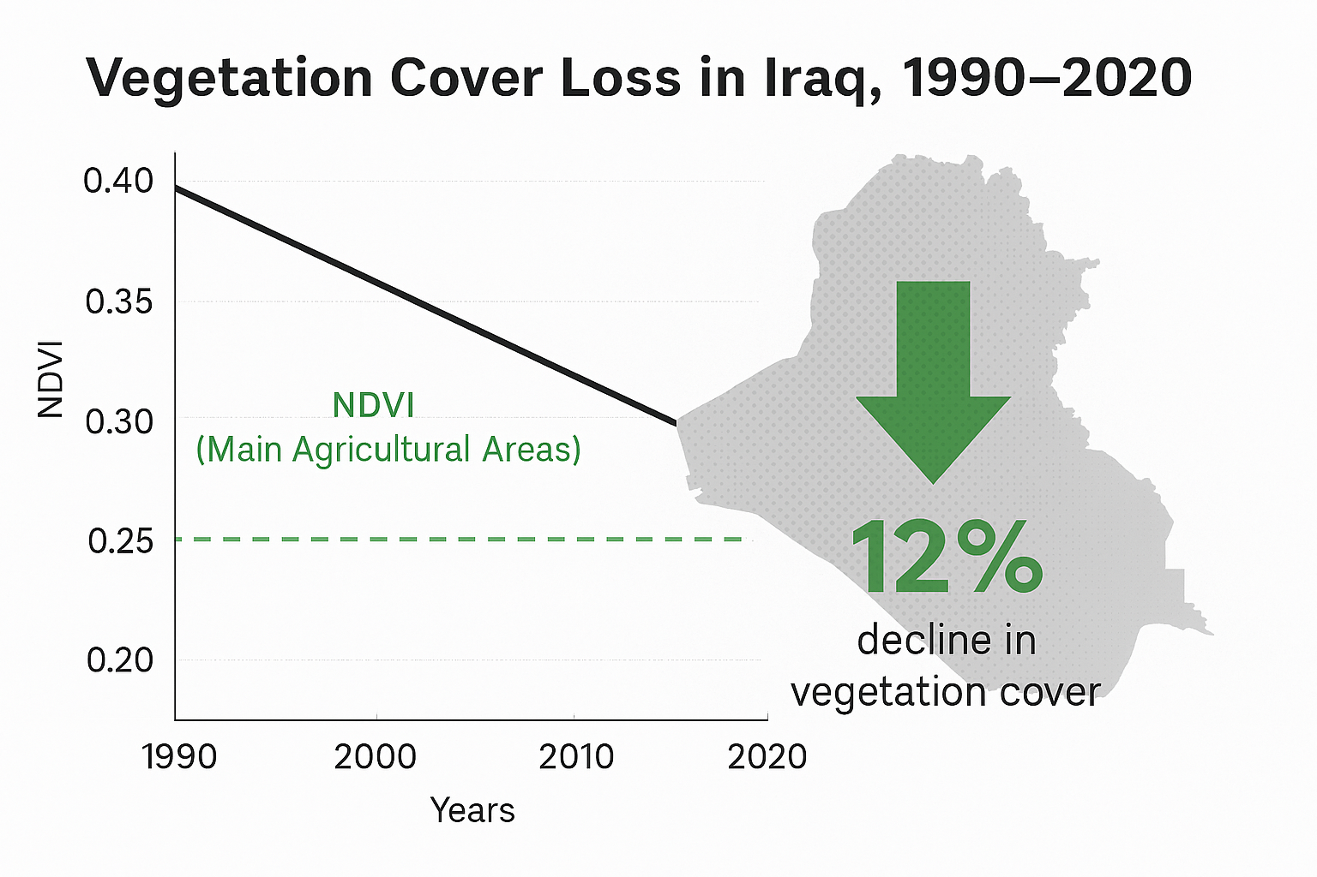
OUTLINE
Global warming in Iraq
This map represents the Land Use and Land Cover (LULC) distribution across Iraq

Slide 4
Short introduction
Salinity creates a multi-trait stress problem, not a single yield problem.
Main aim
Salinity reduces crop performance through osmotic stress, ion imbalance and metabolic disruption.
To describe growth, yield, chlorophyll and biochemical response signatures of Q21 quinoa under a saline field background.
Quinoa is salt-tolerant, but its response still depends on genotype, stress intensity and growth stage.
The study therefore reads the plant as a set of response signatures.
Nano-fertilizers may support plant performance, but the effect depends on the formulation, dose and trait measured.
Growth
Yield
SPAD
Biochemical markers
02
Notes:
The introduction should be short: salinity affects many traits, and nano-fertilizer response is expected to be formulation-specific.

Slide 5
Materials and methods: site and crop
Field screening of Q21 quinoa at Jurf Al-Naddaf, Baghdad.
Q21
4 Nov
5.0 × 2.5 m
22
5.5
5.0→4.5
quinoa genotype
sowing date
2025
field bed
irrigations
recorded
soil EC
dS m⁻¹
irrigation EC
dS m⁻¹
Seasonal context
Purpose of the saline setting
The crop cycle moved from mild establishment conditions to a cooler mid-winter period and a warmer spring.
This background allowed screening of formulation behavior under real saline field conditions.
Q21 quinoa • nano-fertilizer response signatures • saline field background
04
Notes:
The method begins with the field context: Q21 was grown in a saline field, with saline irrigation and a complete season.

Slide 6
Materials and methods: foliar formulations
C
Six treatments were compared; sprays were applied twice.
Control
No nano/humic foliar spray
Application
H
Humic acid
Humic acid 1 g L⁻¹
Spray 1:
four-leaf stage
TZH
Ti + Zn + humic
TiO₂ 80 mg L⁻¹ + ZnSO₄ 2 g L⁻¹ + humic
TH
Ti + humic
TiO₂ 80 mg L⁻¹ + humic
Spray 2, 3, 4:
two weeks later from each others
TAZ
Ti + Ag + Zn
TiO₂ 80 mg L⁻¹ + ZnSO₄ 2 g L⁻¹ + AgO₂ 80 mg L⁻¹+ humic
ZH
Zn + humic
ZnSO₄ 2 g L⁻¹ + humic
05
Notes:
This slide names the treatments and makes the important limitation clear: TAZ cannot be interpreted as an Ag dose-response.

Slide 7
Measurements and data treatment
The analysis was descriptive because independent plot replication was not verified for all endpoints.
Measured traits
• Plant height
• 1,000-seed weight
• Inflorescences per plant
• SPAD
• Seed number per inflorescence
• IAA and GA
• Seed yield
• Myo-inositol and biotin
Statistical handling
Mean ± SD was used for plant-level height and inflorescence counts. Treatment-level values were reported as recorded. No ANOVA or Tukey test was used.
Exploratory screening
Q21 quinoa • nano-fertilizer response signatures • saline field background
06
Notes:
The measurements covered growth, reproduction, chlorophyll and biochemical markers. Because the archived design was incomplete, the interpretation remains descriptive.

Slide 8
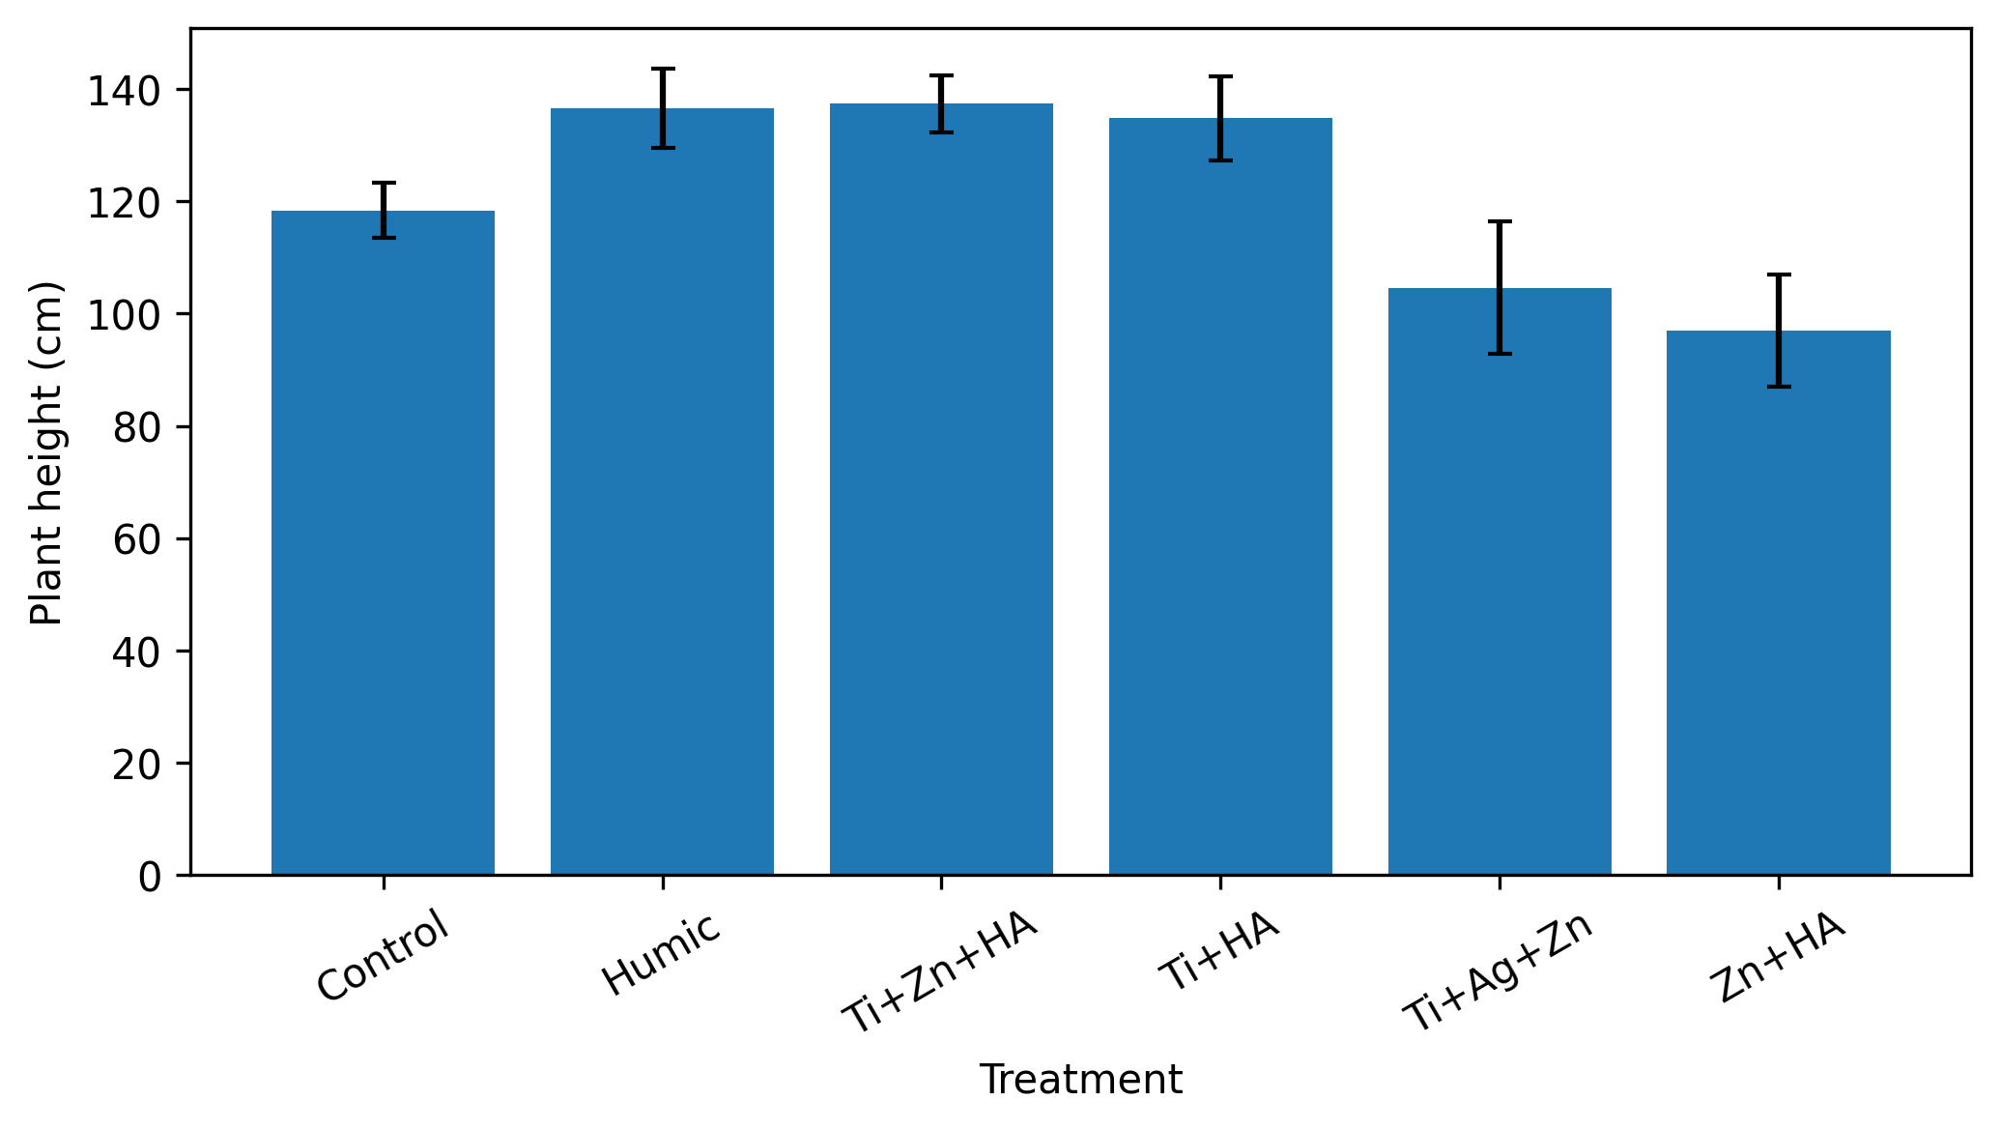
Result 1: vegetative growth
Plant height was highest under Ti + Zn + humic acid.
Strongest recorded height
TZH
137.4 cm
Close followers: Humic acid and Ti + humic acid.
Take-home: tall plants were not automatically the highest-yielding plants.
Q21 quinoa • nano-fertilizer response signatures • saline field background
07
Notes:
The highest vegetative response was TZH. However, this did not mean it had the highest yield.

Slide 9
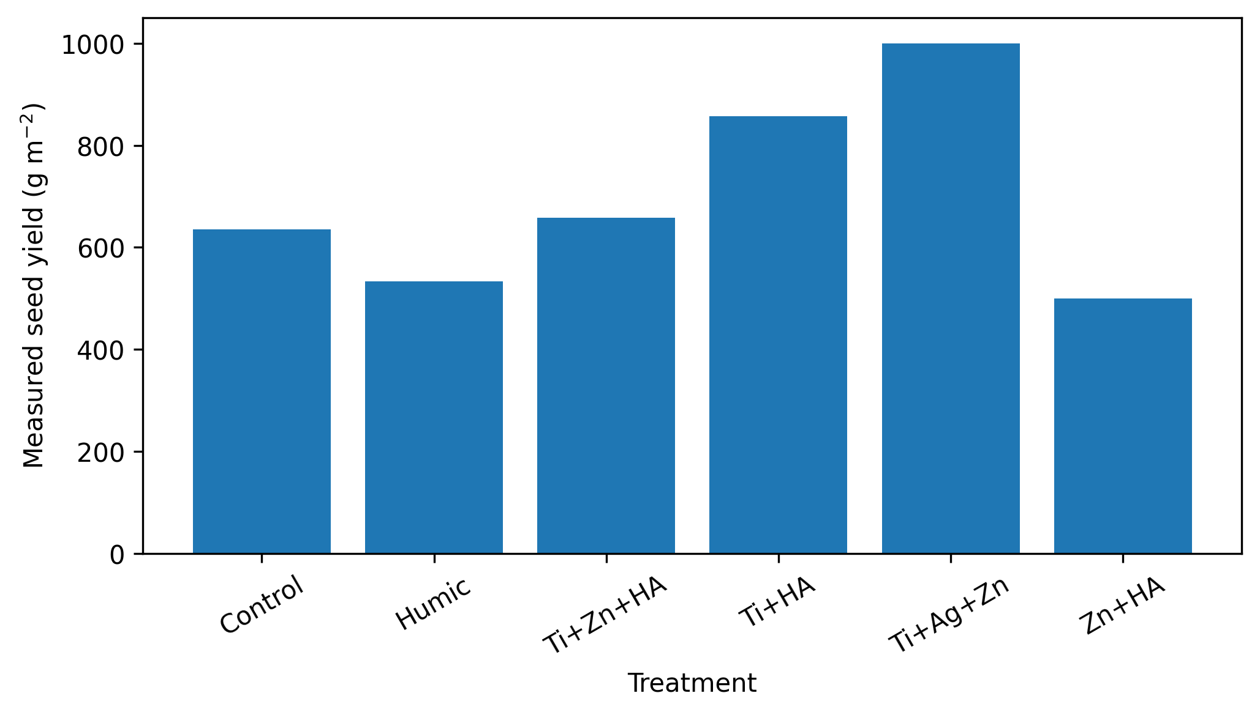
Result 2: seed yield
The highest recorded yield was in Ti + Ag + Zn, followed by Ti + humic acid.
Best recorded yield
TAZ
1000 g m⁻²
+57.6% vs control
(descriptive contrast only)
Second: TH = 856.6 g m⁻²
Q21 quinoa • nano-fertilizer response signatures • saline field background
08
Notes:
TAZ gave the highest recorded treatment-level yield. TH ranked second. This is a descriptive result, not a statistical treatment effect.

Slide 10
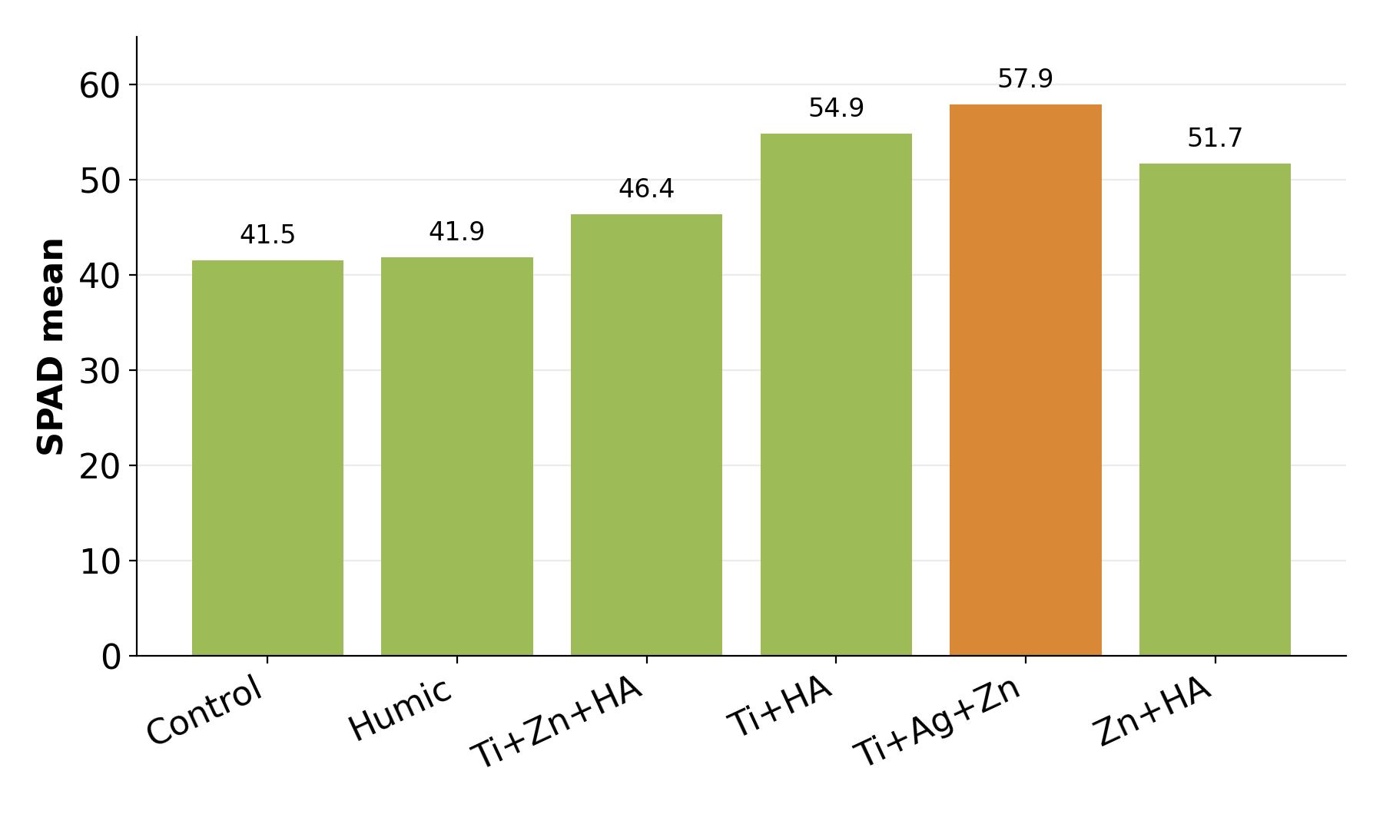
Result 3: chlorophyll and biochemical markers
Different markers selected different leading formulations.
Trait leaders
SPAD
TAZ
57.88
IAA
Humic
50.0 ng g⁻¹
GA
TZH
40.0 ng g⁻¹
Myo-inositol
Humic
300.0 µg g⁻¹
Biotin
Humic
15.0 ng g⁻¹
Lowest biochemical marker values were recorded in Zn + humic acid.
Q21 quinoa • nano-fertilizer response signatures • saline field background
09
Notes:
TAZ led SPAD, humic acid led three biochemical markers, and TZH led GA. This again supports a trait-specific pattern.

Slide 11
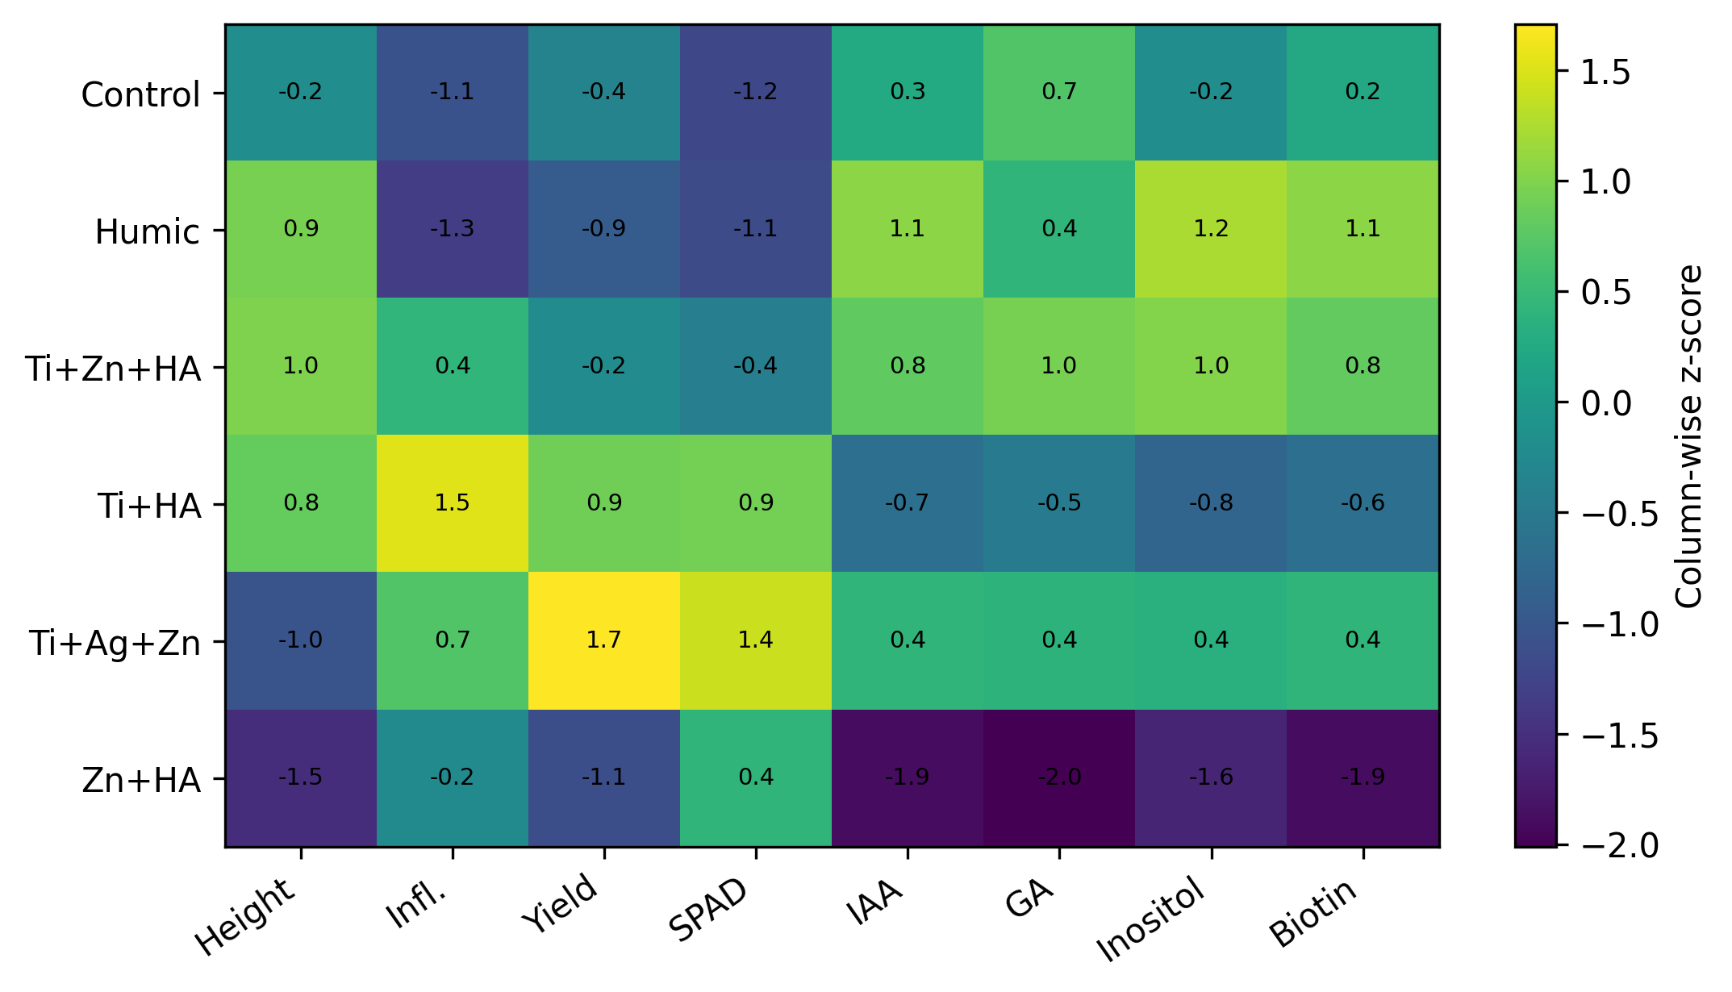
Overall response map
The standardized matrix shows non-parallel responses across traits.
Interpretation
TZH
height + GA
TH
inflorescences + seed number
TAZ
yield + SPAD
Humic
IAA + myo-inositol + biotin
No formulation ranked first across all domains.
10
Notes:
The heatmap is the central message of the presentation: the formulations created different response signatures, not one uniform positive response.

Slide 12
Conclusion and recommendation
The evidence supports response signatures, not a universal best formulation.
Conclusion
Best by trait
Q21 completed the saline-field season in central Iraq. The nano-fertilizer responses were clearly trait-specific.
Height: TZH
Reproductive counts: TH
Yield and SPAD: TAZ
IAA, myo-inositol, biotin: Humic
Recommendation for the next trial
Use independent randomized replicated plots, complete dose records, plot-level yield replication, and targeted ionomic/metabolomic confirmation.
Keep claims conservative
11
Notes:
The conclusion is simple: Q21 performed through the season, but the best formulation depends on the target trait. The next step is a fully replicated efficacy trial.

Slide 13
Selected references
Thank you
for your attention
• Olmos et al. 2024 — salt-tolerance mechanisms in quinoa.
• Yousfi et al. 2025 — irrigation salinity effects on quinoa yield and quality.
• Kwaslema & Michael 2024 — nanomaterials × plants under salinity stress.
Questions?
• Turkoglu et al. 2024 — ZnO nanoparticles and salinity response in quinoa.
• Salim et al. 2024 — Q21 performance across Iraqi sites.
Raghad S. Mouhamad • Scientific Research Commission
Notes:
Close by thanking the audience and inviting questions. The listed references support the salinity, nano-fertilizer and Q21 genotype context.

