Slide 1
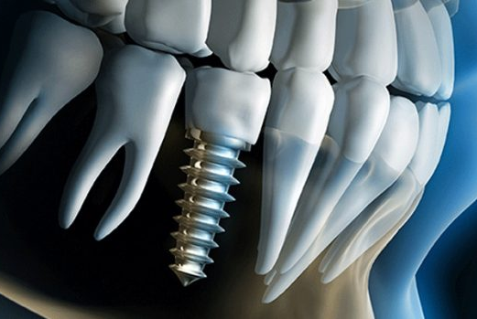
STRESS INTERACTION BETWEEN MANDIBULAR BONE AND IMPLANT WITH MAXIMUM DIAMETER USING FEA
WAN MUHAMAD AMRIZAM
BIN W MOHD AZMI
(UNIMAP)

Slide 2
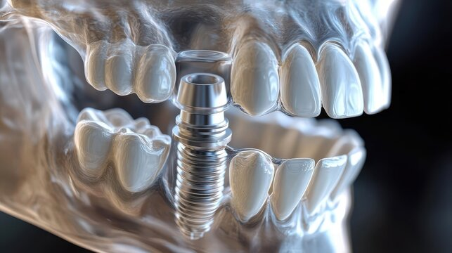
INTRODUCTION
Implant diameter and bone quality are two major factors that influence the biomechanics of an implant-supported prosthesis
The larger diameter offers greater primary stability, especially in areas with dense bone, such as the posterior mandible
However, limited studies have been specially planned in this position. Reaction of implant diameter on bone stress distribution and implant stability in this region remain unclear.
OBJECTIVE
To identify the von misses stress distribution on trabecular bone and cortical bone at mandibular bone after react with single prostheses supported implants using the Finite Element Analysis (FEA) method.

Slide 3
ANALYSIS PLANNING
Selected implant
(size & diameter)
Identify material properties
(implant, cortical and trabecular bone)
Create model
(Catia V5R21)
Run an analysis
(Abaqus CAE)
Result discussion

Slide 4
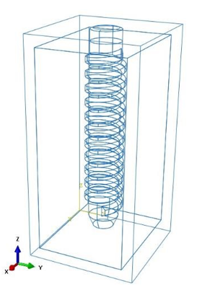
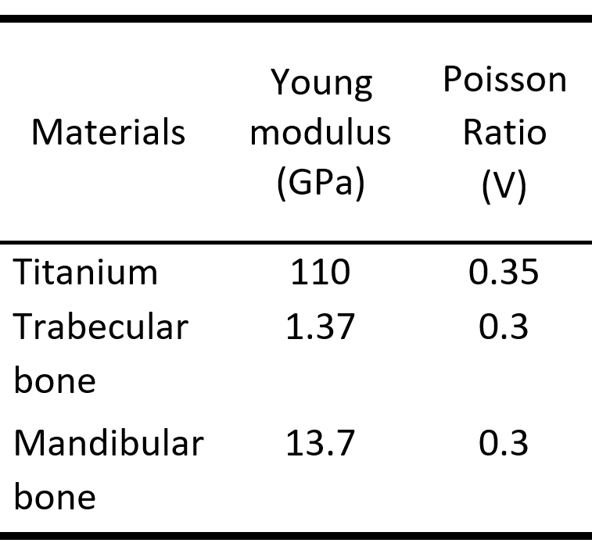
SELECTED IMPLANT
CREATE MODEL
IDENTIFY MATERIAL PROPERTIES

Slide 5
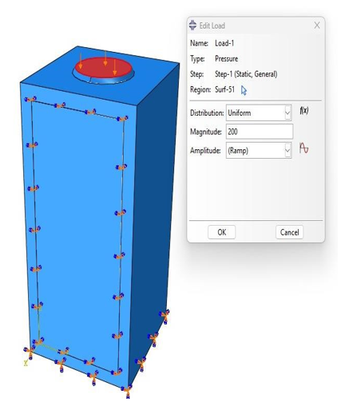
CREATE MODEL
ANALYSIS SETTING

Slide 6
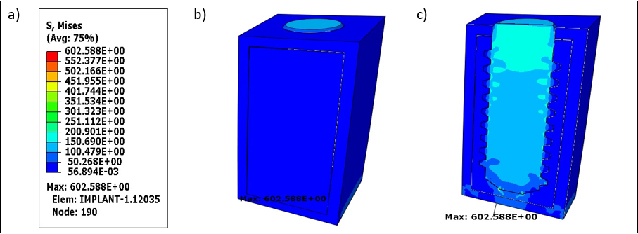
RESULT

Slide 7
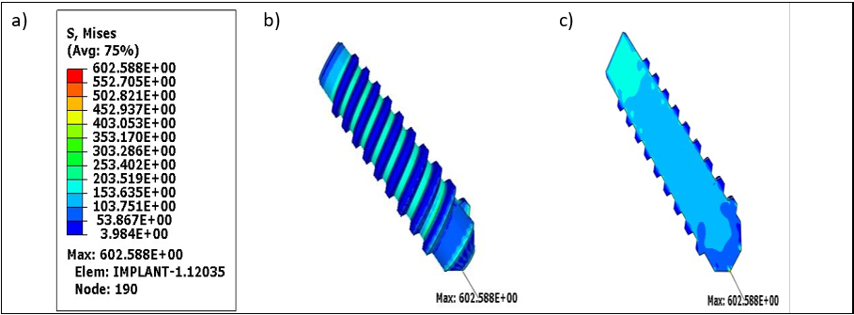
RESULT

Slide 8
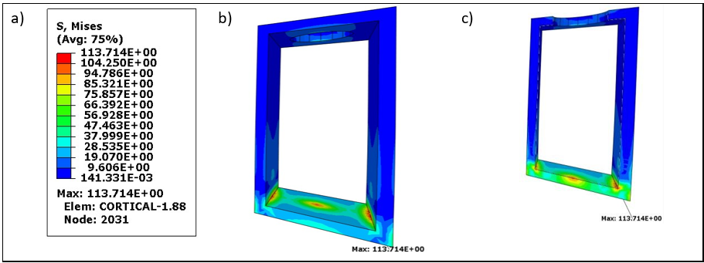
RESULT

Slide 9
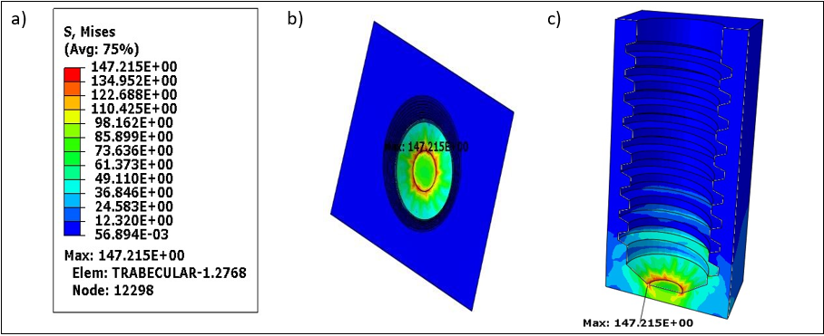
RESULT

Slide 10
RESULT DISCUSSION

Slide 11
CONCLUSION
The study's conclusion is that the value obtained is appropriate. To ensure that the values obtained are safe, however, model improvements must be made. This study needs to be validated with clinical to ensure the results obtained are accurate. If this stress is found to be too high in a clinical context, there needs to be an adjustment in the design and simulation.
THANK YOU

