Slide 1
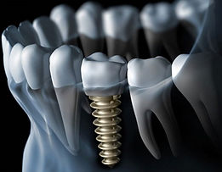
EFFECT ON STRESS DISTRIBUTION WITH MINIMUM IMPLANT DIAMETER TOWARDS MANDIBULAR BONE USING FEA
WAN MUHAMAD AMRIZAM BIN W MOHD AZMI
(UNIMAP)

Slide 2
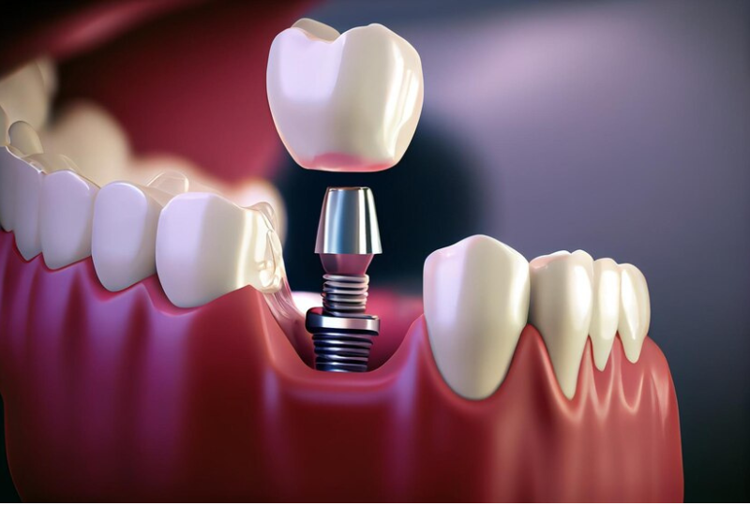
INTRODUCTION
Implants with a diameter of 3.5mm are often chosen for cases with narrow bony ridges or limited interdental space
Mini-implants carry mechanical risks including fracture of implant fixture and reduction in resistance to the occlusal force due to their smaller-diameter
Previous studies have reported the potential risks that might occur as the diameter of implant lessens
OBJECTIVE
To identify the von misses stress distribution on trabecular bone and cortical bone at mandibular bone after react with single prostheses supported implants using the Finite Element Analysis (FEA) method.

Slide 3
ANALYSIS PLANNING
Selected implant
(size & diameter)
Identify material properties
(implant, cortical and trabecular bone)
Create model
(Catia V5R21)
Run an analysis
(Abaqus CAE)
Result discussion

Slide 4
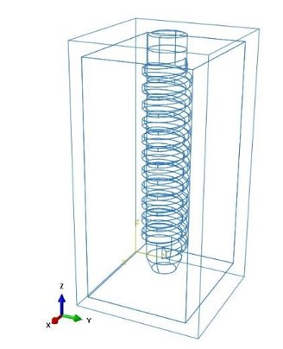
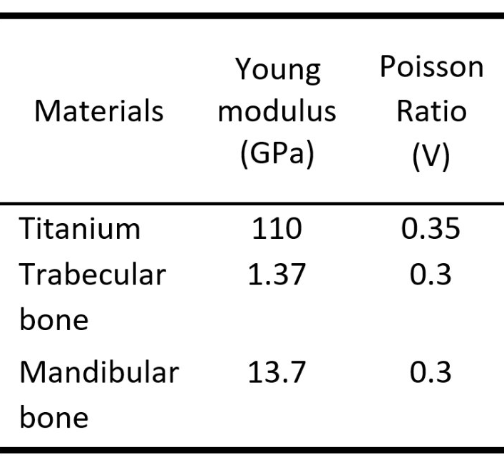
MODEL
SELECTED IMPLANT
MATERIALS PROPERTIES

Slide 5
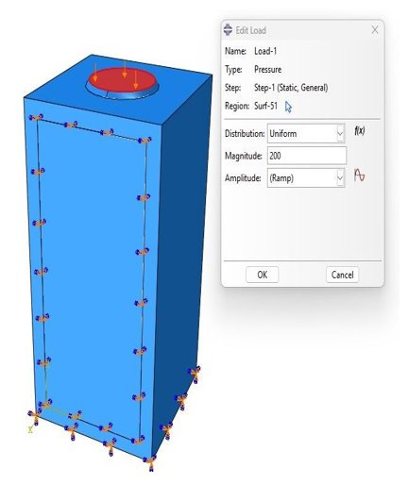
CREATE DESIGN
ANALYSIS SETTING

Slide 6
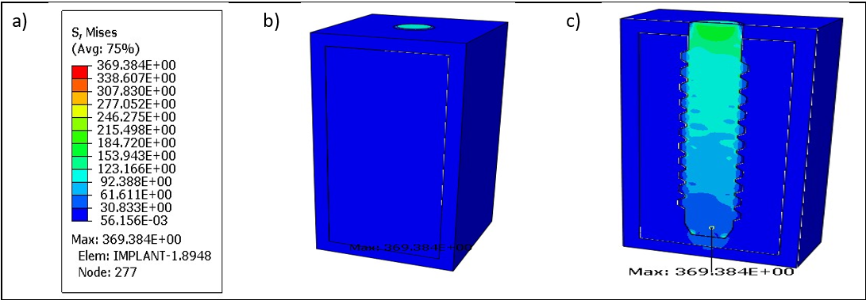
RESULT

Slide 7
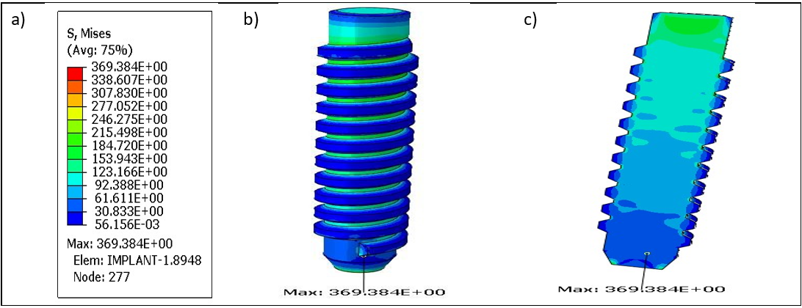
RESULT

Slide 8
RESULT

Slide 9
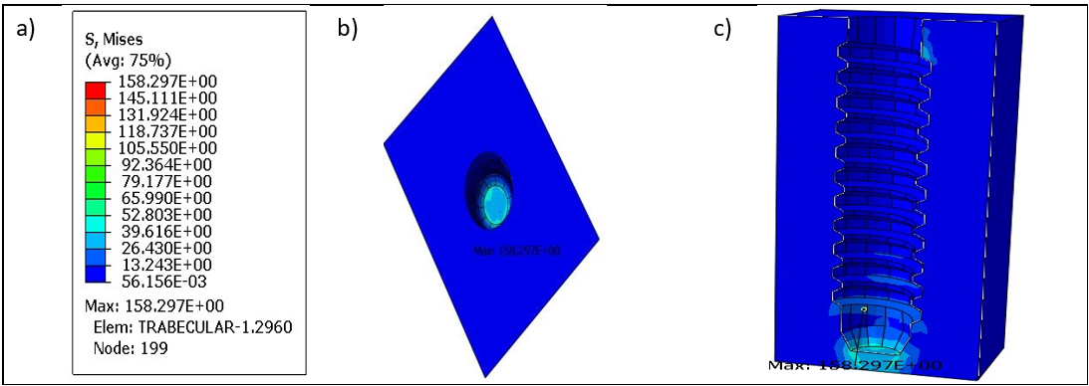
RESULT

Slide 10
RESULT DISCUSSION

Slide 11
CONCLUSION
Based on the study, the value obtained is acceptable. However, model improvements need to be done so that the obtained values are safe.
THANK YOU

