Slide 1
ENHANCING WELD QUALITY THROUGH TIG/MIG HYBRID WELDING: A CFD APPROACH ON THE INVESTIGATION OF CURRENT DENSITY DISTRIBUTION AND HEAT FLUX
International Conference on Mechanical System
Engineering and Technology Applications (ICoMSETA)
Authors: Aisyah Arina Mohammad Shahrazel, Nor Zaiazmin Yahaya, Mohamad Shaiful Ashrul Ishak, Ahmad Nazri Dagang, Mohd Fadzil Abdul Kadir, Sarizam Mamat
Affiliations: Universiti Malaysia Perlis, Universiti Malaysia Terengganu, Universiti Sultan Zainal Abidin, Universiti Malaysia Kelantan

Slide 2
Contents
International Conference on Mechanical System
Engineering and Technology Applications (ICoMSETA)
Problem Statement
Methodology
Results: Thermal-Electric Analysis
Results: Fluent Analysis
Discussion
Conclusion
Introduction

Slide 3
Introduction
International Conference on Mechanical System
Engineering and Technology Applications (ICoMSETA)
The importance of welding process optimization
We investigating current density distribution and heat flux in TIG/MIG hybrid welding using CFD
ANSYS software has been used for thermal-electric and Fluent analysis

Slide 4
Problem Statement
International Conference on Mechanical System
Engineering and Technology Applications (ICoMSETA)
Traditional Challenges: Costly and extensive real world testing in welding
Proposed Solution: Numerical simulation using CFD to optimize welding parameters

Slide 5
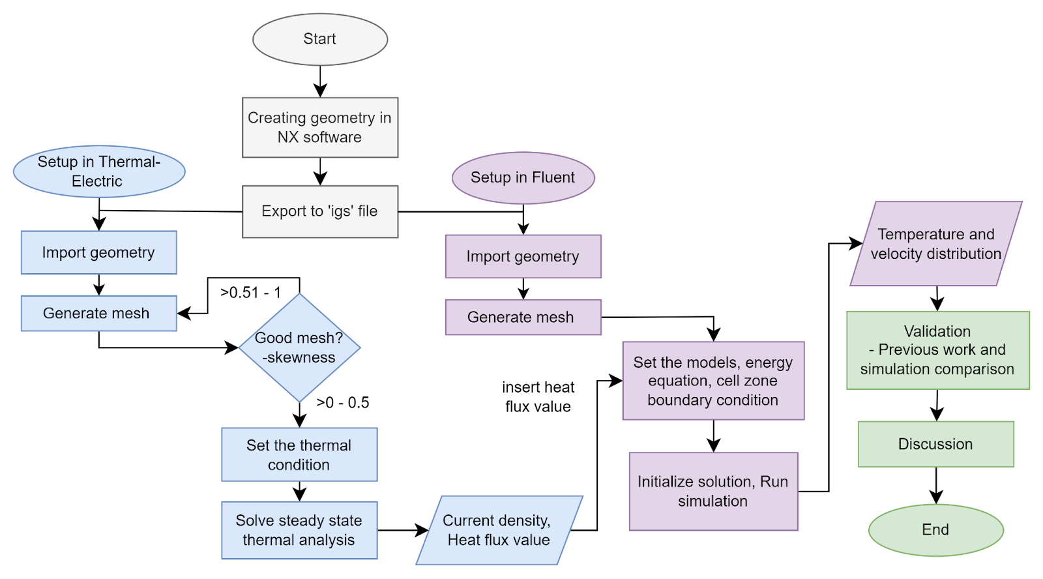
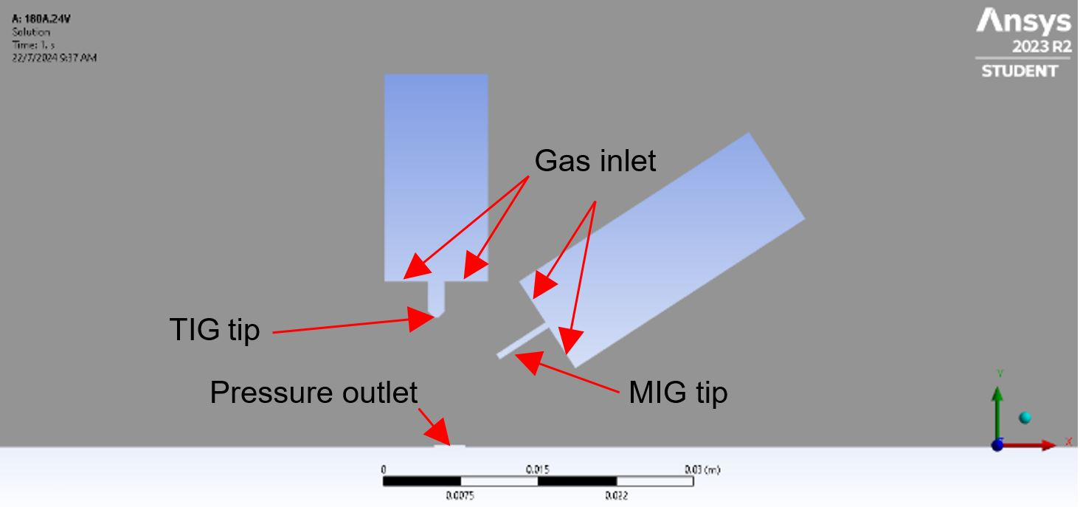
Methodology
International Conference on Mechanical System
Engineering and Technology Applications (ICoMSETA)

Slide 6
Results: Thermal-Electric Analysis
International Conference on Mechanical System
Engineering and Technology Applications (ICoMSETA)
Current density distribution for 3 sets:
Observations: Higher current leads to increased current density, especially near the TIG tip
TIG TIP
MIG TIP

Slide 7
Discussion
International Conference on Mechanical System
Engineering and Technology Applications (ICoMSETA)
The impact of current and voltage on welding quality
To produce the extreme heat needed to melt the base and the charge components, this current concentration is essential. The most electrically active region, indicated by the red zone, indicates the strongest welding arc and may have a direct impact on weld quality, as higher current density can be heated more intensely, affecting penetration depth. Giving deep penetration and strong fusion of materials can improve the efficiency of the welding process.

Slide 8
Results: Thermal-Electric Analysis
International Conference on Mechanical System
Engineering and Technology Applications (ICoMSETA)
Heat flux at TIG and MIG tip for 3 sets:
Observations:
The heat flux value at each MIG tip and TIG tip did not change even though there have been changes to higher voltages and the current value
TIG TIP
MIG TIP

Slide 9
Discussion
International Conference on Mechanical System
Engineering and Technology Applications (ICoMSETA)
The importance of heat flux and it influence the temperature distribution
The heat flux value is important in the heat transfer process. Accurate control of heat flux is essential for predicting and controlling the thermal stresses and distortions for achieving the desired thermal distribution.
This may influence the microstructure and mechanical properties of the welded joint. It ensures that the energy from the welding processes is efficiently utilized, leading to improved weld quality and reduced defects

Slide 10
Discussion
International Conference on Mechanical System
Engineering and Technology Applications (ICoMSETA)
Error variation
The error of variation calculation against Cui et al.'s work
2.16% for TIG tip and 4.96% for MIG tip in heat flux compared to experimental values
Can be used in Fluent analysis

Slide 11
Results: Fluent Analysis
International Conference on Mechanical System
Engineering and Technology Applications (ICoMSETA)
Temperature Distribution:
Velocity Distribution:
TIG TIP
MIG TIP
TIG TIP
MIG TIP
Maximum temperature recorded at 3409.77°C
Maximum velocity of 7.73 m/s

Slide 12
Discussion
International Conference on Mechanical System
Engineering and Technology Applications (ICoMSETA)
Temperature distribution
The red zone represents the maximum heat concentration
High temperature critical for ensuring complete fusion of the material (~3500°C)
Velocity distribution
The velocity represents the molten material velocity.
Higher speeds can result in faster cooling rates, which can affect microstructure formation in the weld.

Slide 13
Conclusion
International Conference on Mechanical System
Engineering and Technology Applications (ICoMSETA)
Effective modeling of TIG/MIG hybrid welding using CFD
Key findings on current density and heat flux
Practical applications for improving welding quality
Future Work: Further experimental validation and exploration of current density effects on weld strength

Slide 14
Acknowledgments
International Conference on Mechanical System
Engineering and Technology Applications (ICoMSETA)
The authors would like to acknowledge the support from the Ministry of Higher Education Malaysia and Research Management Centre (RMC), Universiti Malaysia Perlis (UniMAP) for awarding the research grant under Collaborative Research Grant: project number: 9023-00025 undertaking this project.
THANK YOU
13

