Slide 1
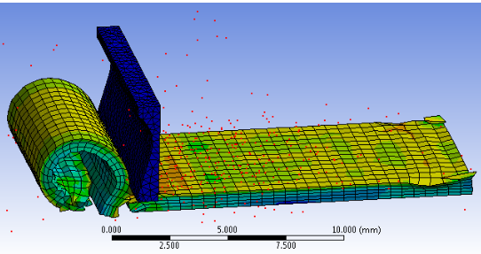
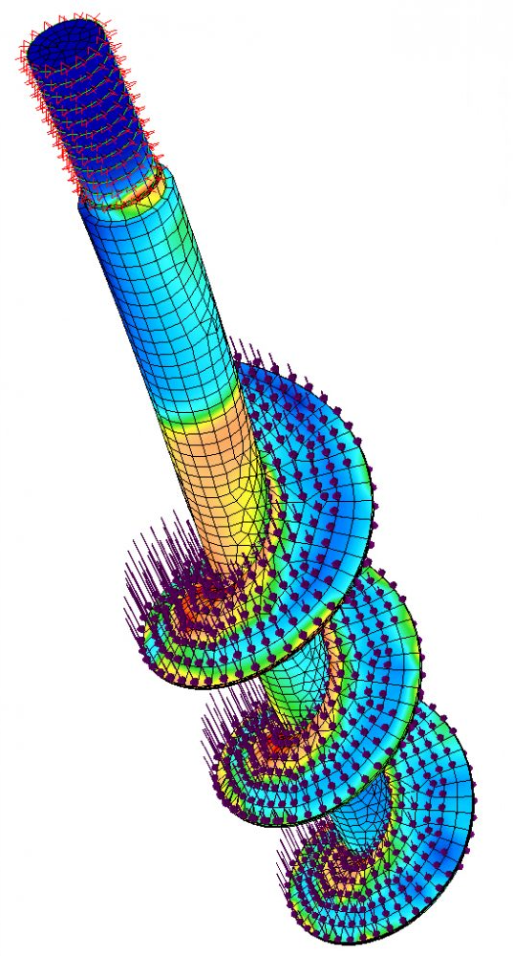
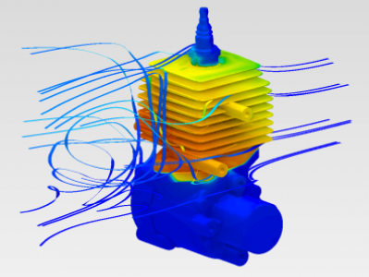
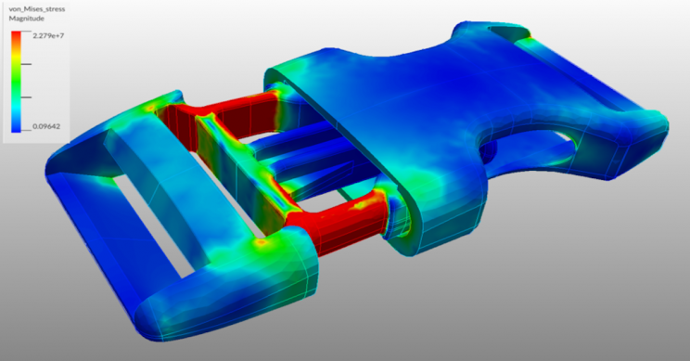
Design Optimization Of Polynomial Flexure Hinges For Enhanced Vibration-assisted Machining
Author:
Achmad Putra Sapujagad¹, Teddy Sjafrizal¹ and Rino Andias Anugraha¹
Telkom University¹

Slide 2
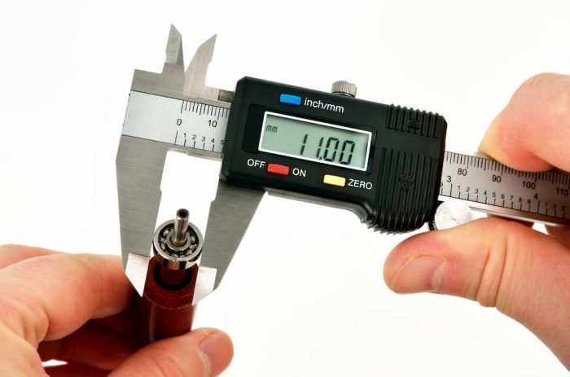
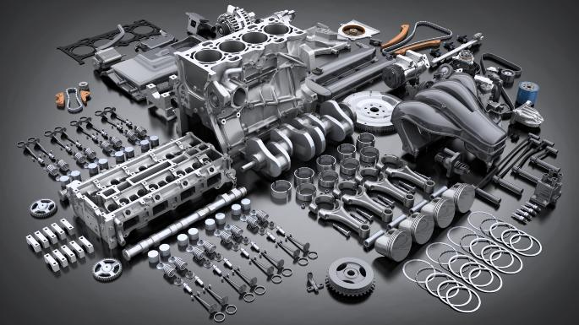
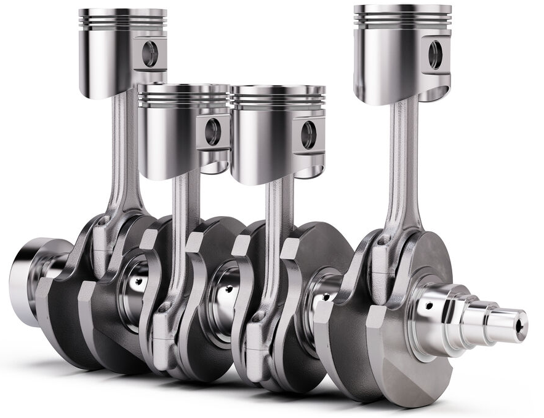
Why Ultrasonic Vibration-Assisted Machining (UVAM) ?
W = deformation (µm)
W = deformation (µm)
Feed direction
Precision results
Ultrasonic Vibration-Assisted Machining (UVAM) employs a vibrating tool that operates at frequencies exceeding 20,000 Hz, resulting in improved cutting quality.
1
2
3
4
Introduction

Slide 3
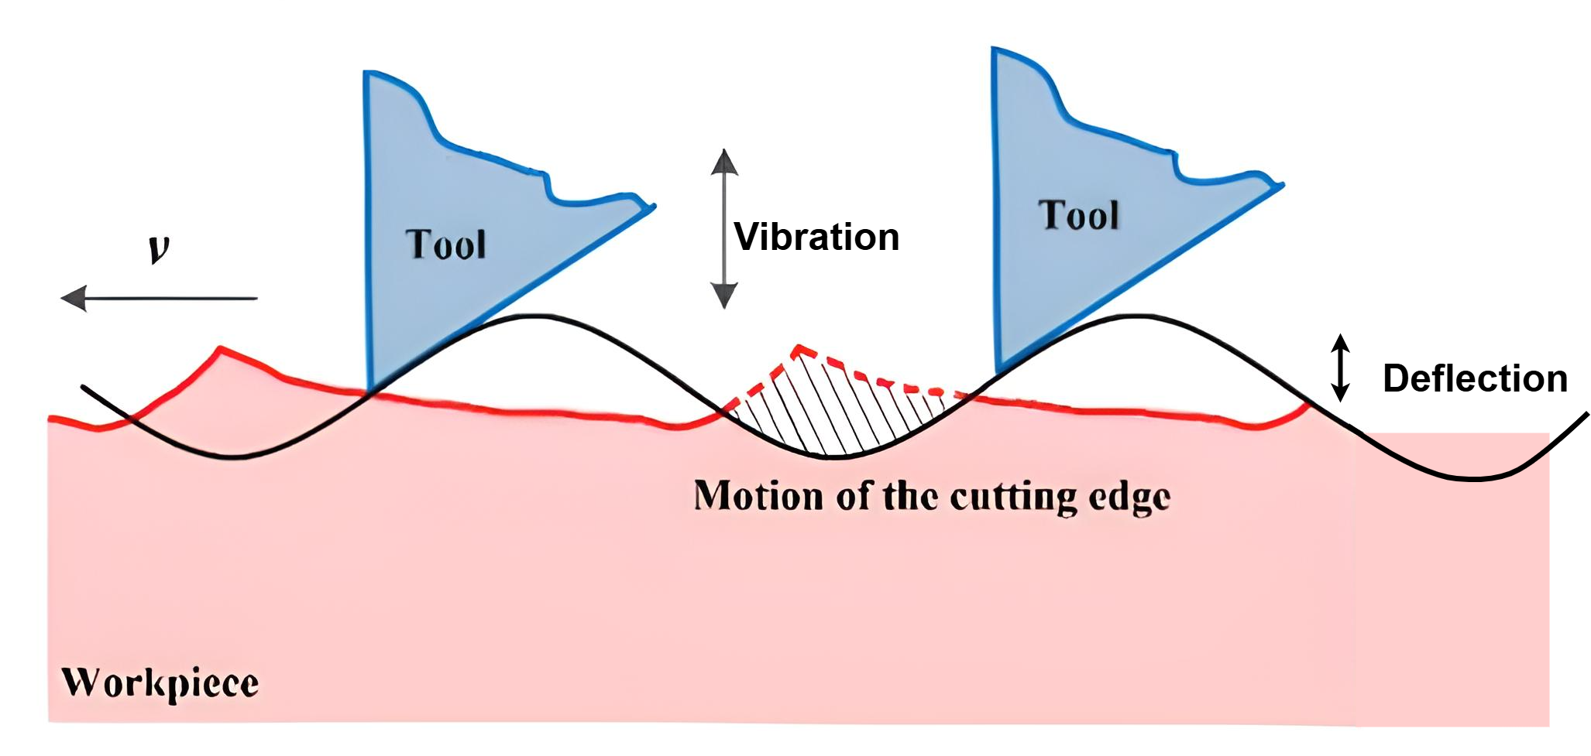
Why Ultrasonic Vibration-Assisted Machining (UVAM) ?
W = deformation (µm)
W = deformation (µm)
(Modified, from Rachmat et al, 2017)
(Sui et al, 2017)
Without a flexure hinge, the vibration tool actuated by piezoelectric actuators has an amplitude of only about 0.001 µm
(Li et al., 2019)
1
2
3
4
Introduction

Slide 4
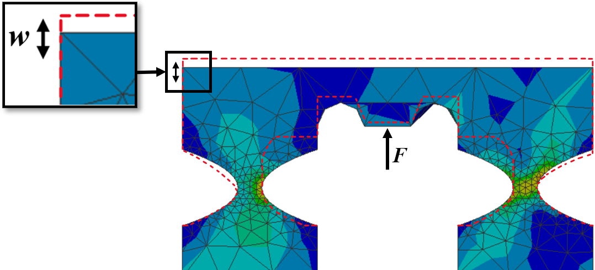
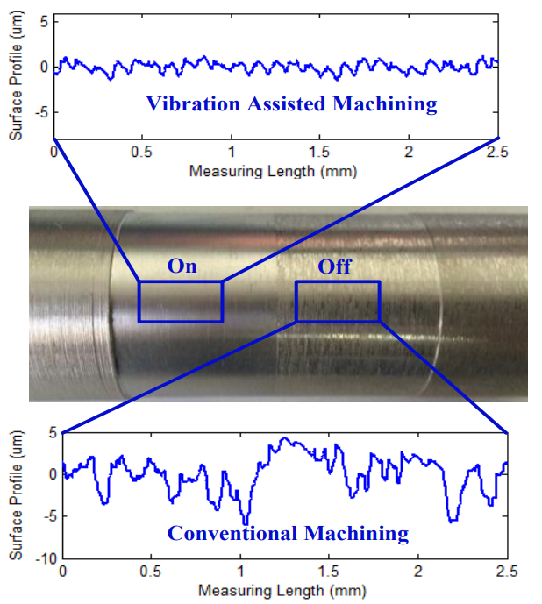
Deformation in flexure hinges and its effect on surface roughness
(Dimodifikasi, dari Wang dkk., (2021), © Author)
UVAM has been shown to significantly enhance surface roughness quality compared to conventional methods.
(Diambil, dari Gao dkk (2015), © Authors)
(Gao et al, 2015)
1
2
3
4
Introduction

Slide 5
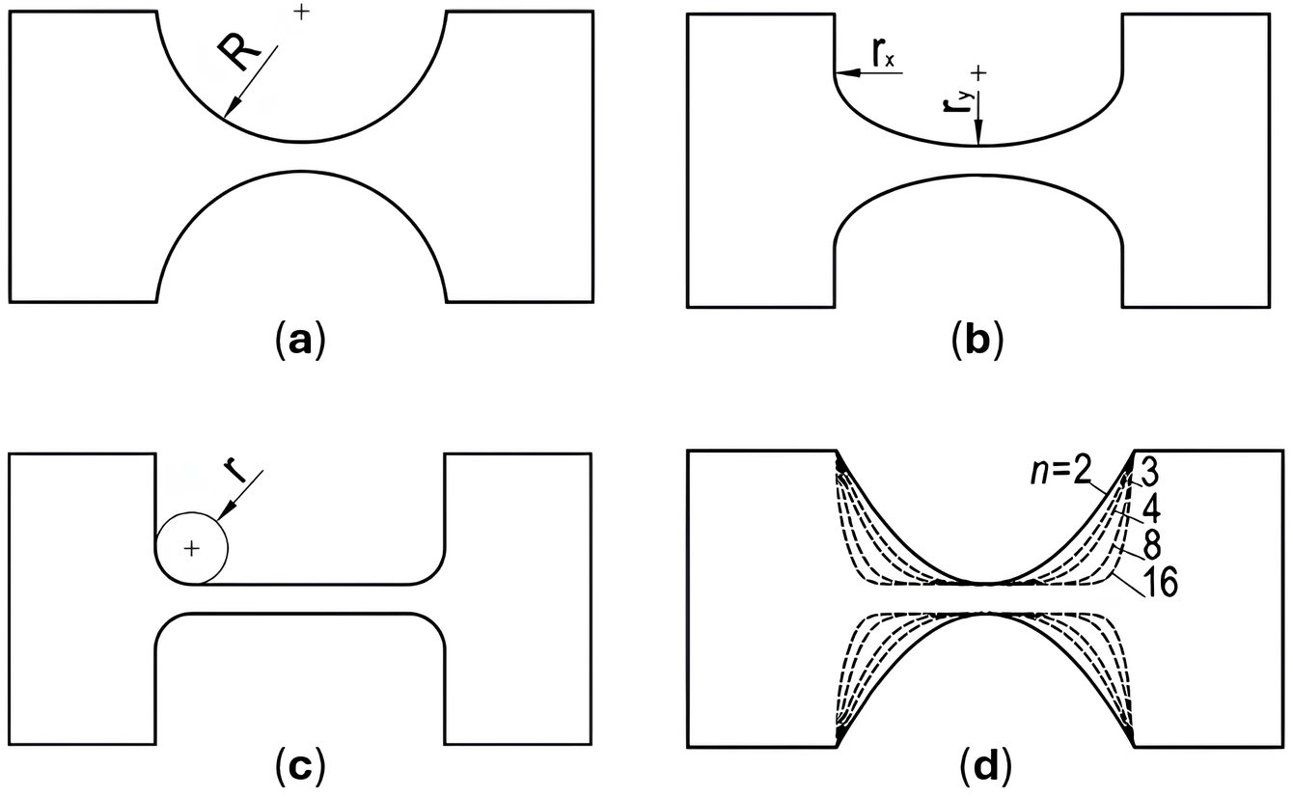
Types of flexure hinges
Commonly used types include semi-circular hinges, elliptical hinges, corner-filleted hinges, and polynomial hinges.
(Linß et al., 2017)
(Linß dkk., 2017)
1
2
3
4
Introduction

Slide 6
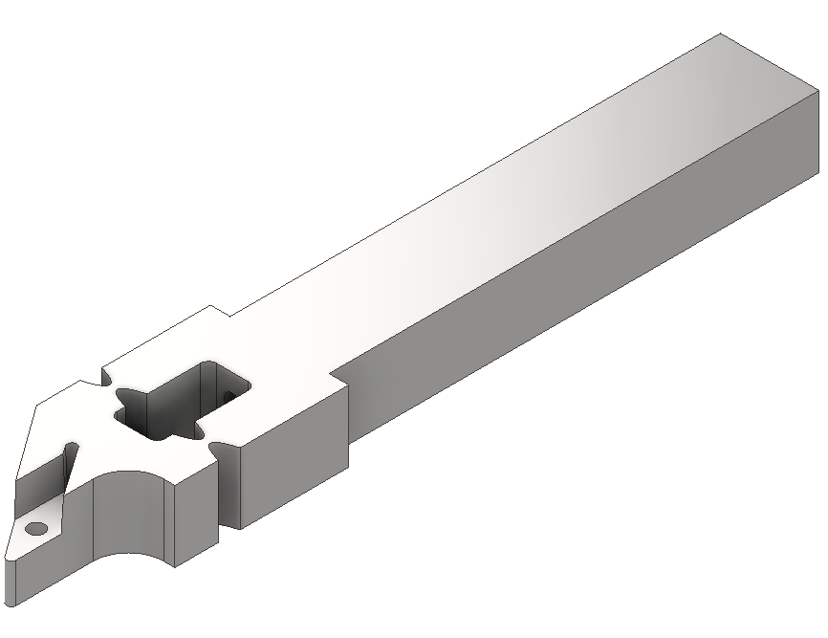
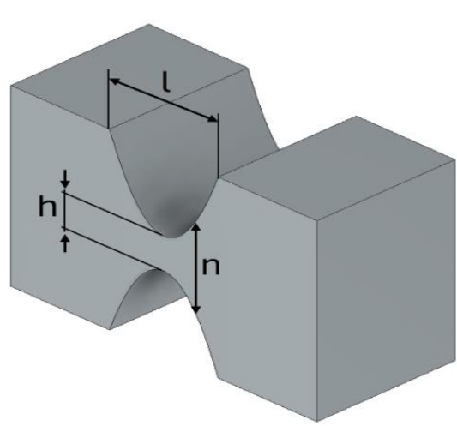
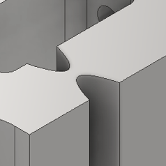
Polynomial Hinge’s structures that affects deformation
(Diambil, dari Gu dkk., (2018)
n = Orde polynomial
h= hinge thickness (mm)
l = length hinge (mm)
This study investigates the effect of polynomial hinge design parameters and optimal combination in maximizing deformation (w) and minimizing stress (σ)
1
2
3
4
Introduction

Slide 7
Design of Experiment
Software :
Ansys Workbench 2021 = Vibration Simulation
Autodesk Inventor 2023 = Modelling
Minitab 19 = Statistical Tool
Frequency = 20000 Hz
Actuated force (F) = 3500 N
Parameters | Level 1 | Level 2 | Level 3 | Level 4 | Level 5
Orde Polynomial | 2 | 3 | 4 | 8 | 16
Hinge thickness | 2 mm | 2.5 mm | 3 mm | 3.5 mm | 4 mm
Length Hinge | 5.5 mm | 6 mm | 6.5 mm | 7 mm | 7.5 mm
1
2
3
4
Introduction

Slide 8
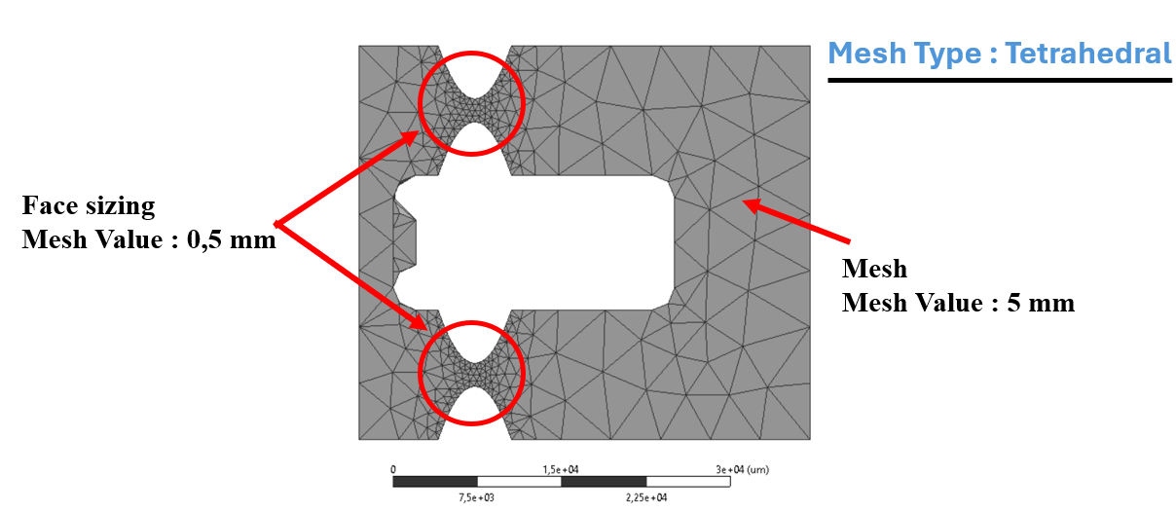
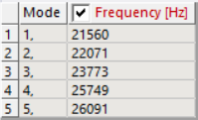
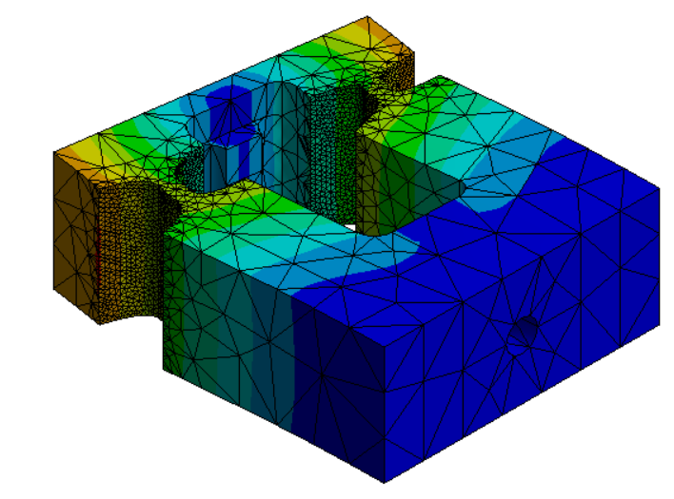
Vibration Simulation
1. Modal Analysis
The aim is to determine the natural frequency of each model.
The natural frequency shown by each model does not approach or match 20,000 Hz, therefore the simulation can proceed.
1
2
3
4
Introduction

Slide 9
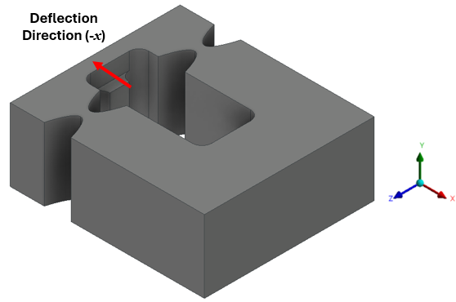
Vibration Simulation
2. Explicit Dynamic
To determine the deformation and stress in each model.
Deformation calculated is directed along the negative x-axis, and the maximum stress will be considered in the analysis.
1
2
3
4
Introduction

Slide 10
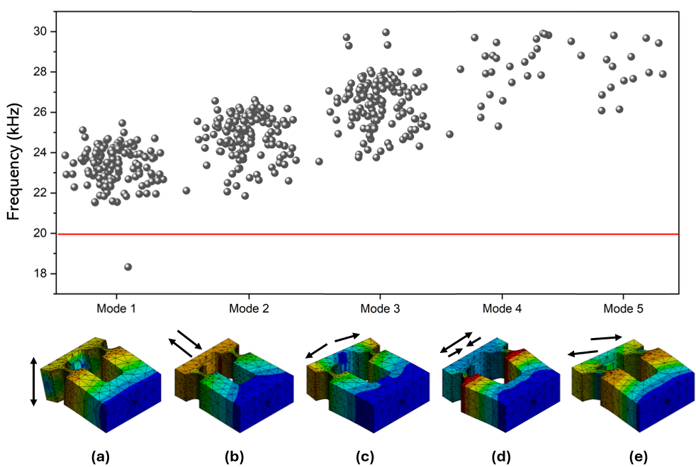
Output Modal : Natural Frequency
The frequency used is 20,000 Hz; however, the data distribution does not indicate any values close to this frequency.
1
2
3
4
Introduction

Slide 11
Design parameters that affect deformation
and stress ?
Explicit Dynamic
Results Analysis
The data indicate that the most influential parameter is hinge thickness, based on the obtained f-values: 73.9 for deformation and 162.56 for stress.
1
2
3
4
Introduction

Slide 12
Recap of Parameter Designs Response
to deformation and stress
Result | Parameter
Parameter | Orde polynomial (n) | Hinge thickness (t) | Hinge length (l)
Deformation (w)
Stress ($σ$)
$$σ=\frac{F}{A}$$
1
2
3
4
Introduction

Slide 13
Grey Relational Analysis Results
Rank | n | h | l | D $x_{i}(k)$ | S $x_{i}(k)$ | D $∆_{i}$ | S $∆_{i}$ | D $γ_{i}\left(k\right)$ | S $γ_{i}\left(k\right)$ | $$γ_{i}$$ | Stress (MPa) | Deformasi (µm)
1 | 2 | 4 | 6 | 0,053 | 0,996 | 0,947 | 0,004 | 0,346 | 0,992 | 0,669 | 39,123 | 1,479
2 | 3 | 2 | 6,5 | 0,000 | 1,000 | 1,000 | 0,000 | 0,333 | 1,000 | 0,667 | 37,978 | 0,278
3 | 16 | 2 | 7,5 | 1,000 | 0,000 | 0,000 | 1,000 | 1,000 | 0,333 | 0,667 | 308,300 | 5,928
4 | 2 | 4 | 5,5 | 0,092 | 0,988 | 0,908 | 0,012 | 0,355 | 0,977 | 0,666 | 41,173 | 0,718
5 | 3 | 4 | 5,5 | 0,059 | 0,990 | 0,941 | 0,010 | 0,347 | 0,981 | 0,664 | 40,620 | 0,528
6 | 2 | 4 | 7 | 0,056 | 0,990 | 0,944 | 0,010 | 0,346 | 0,981 | 0,664 | 40,562 | 0,512
7 | 2 | 4 | 7,5 | 0,066 | 0,988 | 0,934 | 0,012 | 0,349 | 0,977 | 0,663 | 41,217 | 0,569
8 | 16 | 2,5 | 5,5 | 0,062 | 0,987 | 0,938 | 0,013 | 0,348 | 0,975 | 0,662 | 41,383 | 0,543
9 | 2 | 4 | 6,5 | 0,042 | 0,986 | 0,958 | 0,014 | 0,343 | 0,972 | 0,658 | 41,838 | 0,432
10 | 4 | 4 | 5,5 | 0,073 | 0,980 | 0,927 | 0,020 | 0,350 | 0,962 | 0,656 | 43,270 | 0,606
Optimal design
1
2
3
4
Introduction

Slide 14
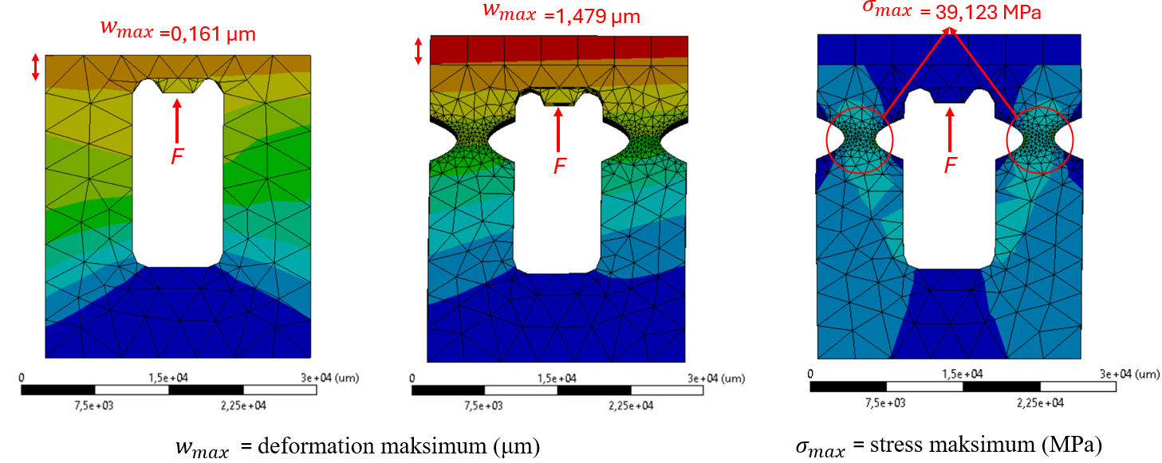
Optimization Results & With vs Without Flexure Hinge
The addition of a flexure hinge results in a deformation increase that is 9 times greater compared to the condition without a flexure hinge.
1
2
3
4
Introduction

Slide 15
Conclusion
The optimal parameter combination for maximizing deformation (w) and minimizing stress (σ) is achieved with a model featuring a polynomial order n=2, hinge thickness of 4 mm, and hinge length of 6 mm. This model results in a deformation of 1.479 µm, which is significantly greater compared to the maximum deformation of 0.161 µm observed without a flexure hinge. The resulting stress is also relatively low at 39.1 MPa
Main Contributions
This study is among the first to investigate the impact of polynomial hinges on deflection in Vibration Assisted Machining.
We successfully investigated the effect of changing the polynomial design parameters on deflection and stress using the finite element method.
We propose the optimal combination for developing UVAM vibration modul
1
2
3
4
Introduction

Slide 16
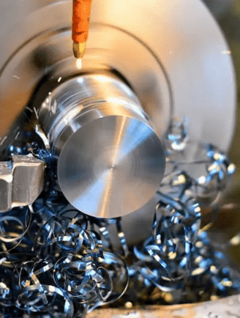
Thank You
1
2
3
4
Introduction

