Slide 1
Vibration Diagnostic Approach Utilising Finite Element Analysis on Reciprocating Machine for Offshore Facility
By:
Mohamed Fuad Al Farabi Shazi
Staff Engineer, Rotating Equipment
Presentation to ICoMSETA 2024
2 September 2024

Slide 2
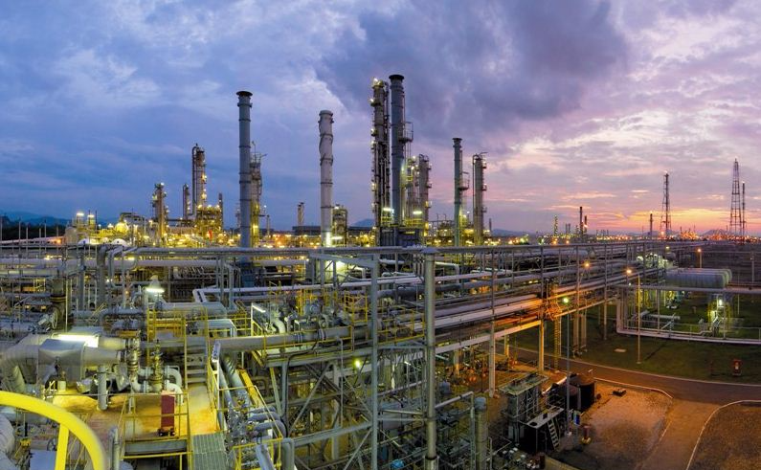








Content
1
Background
2
Equipment Overview
3
Event Chronology
4
Root Cause Analysis
5
Methodologies
6
Outcome & Discussion
7
Conclusion

Slide 3

1. Background
An unmanned offshore facility with 3 units of gas lift compression equipment (Unit-A, Unit-B, & Unit-C) has been operating for more than 20 years since commissioning.
Due to operational demand, changes were made on the operating philosophy with documented Management Of Change to identify potential risks or hazards with mitigated actions.
Multiple compressor failures were recorded since the change took place. Root Cause Analysis was performed and leads to the execution of advanced vibration analysis for a long-term resolution.

Slide 4


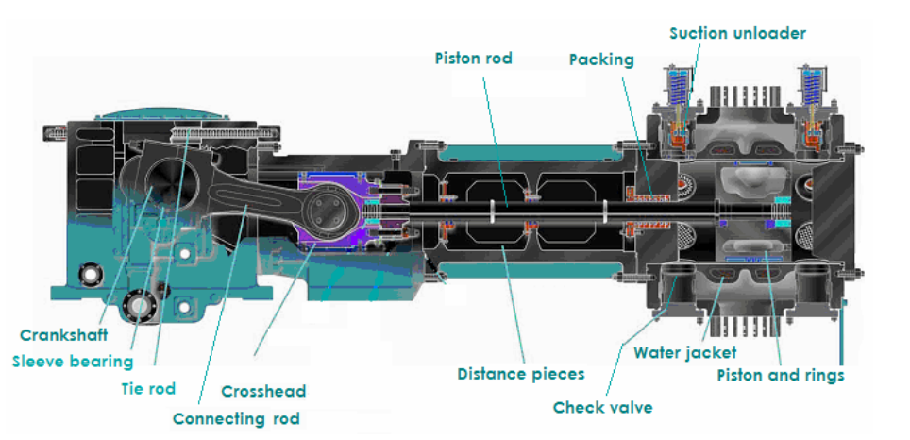
2. Equipment Overview
Features | Details
Construction | 2 Stage Reciprocating Compressor (2 throw)
Medium | Natural Gas
Service | Gaslift
Speed | Compressor: 375 rpm (6.25 Hz); Engine: 1110 rpm (18.5 Hz)
Philosophy | 3 X 50%
LP Gas
Inlet scrubber
HP Gas
2nd stg Scrubber
Cooler
Gas Engine
Speed Reducer
Compressor
2nd Stage Comp
Source: I (wordpress.com)

Slide 5
3. Event Chronology: The Timeline
Revised from
3 X 50% to
3 X 33.3%
Significant floor vibration around engine area
Deployed Frontline Maintenance Team
Commissioning & operation
New operating philosophy
1st piston failure
Overhaul + new piston
Restart compressor
2nd piston failure
Inspection
Consolidate findings
Resonance suspected
Material debris and wreckage
Piston nut loose
Suction scrubber auto-drain malfunction
Unit manually stopped due to knocking sound during walkabout surveillance
Suspected liquid carryover from scrubber
Failure observed on 1st stage

Slide 6
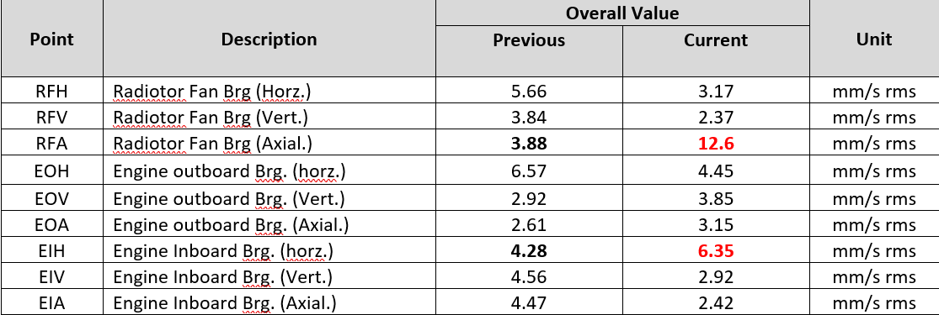
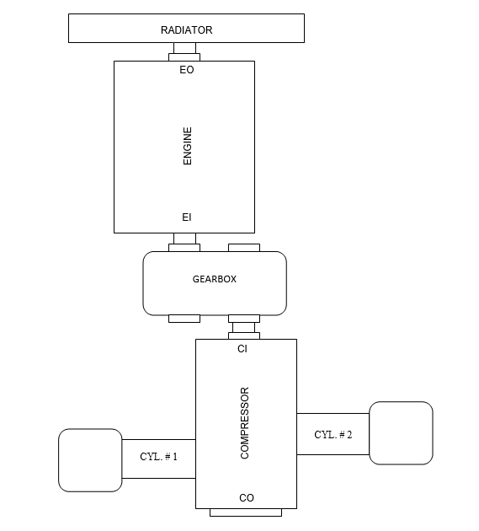
3. Event Chronology: Increase in vibration trending
Vibration exhibited on Unit-C shows increment in magnitude (taken when running all 3 compressors)

Slide 7
4. Root Cause Analysis
1
Auto-drain malfunction
No PPM – Manual Drain
Liquid carryover from scrubber
High moisture content
Changes in current gas composition
2
Casting process imperfection
No QA/QC report for the purchased component
Compressor Piston Multiple Failure
Material and manufacturing defect
Substandard material
X
3
Assembly failure
2 different assembly instruction by OEM
FOD into compressor
X
Prolonged vibration – mechanical looseness and other related failures
Operating close to structural natural frequency
4
Piston Half not intact
Piston nut loose
Inadequate/over torque
on piston nut

Slide 8

4. Root Cause Analysis
1
Auto-drain malfunction
No PPM – Manual Drain
Liquid carryover from scrubber
High moisture content
Changes in current gas composition
Experimental Modal Analysis was employed to resolve the RESONANCE issue
2
Casting process imperfection
No QA/QC report for purchased component
Compressor Piston Multiple Failure
Material & manufacturing defect
Substandard material
X
3
Assembly failure
2 different assembly instruction by OEM
FOD into compressor
X
Prolonged vibration – mechanical looseness & other related failures
Operating close to structural natural frequency
4
Piston Half not intact
Piston nut loose
Inadequate/over torque
on piston nut

Slide 9

5. Methodologies
IDENTIFY
Develop
6 Steps To Resolve Resonance Using Modal Analysis
Resolving Resonance Issue
Verify
Simulate
Modify
Affirm

Slide 10
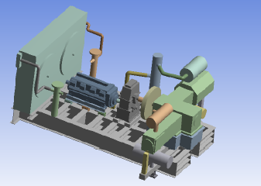
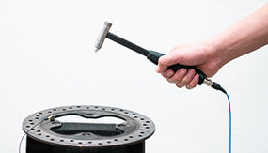
5. Methodologies
IDENTIFY
1
Structural skid Bump Test
DEVELOP
Identify existing natural frequencies
Best performed during Turnaround
RESOLVING RESONANCE ISSUE
VERIFY
SIMULATE
MODIFY
AFFIRM

Slide 11
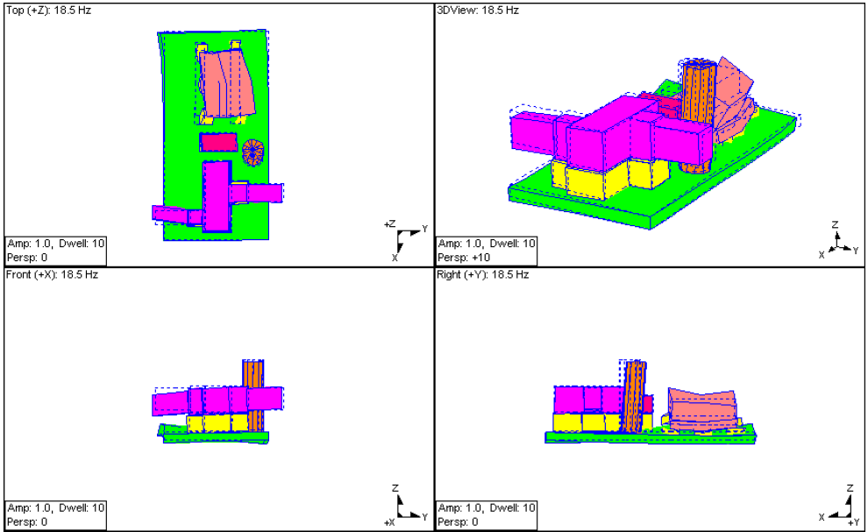
5. Methodologies
2
Model Development
IDENTIFY
DEVELOP
FEA model was derived based on numerical calculations on a particular machine
ODS shows the motion of structure under various forces – Highest at Engine
RESOLVING RESONANCE ISSUE
VERIFY
SIMULATE
Verification via FRF
MODIFY
Frequency Response Function (FRF) Modal analysis was employed to determine dynamic characteristic (Natural frequencies, mode shape, damping)
Used to establish correlation between MA and FRF
AFFIRM

Slide 12
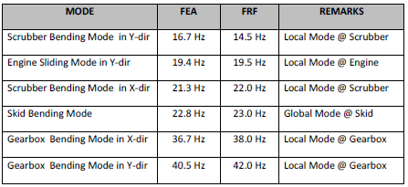
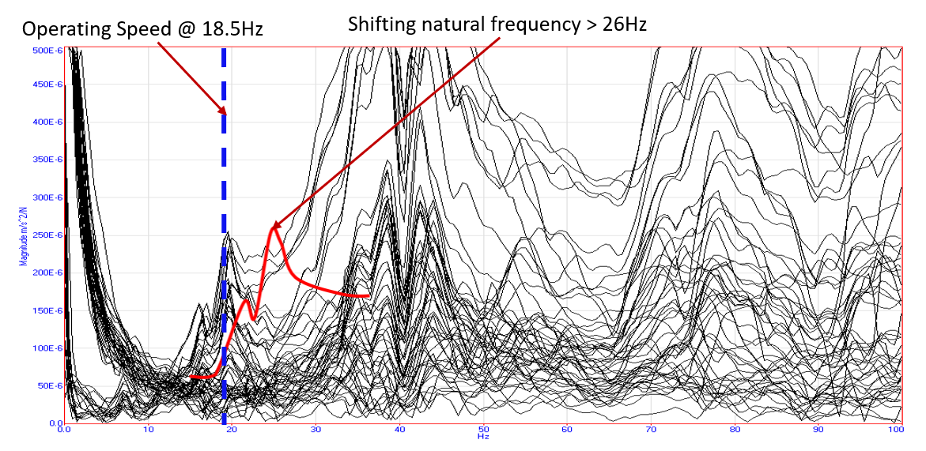
5. Methodologies
IDENTIFY
3
Verification of Resonance
Engine running frequency 18Hz – 20Hz
DEVELOP
Modal analysis revealed dominant horizontal mode at 19.5Hz which is very close to the engine running speed of 18.5Hz.
The overall condition was considered dynamically weak and classified as a Near Resonance issue.
RESOLVING RESONANCE ISSUE
VERIFY
SIMULATE
MODIFY
AFFIRM

Slide 13
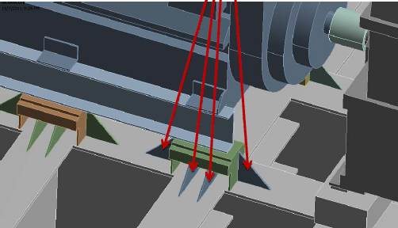
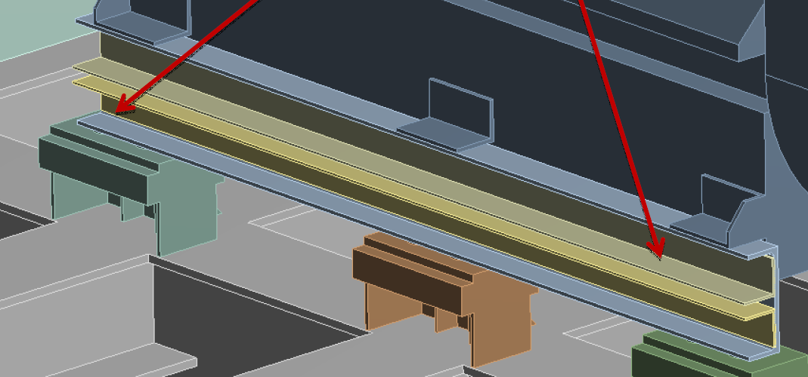
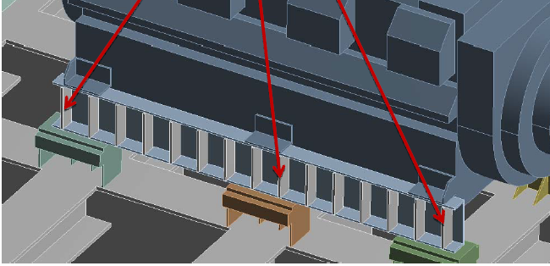
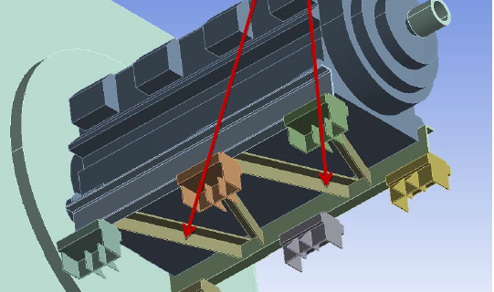
5. Methodologies
Figure | FEA (Original) | SDM
 | 19.4 Hz | 18.9 Hz (-2.5%)
 | 19.4 Hz | 22.5 Hz (+16%)
 | 19.4 Hz | 27.9 Hz (+44%)
 | 19.4 Hz | 23.0 Hz (+18%)
4
Structural Dynamic Modification (SDM)
IDENTIFY
DEVELOP
SDM allows any modification to be performed in a virtual environment
Addition, removal, or modification of the structural geometry/assembly to shift natural frequency away from operating speed.
RESOLVING RESONANCE ISSUE
VERIFY
SIMULATE
MODIFY
AFFIRM
API 618 (7.9.4.2.5.3.2)
“ The predicted mechanical natural frequencies shall be designed to be separated from significant excitation frequencies by at least 20%. ”

Slide 14
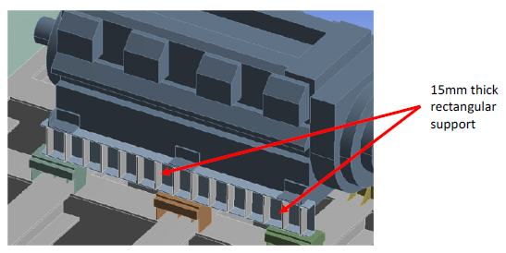
5. Methodologies
5
Execute & Considerations
IDENTIFY
DEVELOP
Selected based on the ease of implementation with the highest probability of success
Accessibility for implementation
Shutdown window availability
Evaluate Economic benefits
Identify existing obstacles and challenges prior to the modification
RESOLVING RESONANCE ISSUE
VERIFY
SIMULATE
MODIFY
AFFIRM

Slide 15
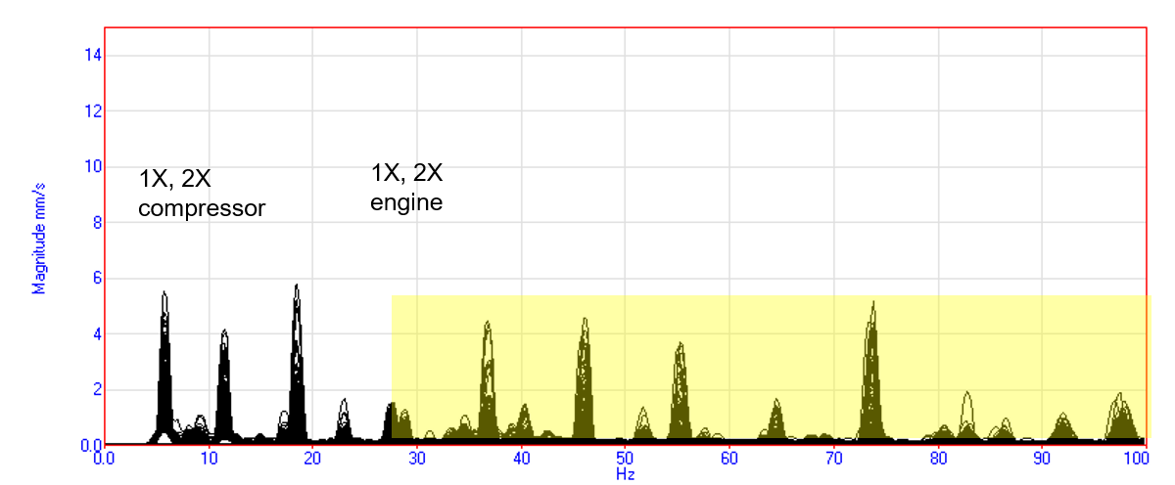
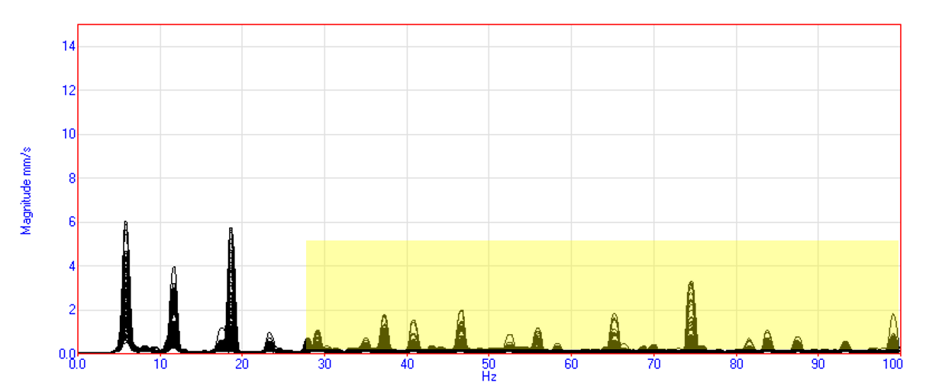
5. Methodologies
6
Pre-Modification
IDENTIFY
DEVELOP
Original vibration level for high frequency harmonics
RESOLVING RESONANCE ISSUE
VERIFY
Post-Modification
SIMULATE
Significant vibration amplitude reduction on high frequency harmonics
Further improvement; i.e., verify model accuracy, install additional rubber isolators, support beam extension
MODIFY
AFFIRM

Slide 16
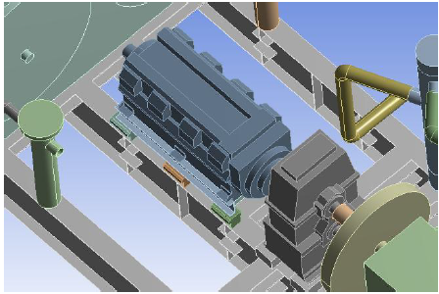
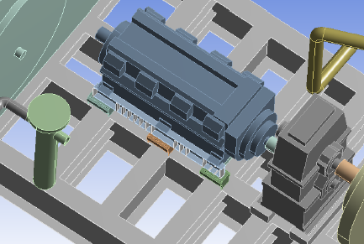
6. Outcome & Discussions
Continuous high vibrations over a long period can cause significant damage, and in some cases lead to safety and environmental issues.
Attention to details: Ensure assumptions used in modelling is as accurate as possible to the actual machine construction.
Structure support integrity may impact the overall outcome. Remember to include reasonable tolerances in the analysis.
Original FEA model without Structural horizontal beams
Corrected model with Structural beams

Slide 17

7. Conclusion
1
From the Finite Element Analysis, it was evident that structural strengthening is required due to resonance.
2
Once the weak and flexing points are identified, appropriate stiffening options were analysed and selected to improve the overall vibration levels.
3
Successful collaboration with Mechanical, Civil & Structure, Piping, Turnaround Team, Operations, and Association with Institutional of Higher Learning to resolve complex vibration issue.

Slide 18
Questions

