Slide 1

Machinery Integrity: Synergizing Engineering solutions and AI-Driven Diagnostics
Presented by
MOHAMAD RABA’I BIN YAHAYA
PRINCIPAL ENGINEER (ROTATING EQUIPMENT)

Slide 2
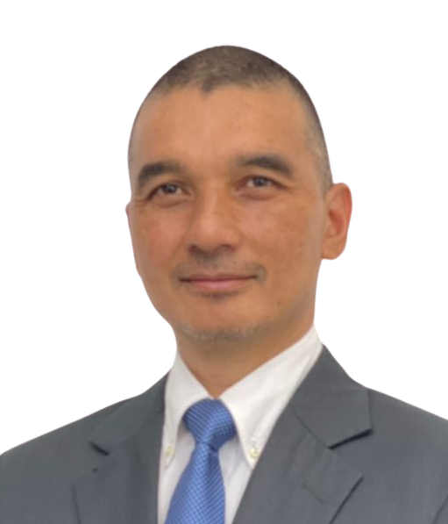




Authors Biography
Mohamad Raba’i Bin Yahaya
rabaiyahaya@petronas.com
+(609) 831 2534
Ir. Abdul Latif Bin Mohamed
alatif_mohamed@petronas.com
+(603) 2392 6109
A Custodian Engineer Rotating Equipment at Group Technical Solutions (GTS) since 2021
Specializing in Turbomachinery and has been working both upstream and downstream sectors including Petrochemical. He has vast experience in operation and maintenance, troubleshooting, failure analysis and engineering design.
A Professional Engineer registered with Board of Engineers (BEM), Malaysia and Institution of Engineers, Malaysia (IEM).
Principal Engineer Rotating Equipment at Group Technical Solutions (GTS)
18 Years of experience with turbomachinery equipment in oil & gas industry covering operation, maintenance, troubleshooting, failure analysis and engineering design.
Graduated from Universiti Teknologi PETRONAS, Malaysia

Slide 3
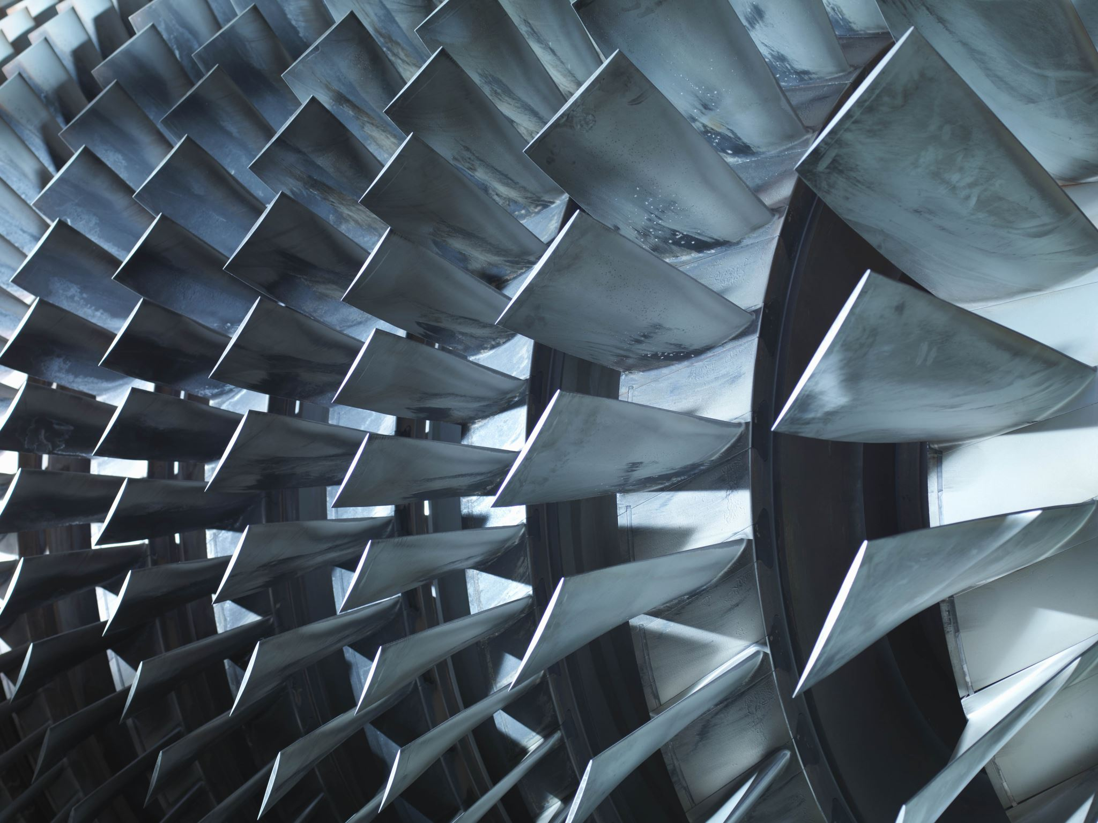

The objectives of presentation are
To share the methodological approach for assessing the material integrity of power turbines, aiming to ascertain their structural robustness and operational viability
To share the utilization of digital tools in supporting the real time performance monitoring of turbomachinery

Slide 4





Facility Background
Located at Peninsular Malaysia, the facilities are to process and transport natural gas for consumption of customers in the power generation sector as well as various industries such as petrochemicals.
Upstream Supply
Gas Processing & Utilities
Customers
4
Power Sector
Utilities
Manufacture & supply electricity, steam, industrial gases & others
Gas Processing
Process PETRONAS’
upstream natural gas
C2, C3, C4
1
Industries
2
Gas Transportation
Transport processed gas
Upstream
Power Sector
Salesgas
Industries
3
Regasification
Convert LNG
into salesgas
LNG Shippers

Slide 5
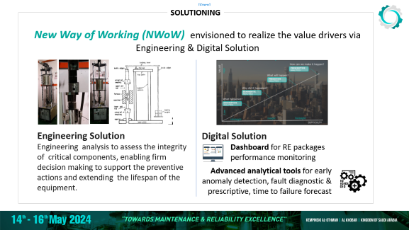
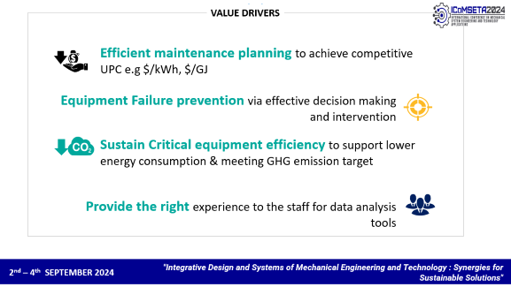
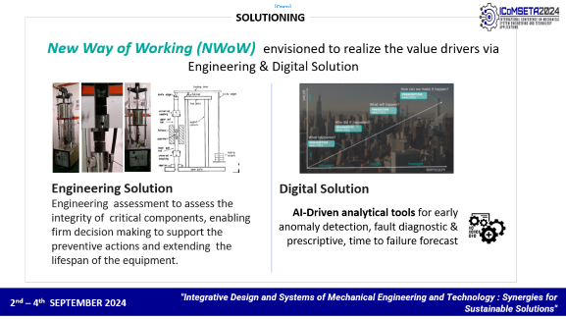
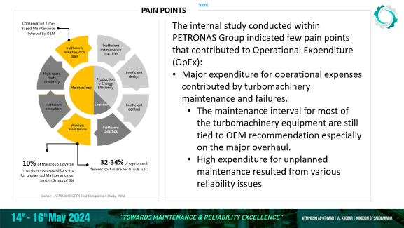
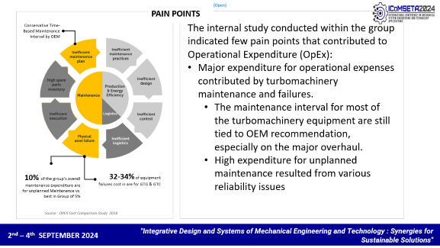
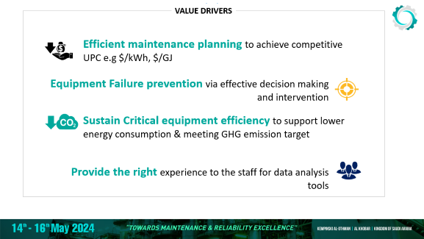
New way of working (NWoW) require us to resolve pain points by focusing on efficient maintenance planning and failure prevention.
Notes:
Pain points
In addition, we have journey for NZCE and provide the right experience as part of talent development

Slide 6
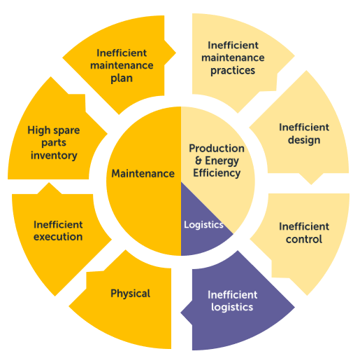
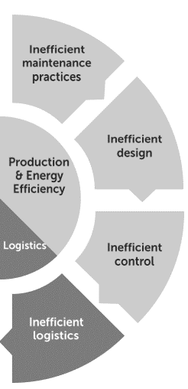
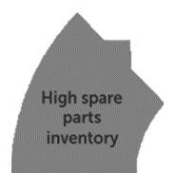
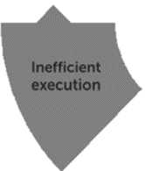

PAIN POINTS
Conservative Time-Based Maintenance Interval by OEM
The internal study conducted within the group indicated few pain points that contributed to Operational Expenditure (OpEx):
Major expenditure for operational expenses contributed by turbomachinery maintenance and failures.
  The maintenance interval for most of the turbomachinery equipment are still tied to OEM recommendation, especially on the major overhaul.
  High expenditure for unplanned maintenance resulted from various reliability issues
10% of the group’s overall maintenance expenditure are for unplanned Maintenance vs. best in Group of 5%
32-34% of equipment failures cost in are for GTG & GTC
Source : OPEX Cost Comparison Study 2018
Notes:
Pain points
In addition, we have journey for NZCE and provide the right experience as part of talent development

Slide 7
VALUE DRIVERS
Efficient maintenance planning to achieve competitive UPC e.g $/kWh, $/GJ
Equipment Failure prevention via effective decision making and intervention
Sustain Critical equipment efficiency to support lower energy consumption & meeting GHG emission target
Provide the right experience to the staff for data analysis tools
Notes:
Pain points
In addition, we have journey for NZCE and provide the right experience as part of talent development

Slide 8
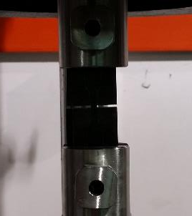
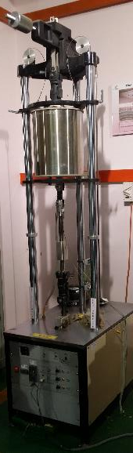
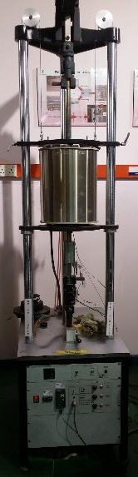
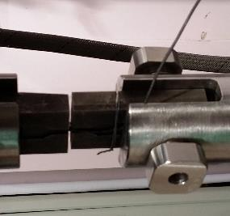

SOLUTIONING
New Way of Working (NWoW) envisioned to realize the value drivers via Engineering & Digital Solution
Engineering Solution
Engineering assessment to assess the integrity of critical components, enabling firm decision making to support the preventive actions and extending the lifespan of the equipment.
Digital Solution
AI-Driven analytical tools for early anomaly detection, fault diagnostic & prescriptive, time to failure forecast
Notes:
Pain points
In addition, we have journey for NZCE and provide the right experience as part of talent development

Slide 9
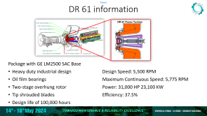
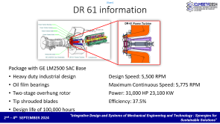
Our turbomachinery typical maintenance
There are 8 units of DR-61 Power Turbines manufactured by Dresser Rand aerodynamically coupled with gas turbine
Based on OEM Operation and Maintenance Manual, Power Turbine rotor need to be retired* at 100,000 running hours.
The challenge is to reform the mean time between overhaul for this equipment to support the plant operational excellence.

Slide 10
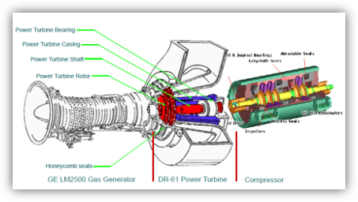
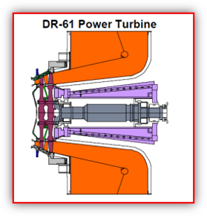
DR 61 information
Package with GE LM2500 SAC Base
Heavy duty industrial design
Oil film bearings
Two-stage overhung rotor
Tip shrouded blades
Design life of 100,000 hours
Design Speed: 5,500 RPM
Maximum Continuous Speed: 5,775 RPM
Power: 31,000 HP 23,100 KW
Efficiency: 37.5%

Slide 11
There are 2 steps to address this challenges and make it feasible
Engineering approach as part of Feasibility Assessment
Perform Remnant Life Assessment (RLA) – to access the material integrity as the Power Turbine is exposed to the thermal stress throughout the service.
Digital solution for the Sustainable Operational Performance
Using digital diagnostic tools allow us to monitor the real time performance of the equipment which enable us to monitor real time performance, perform fault diagnostic and predict the time to failure.

Slide 12



Remnant Life Assessment (RLA) approach
Inspection
Visual
Material Identification
NDT – FPI
Dimensional Measurement
Check for external defects and distortion
Optical Microscope - material structure phase, defect and grain size observation
Scanning Electron Microscope - to analyze the size, shape and distribution of particles
Hardness testing
Stress Rupture Testing – to determine the time to rupture and compared to the established TTR of the similar material
Microstructure
Material Testing

Slide 13








Critical component were subjected to inspection and testing
Major components (Rotating Parts) analysis
Turbine Shaft
Turbine Disc Stg 1
Turbine Disc Stg 2
Turbine Blade Stg 1
Turbine Blade Stg 2
Running Hours: ~100k & 120k
Exposure Temp: >700 DegC

Slide 14
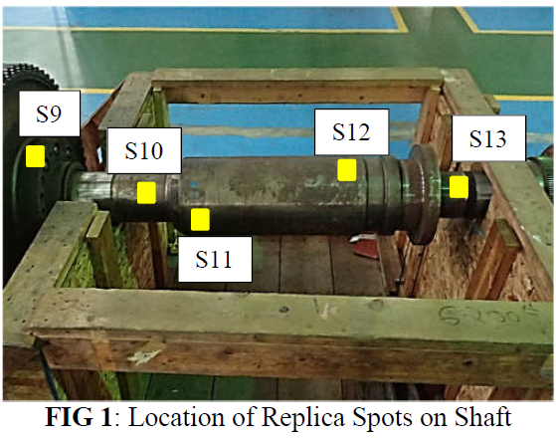
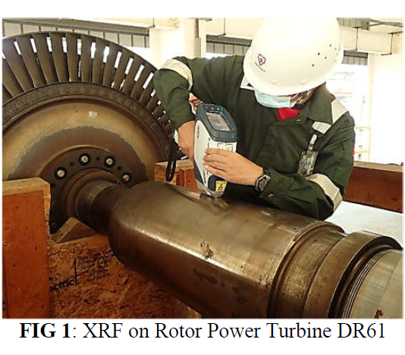
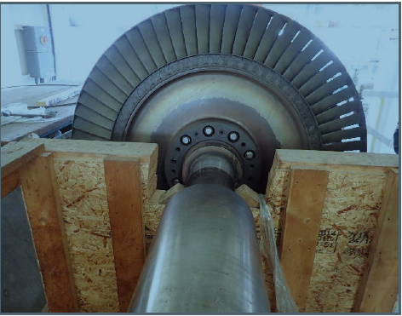
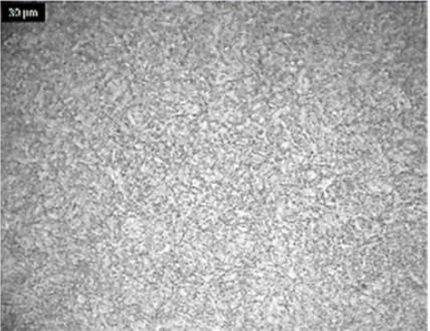
Shaft
Satisfactory Martensitic microstructure of Alloy Steel 4340
No significant degradation on microstructure
No evidence of significant defect & creep void
Satisfactory Hardness

Slide 15
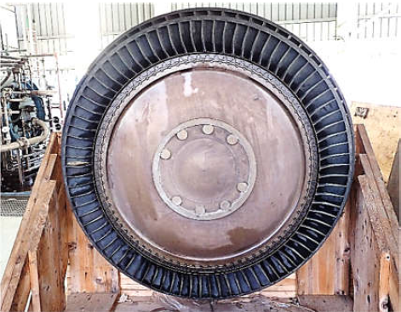
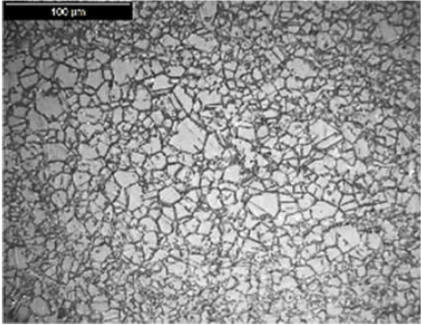
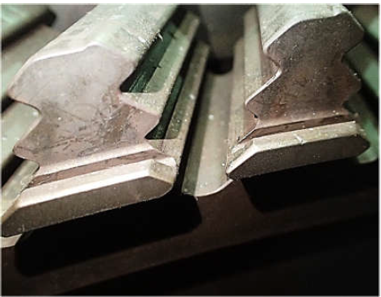
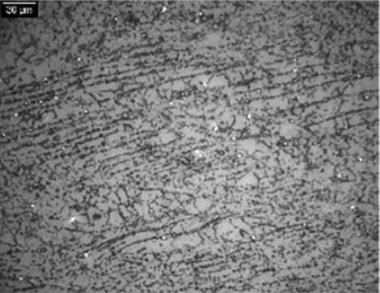
Disc Stage 1 & 2
Normal degradation Austenitic microstructure of Inconel 718
Material consists of fine grain structure with non-uniform size
No evidence of significant defect & creep void
Satisfactory Hardness

Slide 16
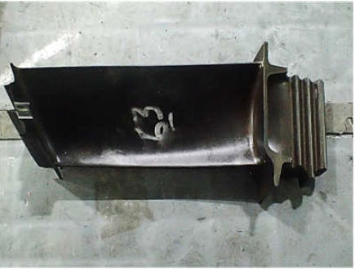
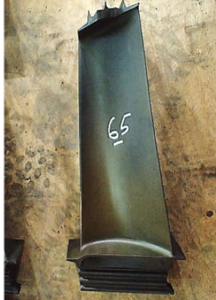
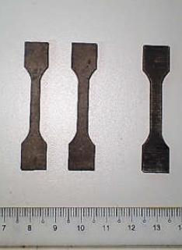
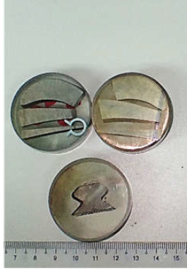
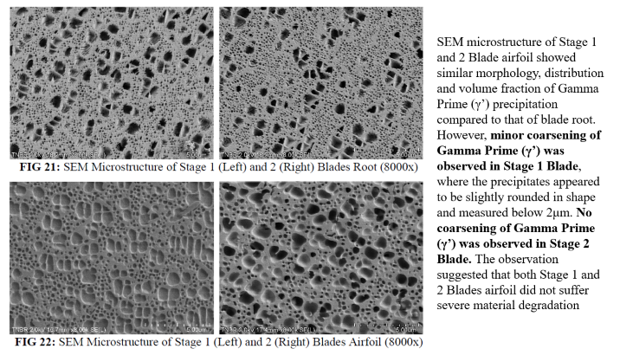
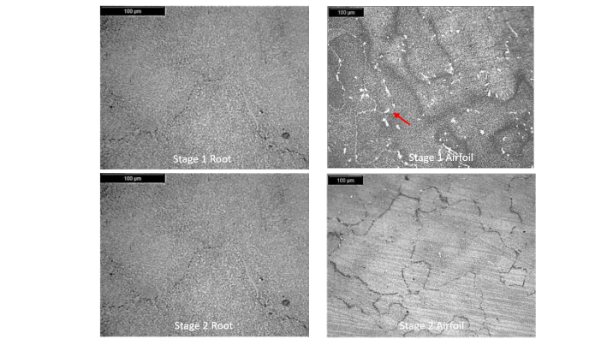
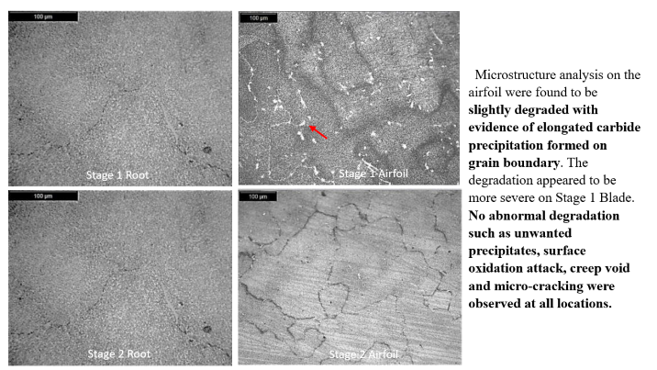
Blade Stage 1 & 2
No crack or significant damage
No material loss due to hot corrosion
No excessive distortion or creep deflection
Satisfactory material construction (IN 738)
Satisfactory microstructures with minor degradation
Satisfactory hardness
Adequate Creep Rupture Life

Slide 17
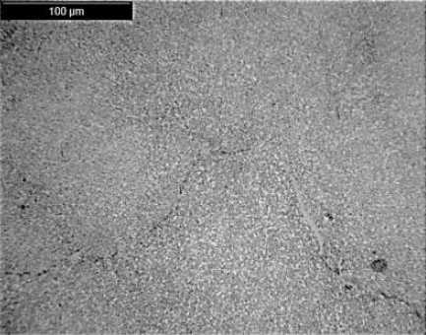
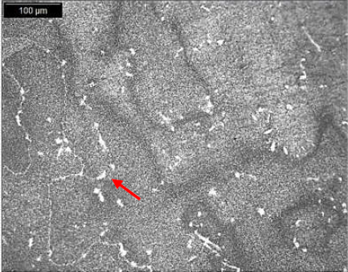
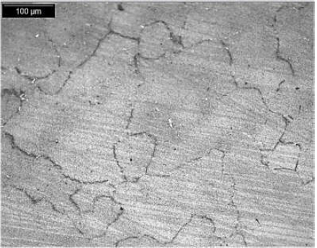
Microstructure analysis on the airfoil were found to be slightly degraded with evidence of elongated carbide precipitation formed on grain boundary. The degradation appeared to be more severe on Stage 1 Blade. No abnormal degradation such as unwanted precipitates, surface oxidation attack, creep void and micro-cracking were observed at all locations.
Stage 1 Root
Stage 1 Airfoil
Stage 2 Root
Stage 2 Airfoil

Slide 18
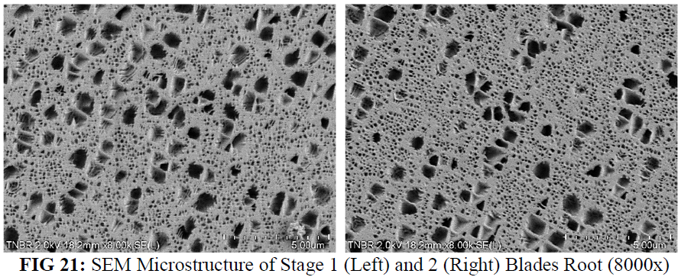
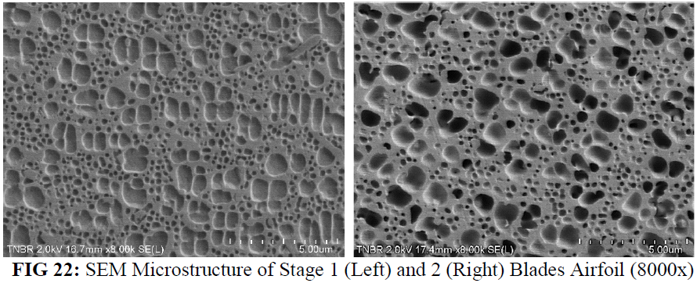
SEM microstructure of Stage 1 and 2 Blade airfoil showed similar morphology, distribution and volume fraction of Gamma Prime (γ’) precipitation compared to that of blade root. However, minor coarsening of Gamma Prime (γ’) was observed in Stage 1 Blade, where the precipitates appeared to be slightly rounded in shape and measured below 2μm. No coarsening of Gamma Prime (γ’) was observed in Stage 2 Blade. The observation suggested that both Stage 1 and 2 Blades airfoil did not suffer severe material degradation
Stage 1 Root
Stage 1 Airfoil
Stage 2 Root
Stage 2 Airfoil

Slide 19
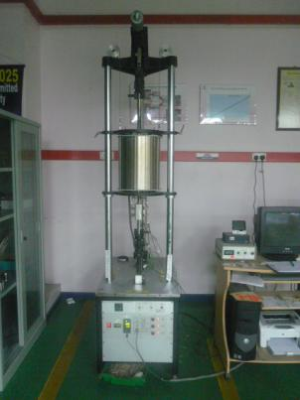
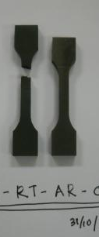


Blade Stress Rupture Test
To Measure Rupture Life
Test Condition
  Temperature:845ºC
  Load: 350MPa
  Min Life: 30 Hours*
Result
  Root Stage 1: 58 hrs/ 84hrs
  Root Stage 2: 66 hrs/ 40hrs
  Airfoil Stage 1: 57 hrs/ 30hrs
  Airfoil Stage 2: 60 hrs/ 60hrs
*Based on Larson-Miller parameter graph for IN 738

Slide 20

Remnant Life Assessment Summary
Turbine Shaft
Turbine Disc Stg 1 & 2
Turbine Blade Stg 1 & 2
In general, all major components (Shaft, Disc and Blade) of Power Turbine were found to suffer typical operational damages with insignificant material degradation. There was no evidence of grain coarsening, creep cavity, micro-crack or other significant material defect.
The Stress Rupture Test also indicated the material time to rapture still within the expected value but reduced as compared to the test at 100k and 120k running hours.
Therefore, the MTBO extension is decided to stop at 120k hours only

Slide 21

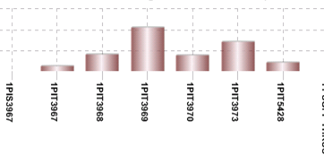




Machinery Monitoring and Prescriptive Diagnostics (MMPD) to support operational sustenance and maintenance efficiency
The available features allow us react on time in supporting the equipment performance excellence
Predictive Trends
Prescriptive Fault Diagnostic
Forecast
Early indication of anomalies
Problem cause identification and prescribe actions
Predict future values of project points based on past behavior

Slide 22
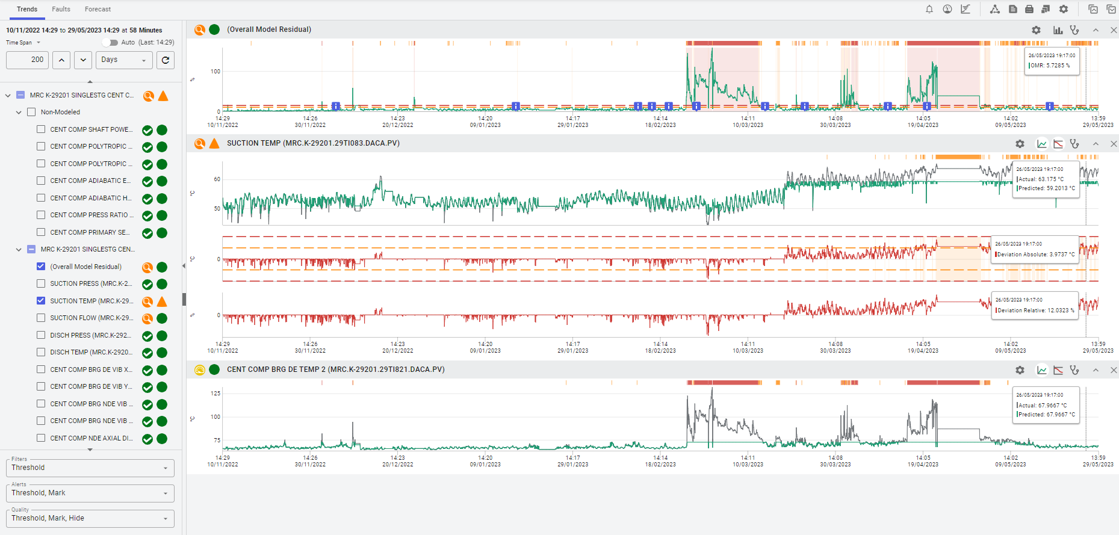
MMPD Features – Predictive Trending
Overall Model Residual (OMR)
Date & Time
Prediction trending in Green and Actual trending in Black
PI Tags
Deviation trending

Slide 23
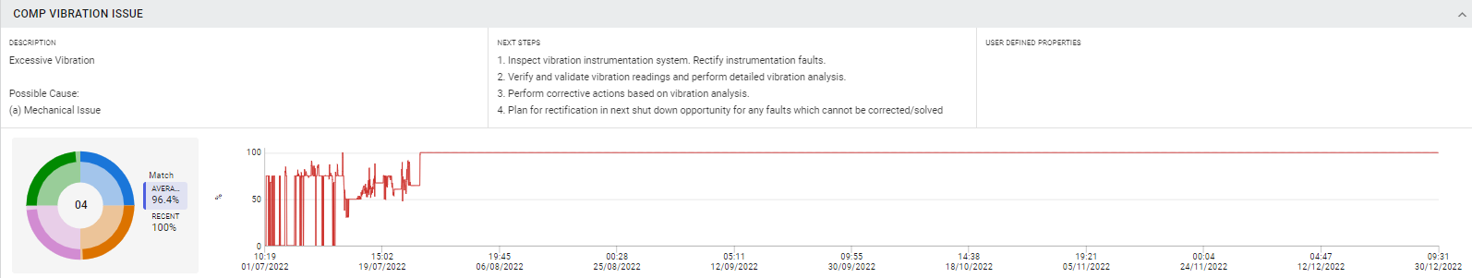
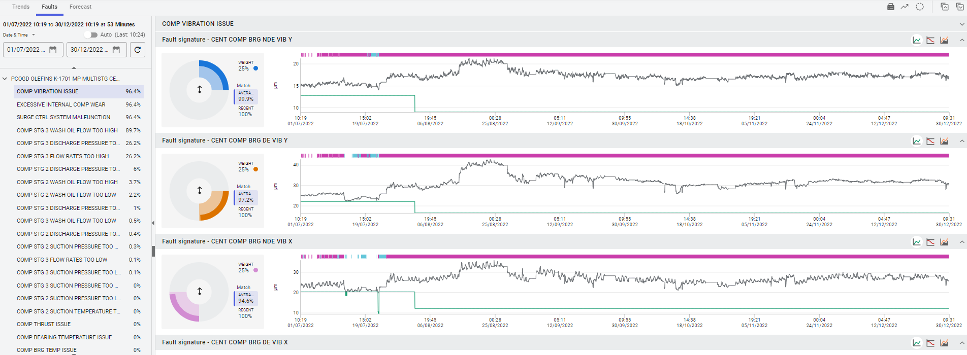
MMPD Features – Prescriptive Fault Diagnostic
Fault Description & Possible cause
Prescriptive Diagnostics with recommended actions
Fault signature match chart
Faults diagnostics ranked list
Notes:
Forecast utilizing linear regression to determine whether are safe to run towards desired period.

Slide 24
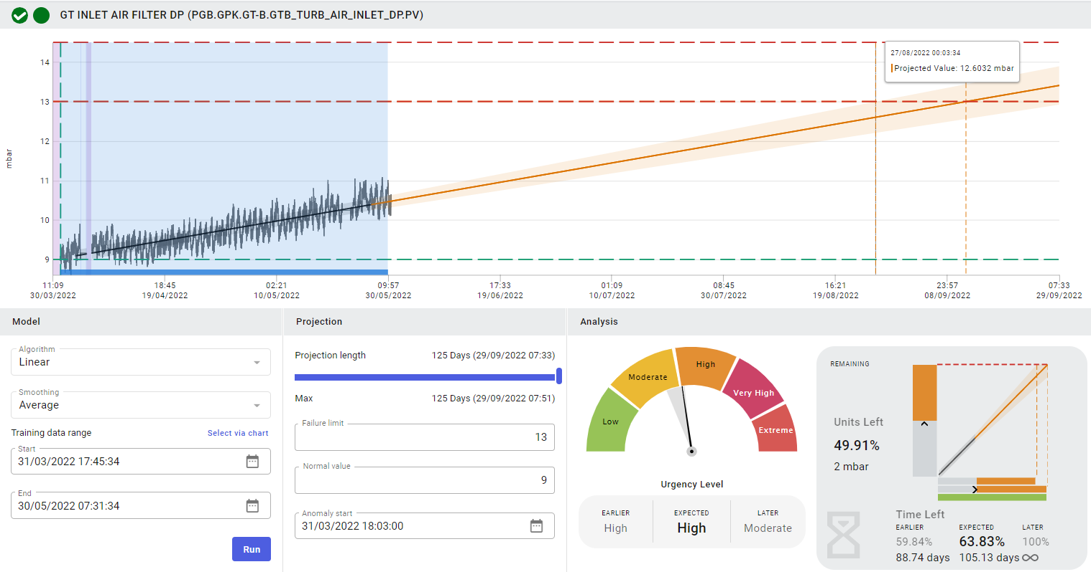
MMPD Features – Forecasting Analysis
Earlier estimated TTF
Blue region area as the dataset
Projection estimated TTF
Projection length – is based on pre-selected historical dataset
Level of urgency of the analysis
Failure limit:
Initially pre-calculated with forecast analysis, but can be changed to follow user’s alarm setting
TTF
Earlier
Expected
Later
Notes:
Forecast utilizing linear regression to determine whether are safe to run towards desired period.

Slide 25

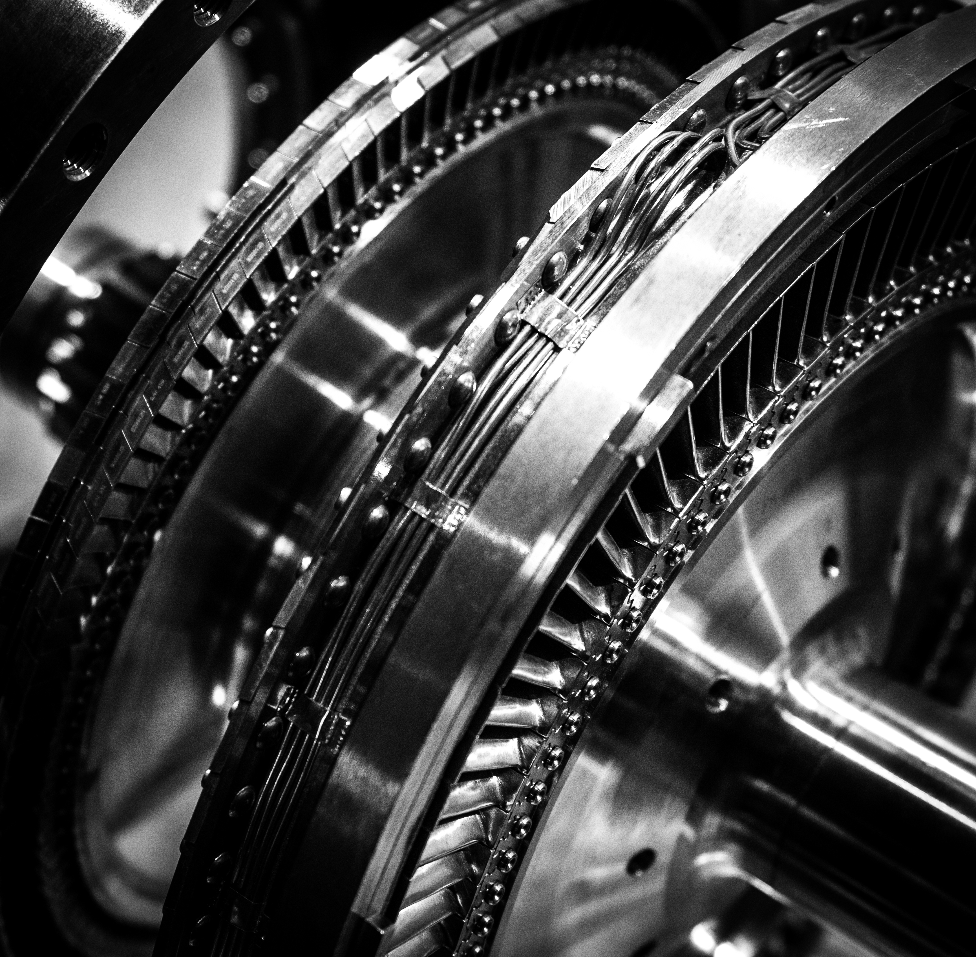

Key takeaway from this presentation are
To have courage, is to have purpose
Purpose gives courage its direction, and courage gives purpose its potential for realization
Invoke the right tools with mastery, and the tapestry of excellence will be woven
emphasizes the importance of using the appropriate skills or resources effectively to achieve outstanding results
Adapt swiftly; thrive endlessly
by quickly adjusting to changes and challenges, one can ensure ongoing success and growth

Slide 26
THANK YOU

