Slide 1
Enhancing Packing Processes through an Ergonomic Worker Study using Digital Human Modeling and Environmental Assessment
Researcher
Pratzanee Sungkaratn
Sukhothai Thammathirat Open University, Thailand

Slide 2
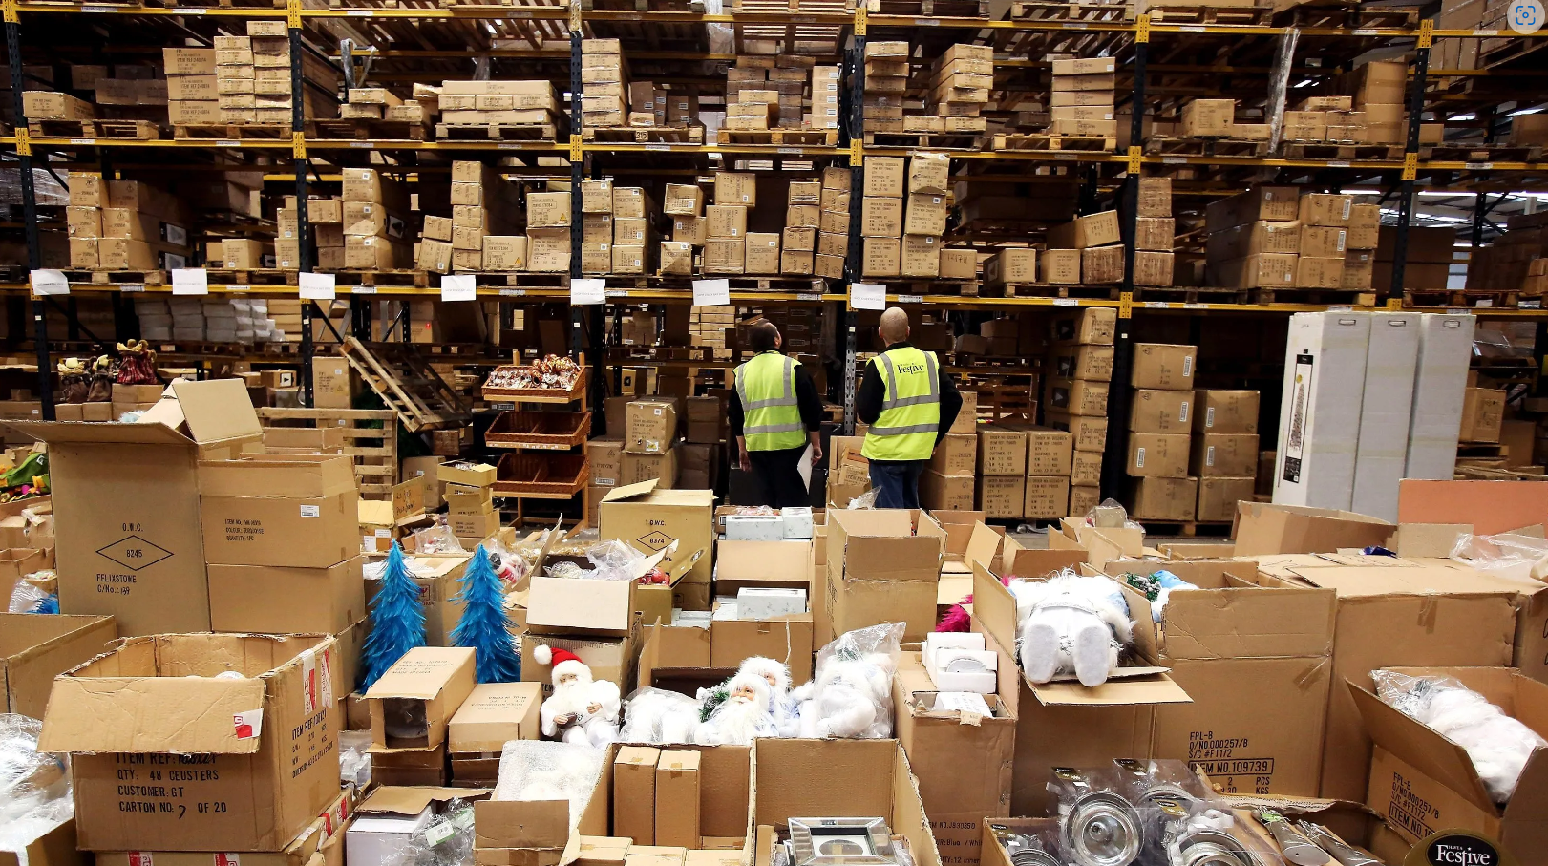
Page 1 of 18
Introduction
A manual lifting is the transporting or supporting of a load (including lifting, putting down, pushing, pulling, carrying or moving) by hands or body force
Sukhothai Thammathirat Open University, Thailand

Slide 3
Source : Thailand ministry of labour
Introduction
THAILAND OCCUPATIONAL INJURIES CLASSIFIED BY CAUSE 2022
Injury from lifting heavy object 763 cases.
No death, 1 invalidity, 1 lose some organ, 761 off work
Repetitive motion injury
Page 2 of 18
Sukhothai Thammathirat Open University, Thailand

Slide 4
Introduction
Maximum weight allowance
Country / Organization | Gender / Age | Allowance Weight
Thai Labor laws | Female over 18 years old Male over 18 years old | 25 kilograms 55 kilograms
Japan | For Female | 30 kilograms for non-continuous lifting 20 kilograms for continuous lifting.
Philippines | No mention gender | no more than 55 kilograms and the lifted weight should not exceed 40% of the worker's body weight
Australia | Female over 18 years old | 16 kilograms.
International Safety Data Center | Female 18-20 years old Female 20-35 years old Female 35-50 years old Female over 50 years old | 14 kilograms 15 kilograms 13 kilograms 10 kilograms
Source : The National Labour Research Center
Page 3 of 18
Sukhothai Thammathirat Open University, Thailand

Slide 5
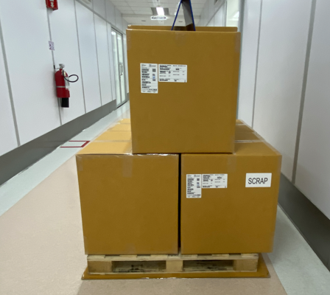
Page 4 of 18
Propose
Purpose of the study
Purpose of the study
The aim of this study is to improve the lifting process for 25kilogram boxes vertically stacked on pallets by maximum allowance, with consideration for the inclusion of female workers as per Thai labor regulations. Utilizing the National Institute for Occupational Safety and Health (NIOSH), Composite Lifting Index (CLI) through Digital Human Modeling (DHM) and the risk of musculoskeletal disorders (MSDs) from a single worker lifting who performs 6 lifts per hour and works 8 hours a day.
Sukhothai Thammathirat Open University, Thailand

Slide 6
Propose
Study Questions
1. How much NIOSH recommended weight for the study process?
2. How risk of MSDs levels by NIOSH Lifting Index ?
3. How to enhance the process while maintaining safety?
Page 5 of 18
Sukhothai Thammathirat Open University, Thailand

Slide 7
\
Methodology
Recommended Weight Limit
NIOSH91 :
$$RWL=LC×HM×VM×DM×AM×FM×CM$$
Where: RWL = Recommended Weight Limit
LC = Load Constant 23 kgs.
HM for Horizontal multiplier, equal 1.0 if hand location is less than 250mm
VM for Vertical multiplier, the absolute value from optimum height 750mm
DM for Distance multiplier, is the travel distance of hands that computed
AM for Asymmetric multiplier, equal 1.0 when lifted directly in front of body
FM for Frequency multiplier, is defined by frequency of lifting
Page 6 of 18
Sukhothai Thammathirat Open University, Thailand

Slide 8
Methodology
Lifting Index (LI)
The goal of ergonomic risk assessment in designing manual lifting tasks is to achieve an LI of 1.0 or less as NIOSH Criteria for Risk Levels of Lifting Index (LI)
LI is calculated using the following equation:
$$LI=\frac{Load}{RWL}$$
Lifting index | Criteria
LI <1 | Safe, low risk.
1 ≤ LI < 3 | Moderate risk; consider ergonomic improvements.
LI ≥3 | High risk: immediate ergonomic intervention needed.
Page 7 of 18
Sukhothai Thammathirat Open University, Thailand

Slide 9
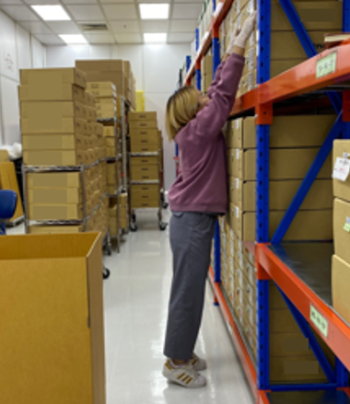
Methodology
Research methodology
To assess and improve the process, evaluating the Lifting Index is crucial for risk assessment using Tecnomatix software calculations.
The default tasks in a packing room were observed to create DHM.
Worker shortest height in the process 148 cm
Page 8 of 18
Sukhothai Thammathirat Open University, Thailand

Slide 10
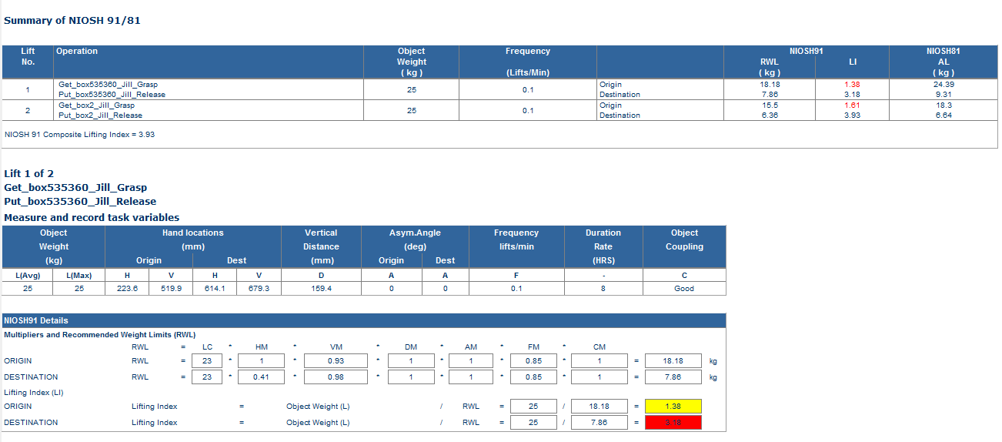
Page 9 of 18
Methodology
TECNOMATIX NIOSH simulation report
6 lifts per hour
CLI
RWL
LI
Sukhothai Thammathirat Open University, Thailand

Slide 11
Methodology
Composite Lifting Index (CLI)
Since this study is multi-task lifting, The Composite Lifting Index has been
considered two identical boxes as equation
Where STLI is computed for Single Task Lifting Index for each task
$$CLI=ST{LI}_{1}+\sum{Δ}LI$$
Page 1 0of 18
Sukhothai Thammathirat Open University, Thailand

Slide 12
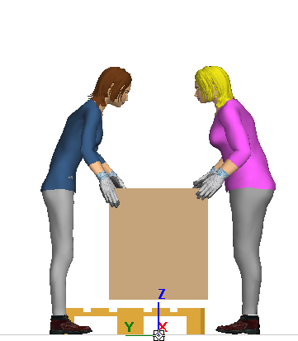
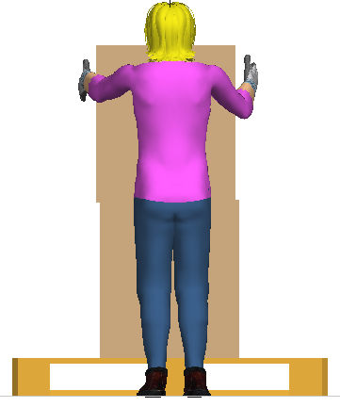
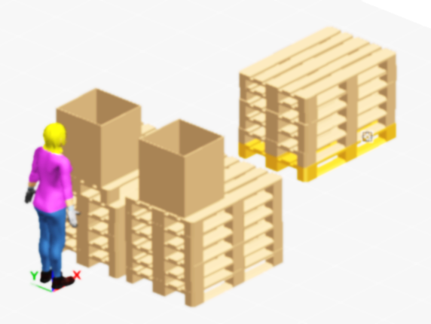
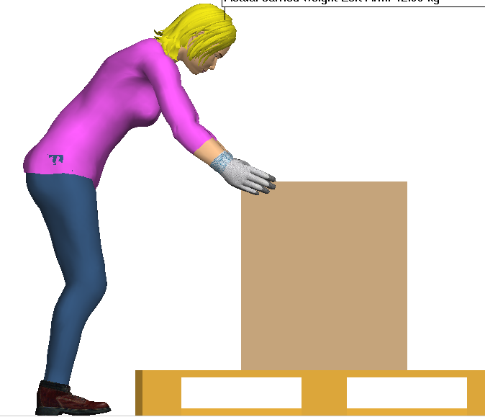
Page 1 1of 18
Methodology
Design process option
Then design improvement processes for three options
1. assigning tasks to two workers for manual lifting without assistive tools
2. implements a system where height adjustment precedes solo lifting
3. utilizes a spring balancer to aid in lifting the box.
Sukhothai Thammathirat Open University, Thailand

Slide 13
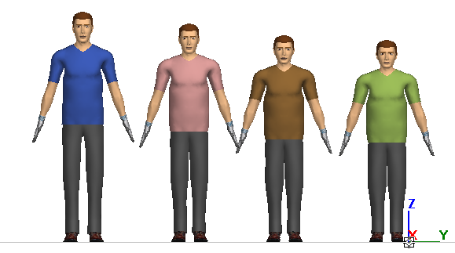
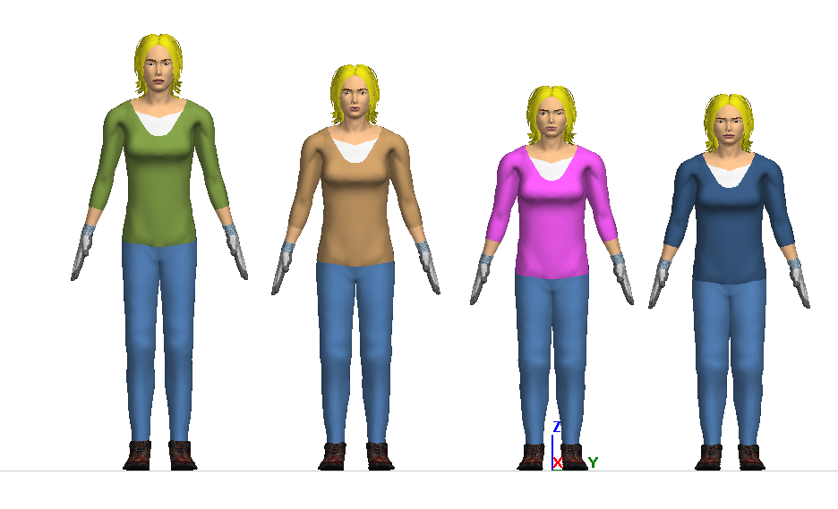
Page 1 2of 18
Methodology
START
Simulation flow
Create models
Set up Load
Set lift frequency
Set position Box1
Set position Box2
Run Simulation
Get NIOSH LI report
No
Finish all models?
Yes
No
New process design?
Yes
End
Sukhothai Thammathirat Open University, Thailand

Slide 14
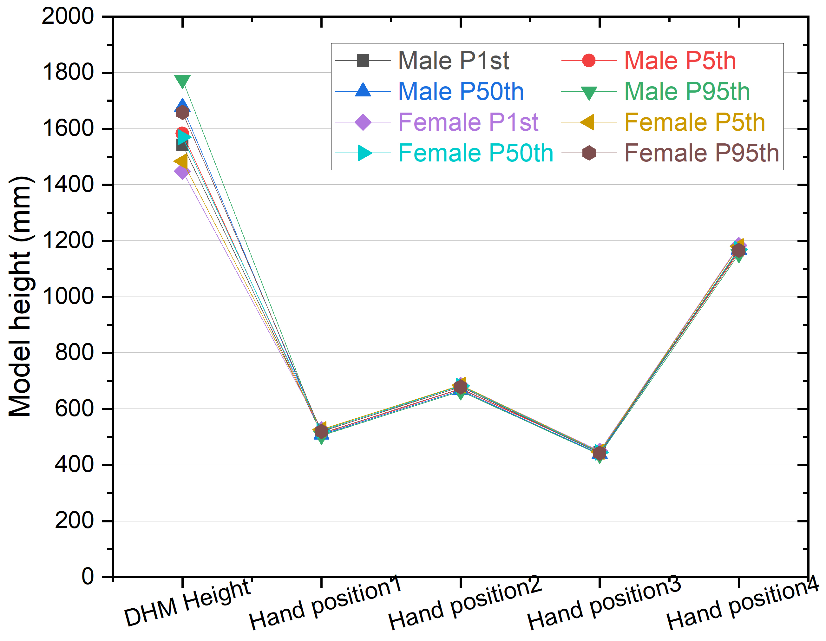
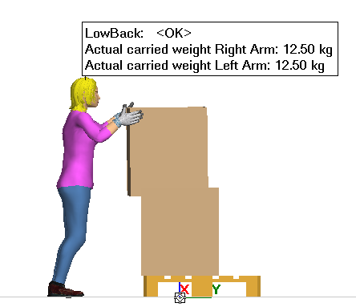
Photo of simulation for model female height at 5th percentile stacked 2nd box vertically at the hand position4 height 1180millimeters
Result
Height and Hand positions results
Page 13 of 18
Sukhothai Thammathirat Open University, Thailand

Slide 15
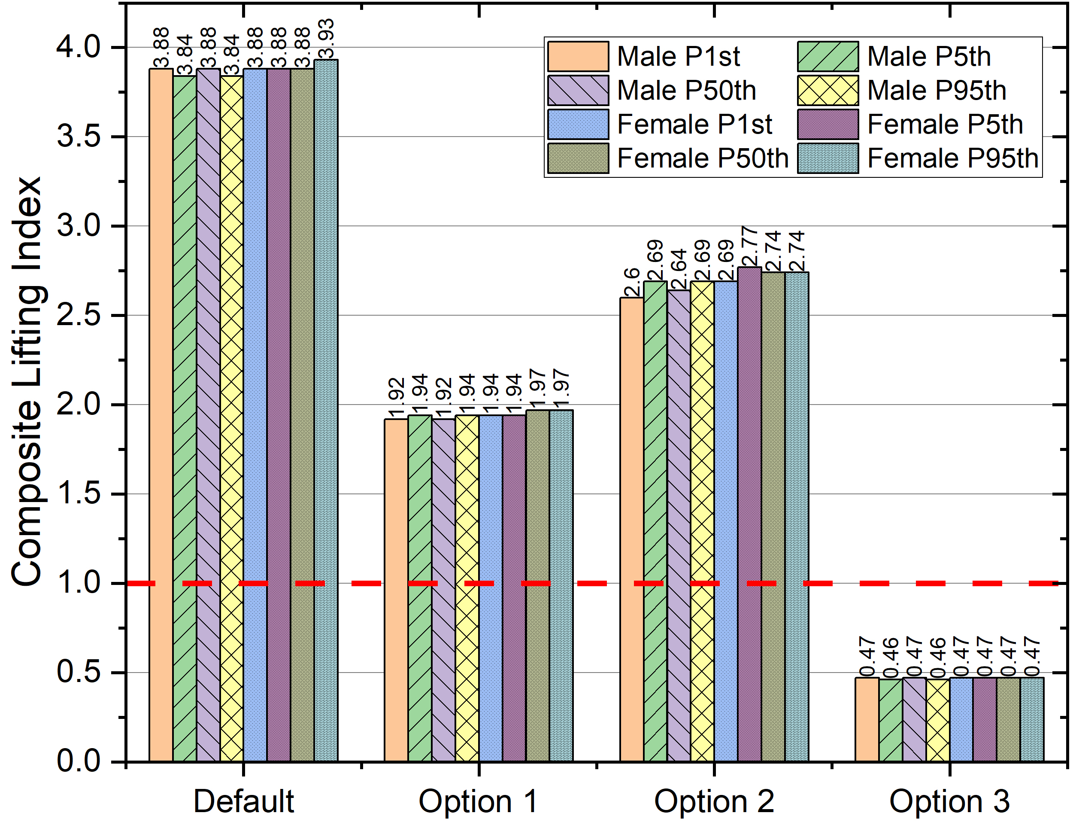
Result
Composite Lifting index results
The default process, one worker.
maximum CLI is 3.93
Option 1. two workers lifting,
Max resulted in a CLI of 1.97
Option 2. height adjustment, one worker. Max resulted in a CLI of 2.77
Option 3. utilizes a spring balancer,
load reduce to 3 kg and boost lift frequency to 1 lift/min. (10 times)
Max resulted in a CLI of 0.47
Page 14 of 18
Sukhothai Thammathirat Open University, Thailand

Slide 16
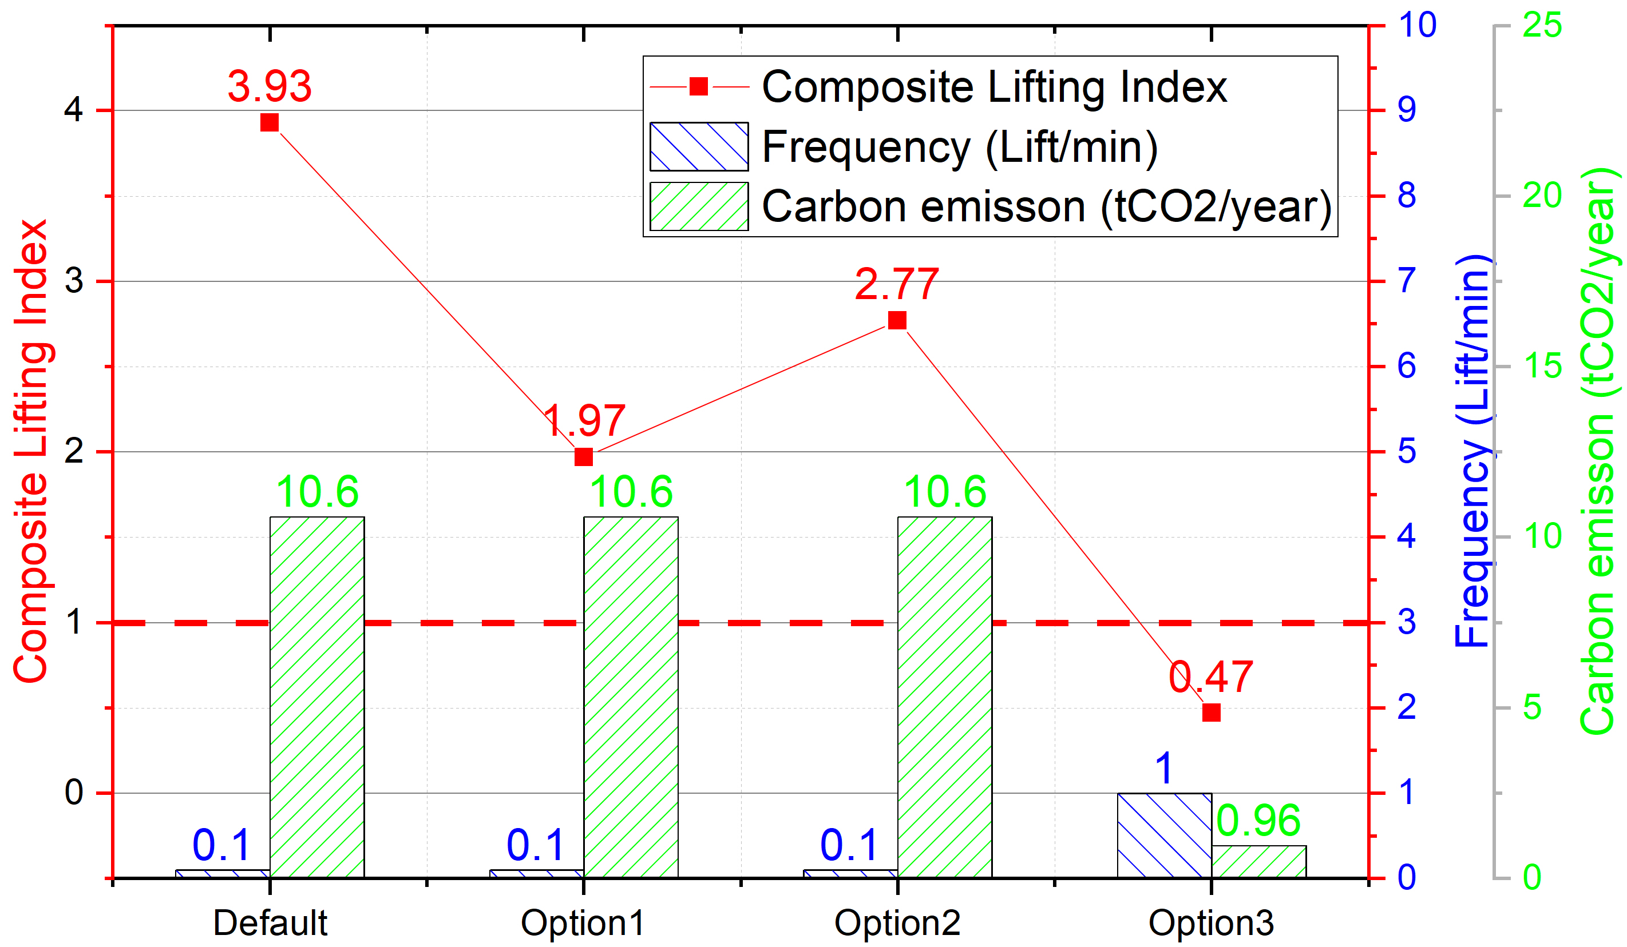
Page 1 5of 18
Result
Compare CLI and carbon emission
The default process requires operators to work 8 hours a day to transport 40 boxes. (6 lifts per hour)
From the factory indicates an annual electricity consumption of 18,900 kWh. The factor used is 0.5610 equal to 10.6tCO₂e per year.
The option 3 which CLI is 0.47 boosted to the highest efficiency (60 lifts per hour), the tasks can complete within 0.72 hours a day, resulting in the lowest electrical consumption equal 0.96tCO₂e per year.
Sukhothai Thammathirat Open University, Thailand

Slide 17
Discussion
Conclusion
The risk of MSDs from the packing process is high when handling vertically stacked 25-kilogram boxes on pallets. The recommended weight only 6.36kgs. by work an 8-hour day, as NIOSH CLI equation.
This study recommends simply and effective engineering improvement the process by spring balancer assistance. Then productivity can safely increase 10x. thereby reducing cycle times, number of required workers and the carbon emissions.
There are more improvement by human management or robust process design which have not discussed in this topic.
Page 1 6of 18
Sukhothai Thammathirat Open University, Thailand

Slide 18
End
We request you to provide the suggestion.
Thank you.
Page 18 of 18
Sukhothai Thammathirat Open University, Thailand

